Slide 1
High energy heavy ion collisions
-- From basic to current status --
Takao Sakaguchi
Brookhaven National Laboratory
Outline of the lecture
Introduction
Basics of high energy HI collisions
Review of some experimental results
Future facilities
Homework

Slide 2
Introduction

Slide 3
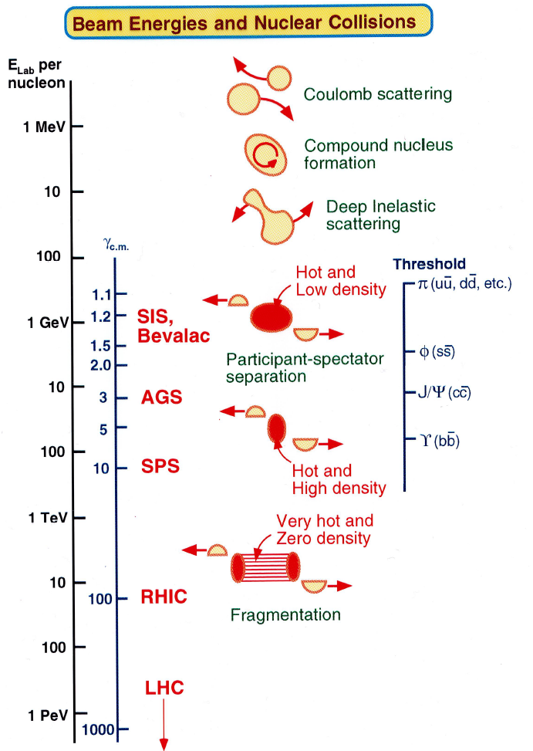
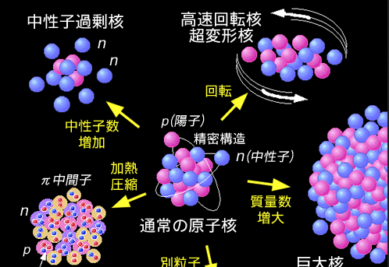
Conventional heavy ion physics
Nuclear physics looks for collective nature of nucleus, composed of nucleons (protons and neutrons)
  Smallest quantum many body systems on the earth
  Electro-magnetic and strong interaction system
Areas of research includes excited states, giant nucleus, Neutron-rich nucleus, and hot nuclear matter, etc…
Heavy ion collisions increase pressure and temperature
Neutron-rich
nucleus
High spin, deformed nucleus
Hot nuclear matter
Normal nucleus
Giant nucleus

Slide 4
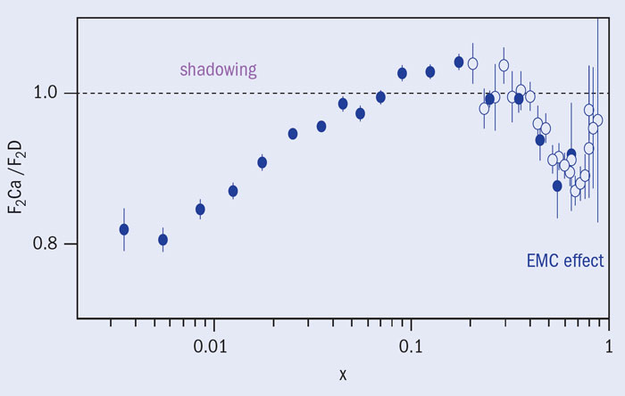
Quarks updated the goal
Deep Inelastic scattering of protons by electrons suggested the existence of partons (quarks and gluons. ~1960)
Discovery of charmonium (c-cbar, e.g., J/ψ) confirmed the quark model is correct. (1974 Nov revolution)
  Idea of making “quark soup” using HI collisions also arised in 1974
Structure functions in Deuteron and Calcium were found different (EMC effect, 1982) → quark manifests in nucleus
x=2p_{T}/s^{1/2}
e, and μ scattering at SLAC (1994), Fermilab (1995), NMC exp. at CERN (1995,1996)

Slide 5
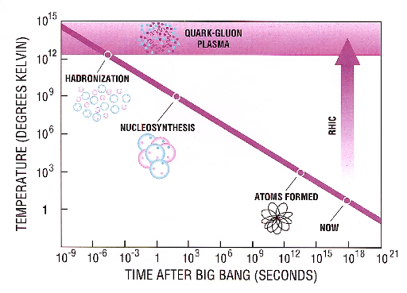
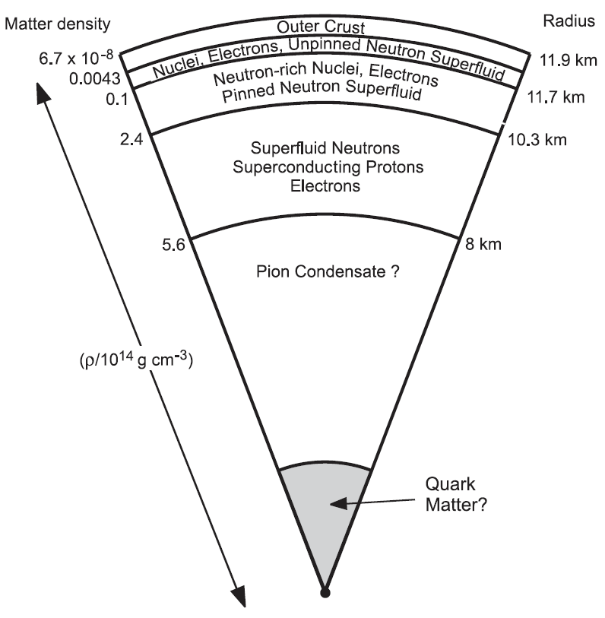
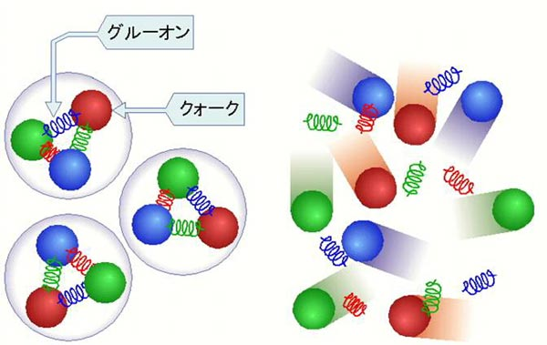
Towards Quark-Gluon Plasma
Quarks and Gluons confined in nucleons will be liberated in a hot and dense matter, i.e., Quark Gluon Plasma (QGP)
  Understanding quark confinement
  Origin of nucleon mass (Chiral symmetry breaking)
This phase is believed to have existed in the early Universe
  Possibly existing in the core of neutron stars
Explore collective nature of multi-parton system
gluons
quarks
Pressure
Heat
Phase transition
Hadron
QGP

Slide 6
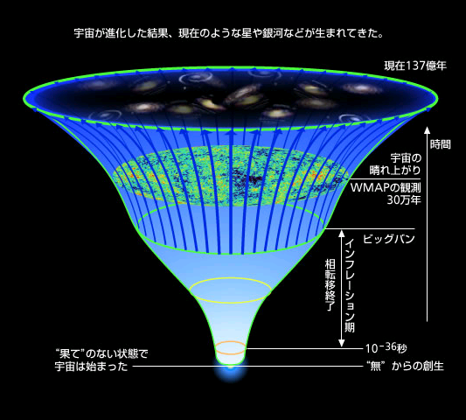
Big Bang and Little Bang
time
collision axis
0

Slide 7
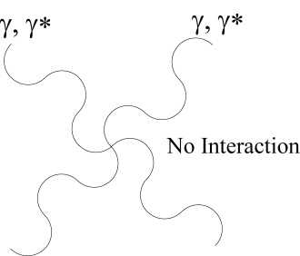
QCD matter
Strong interaction system (described by QCD)
Gauge particles (gluons) in QCD interact each other.
  Coupling constant α_{s} runs lower with increasing energy
Quarks and gluons are confined in hadrons
  As pulling q-qbar apart, new q-qbar pair will be created from vacuum to reduce energy
  Only color neutral objects can be observed
QED
QCD

Slide 8
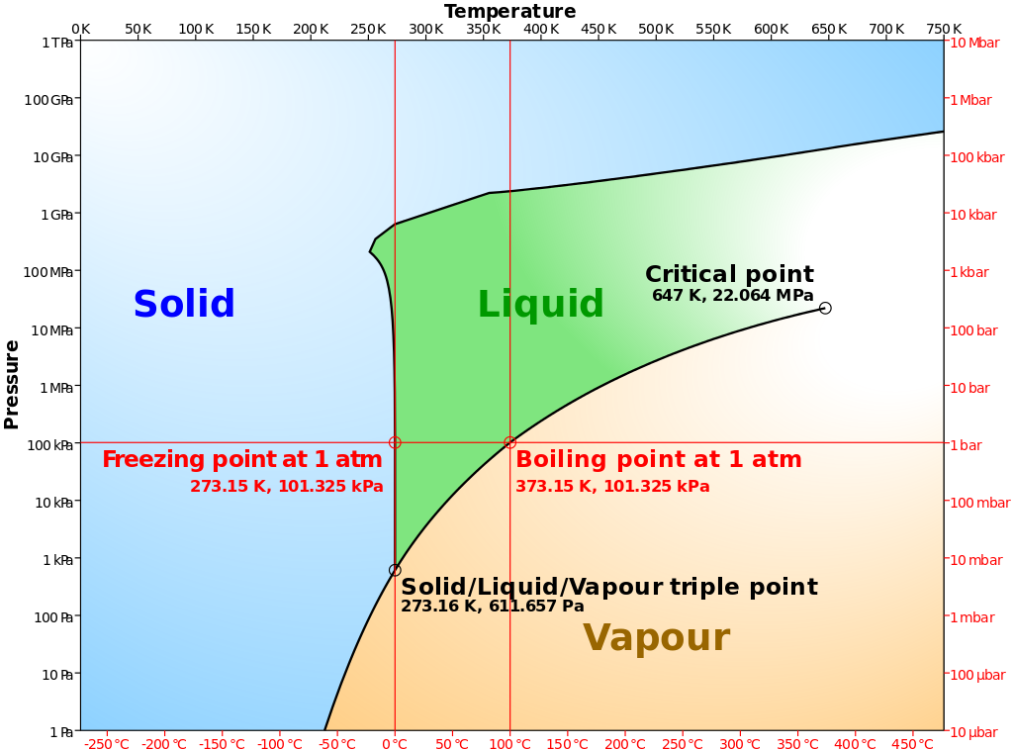
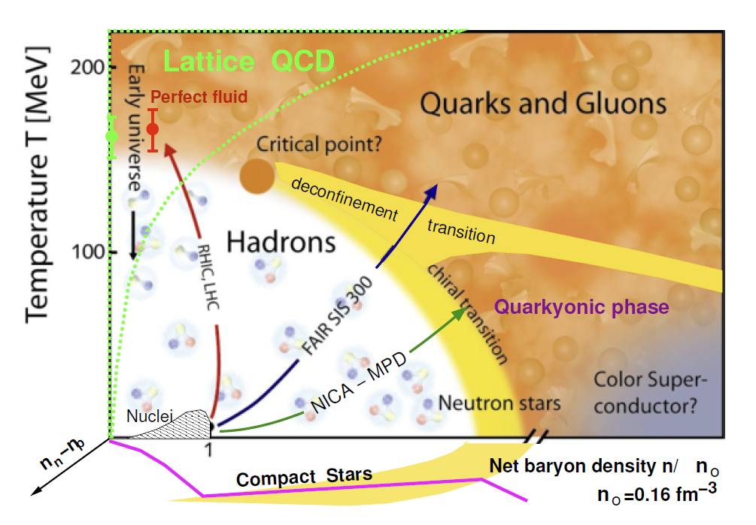
Water (QED) and nucleus (QCD) phase diagram
1st order
transition
Even though the nature of interactions are different, the phase diagrams don’t look very different
At High pressure (or density) and/or high temperature, solid transits to vapour
Cross-over
Temperature
Pressure
Baryon Density = Pressure

Slide 9
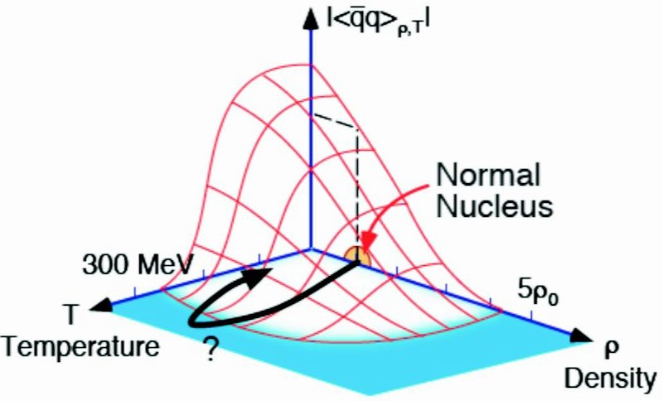
Origin of mass (chiral symmetry breaking)
Mass generation by symmetry breaking
  Nanbu-Goldstone theorem
  Symmetry breaking generates two modes
  Zero-mass and heavy mass
EW-symmetry breaking generated photons and Higgs bosons
  Quarks, Z, W+/- acquired mass from this breaking
Chiral symmetry breaking (q-qbar condensate changes) generates additional mass of quarks (Strong interaction)
  Zero-mass: π -meson (m=138 MeV/c²)
  Heavy-mass: σ-meson (m=600-1200 MeV/c²)
Studying chiral symmetry restoration is essential in understanding the origin of mass (and property of QCD vacuum).

Slide 10
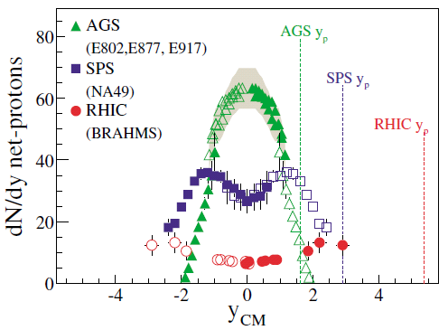
Fixed target experiment at Bevalac and AGS
Bevalac (LBL ~1984):
  Elab = 0.8-2AGeV, C, Ne, Ar, etc.
  Basic understanding of heavy ion reaction (spectator-participant relation)
  Observation of meson production, collective motion of particles
AGS (BNL 1984-1990):
  √s_{NN}＝5.5AGeV, Au+Au
  Strangeness enhancement, Baryon stopping
E802/E866 exp.

Slide 11
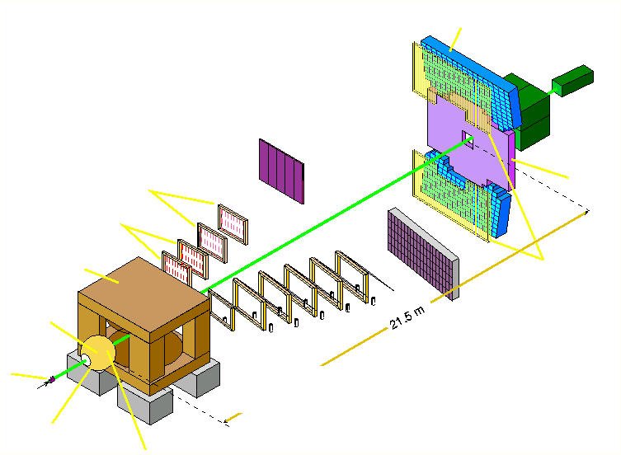
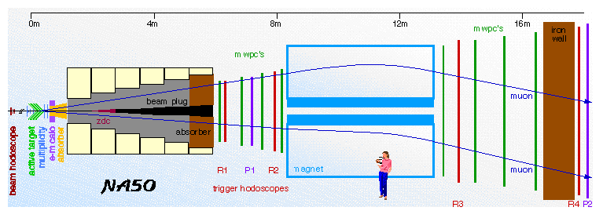
Fixed target experiment at SPS
SPS (CERN 1990-2000): √s_{NN}= 17AGeV, Pb+Pb
  Search for Quark Gluon Plasma via many observables
  J/ψ, photons, dileptons
WA98 experiment (photons)
zero degree calorimeter:
forward energy
NA50 experiment (J/ψ)
photon spectrometer (LEDA)
photon multiplicity
detector (PMD)
TOF 2
streamer tubes
pad chambers
magnet
TOF 1
veto detector for
charged particles
target
21.5 m
multistep avalanche chambers (MSAC)
Plastic Ball

Slide 12
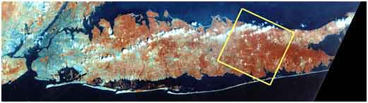

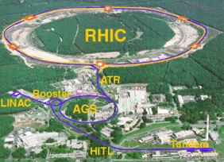
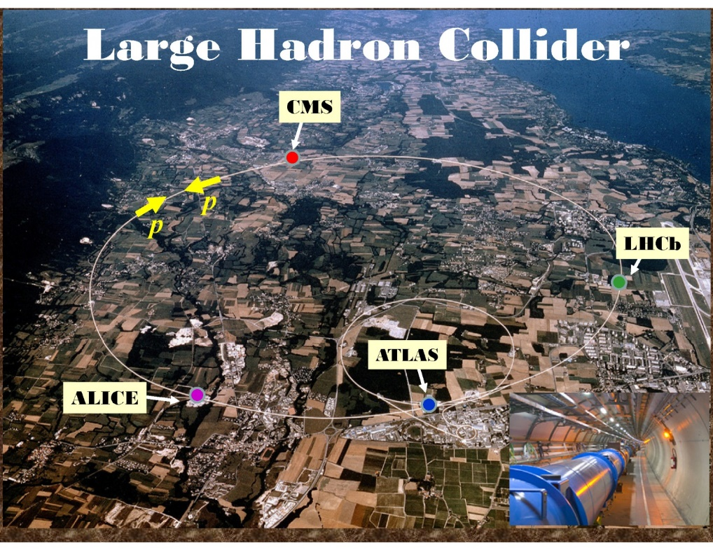
Colliders at RHIC and LHC significantly changed game
Manhattan
Long Island, New York
RHIC at BNL (2000-), 3.8km perimeter
√s_{NN}=7.7-200GeV Au+Au, U+U, etc.
LHC at CERN (2009-), 27km perimeter
√s_{NN}=2.76(5.1)TeV Pb+Pb, etc.

Slide 13
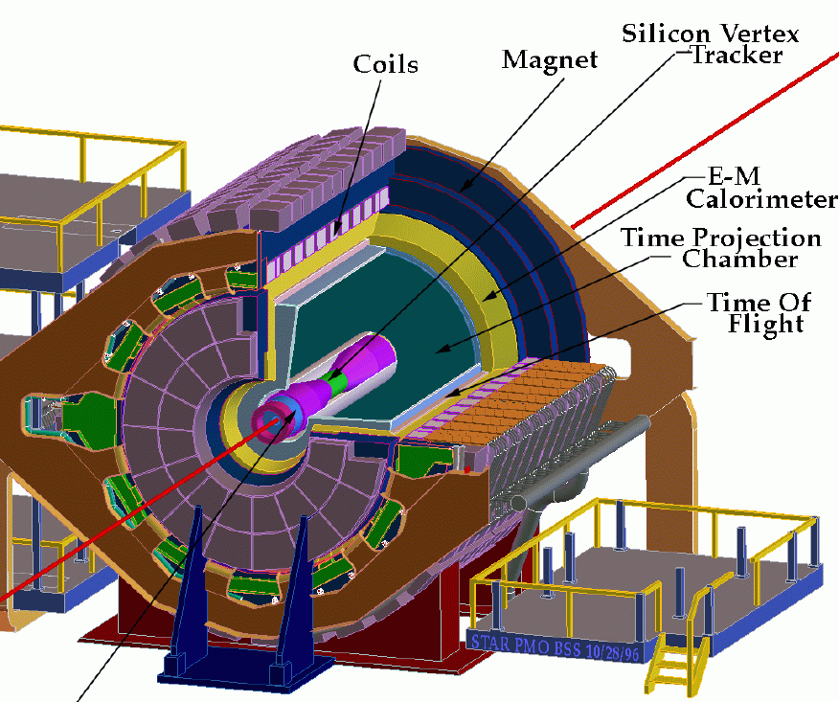
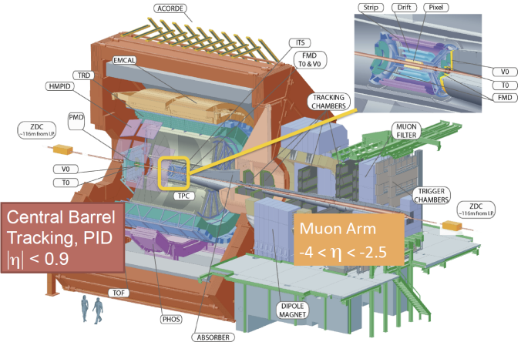
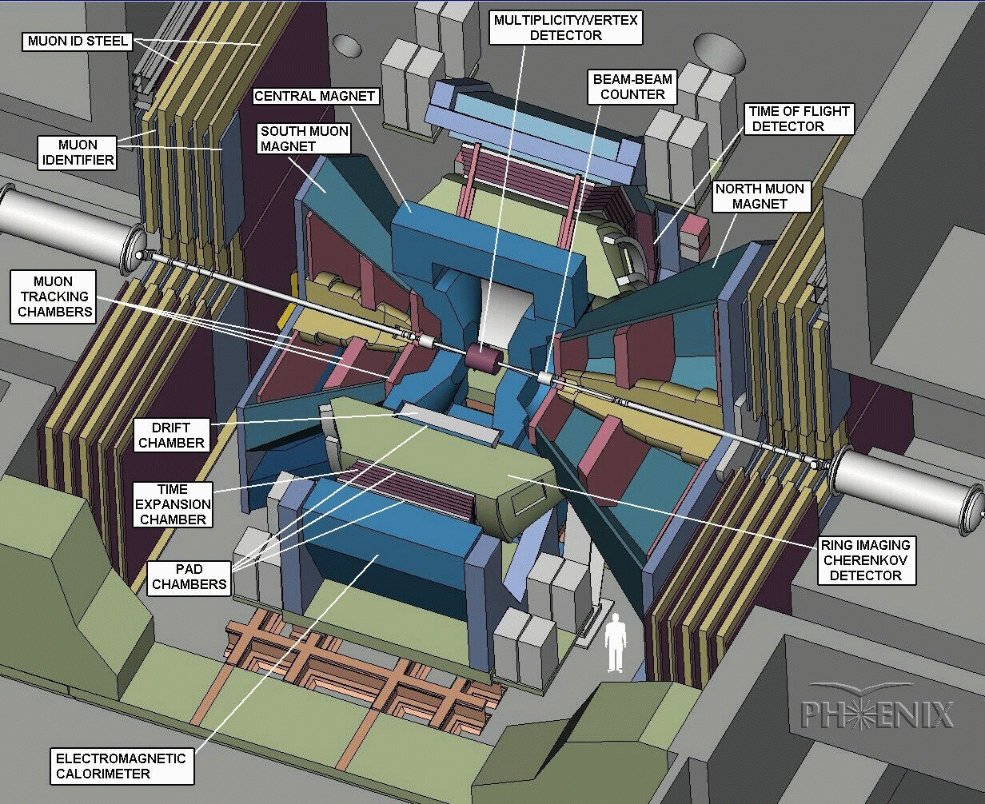
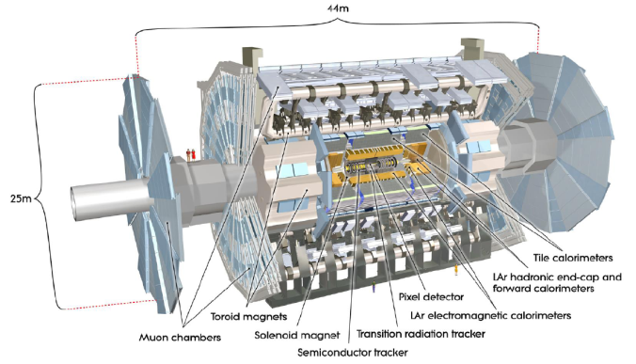
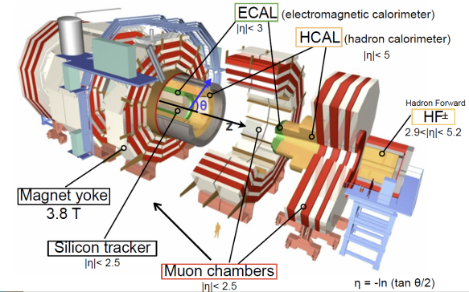
Big five experiments in service
ALICE
STAR
PHENIX
ATLAS
CMS
RHIC
LHC

Slide 14
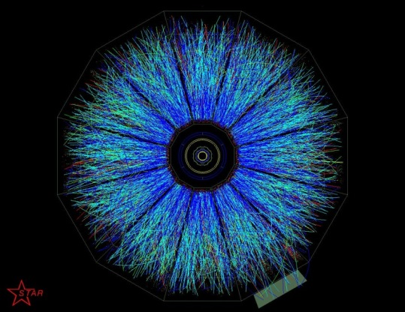
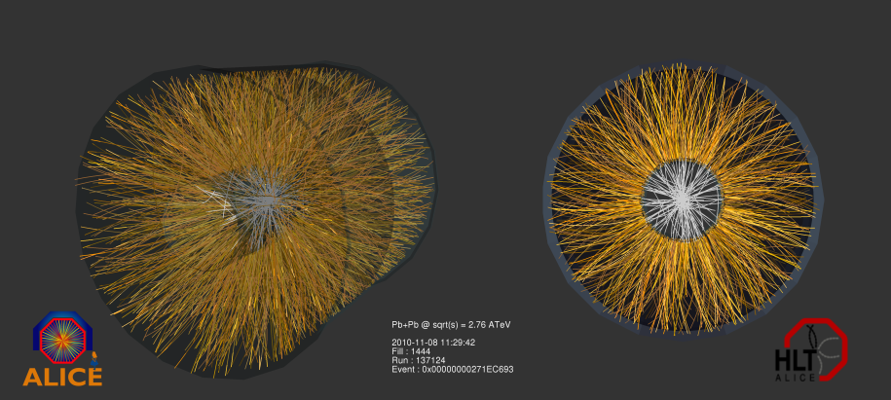
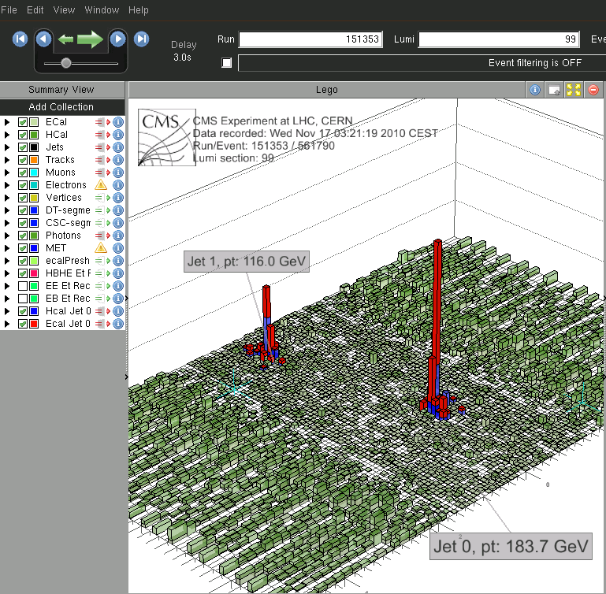
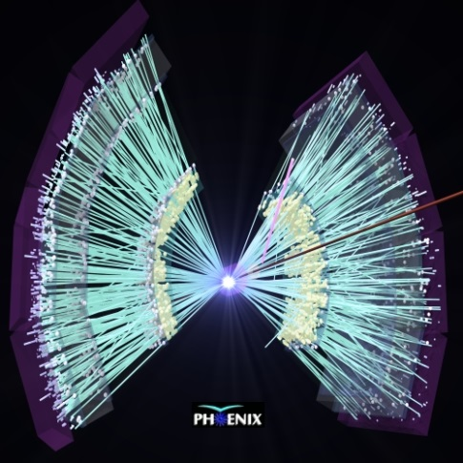
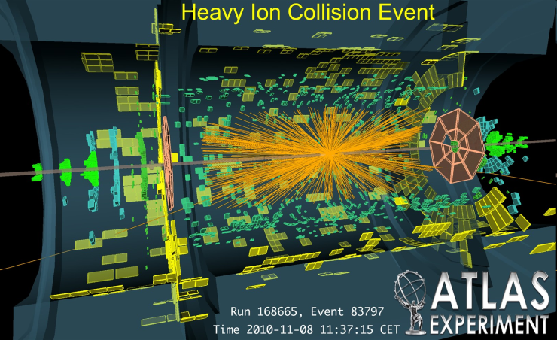
Big five experiments in service
ALICE
STAR
PHENIX
ATLAS
CMS
RHIC
LHC

Slide 15
Basics of heavy ion collisions

Slide 16
Reality of collisions
Total rapidity loss of beam: 25TeV in 200GeV Au+Au collisions at RHIC
Rather different collision profile at low and high energies
Rapidity: y = ½ ln{(t+z)/(t-z)}

Slide 17
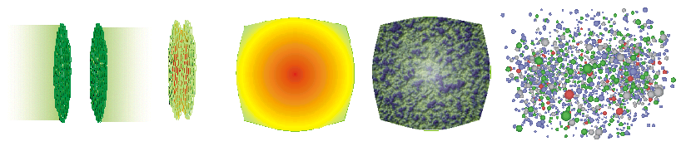
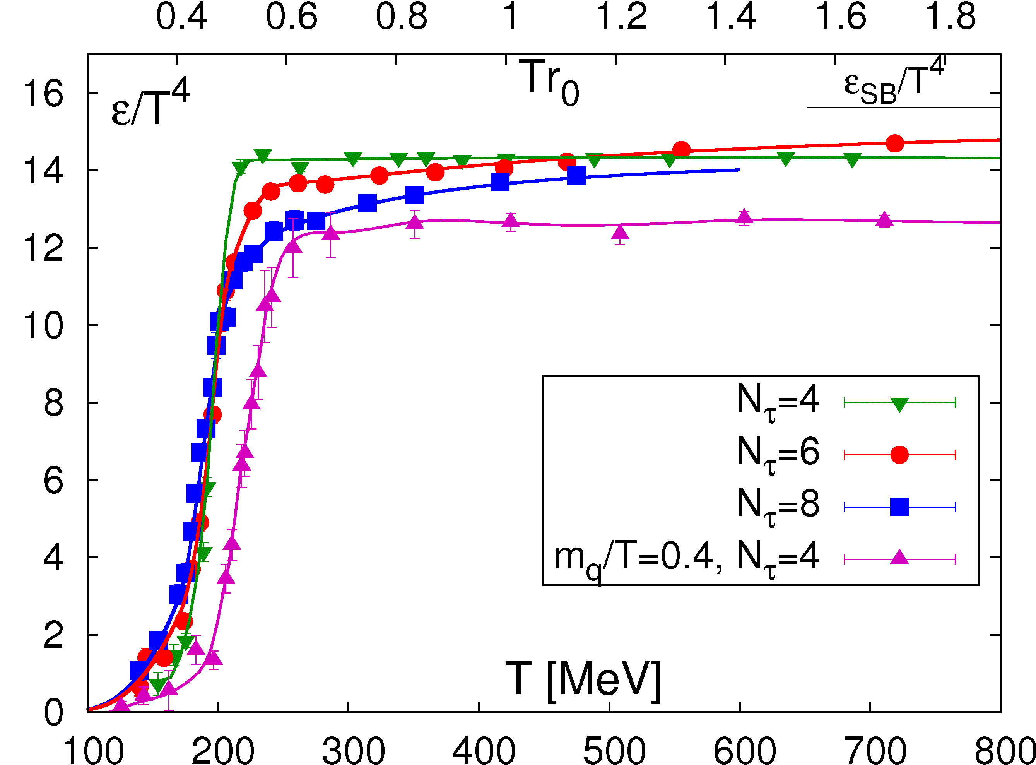
System development after collisions
Pre-equilibrium
Gluon Plasma
QGP phase
Mixed phase
Hadronization +
Expansion
Gold ions pass through each other
  High momentum (high-x) partons fly away
  Low momentum (low-x) gluons remain in the mid-rapidity (y=0), and create “gluon matter”
(Pre-equilibrium) Gluon plasma → QGP → Hadronization
Transition temperature (quark to hadron)： T=~180MeV
Energy density: >2GeV/fm³
  Estimate from Lattice QCD calculation
# of DOF

Slide 18
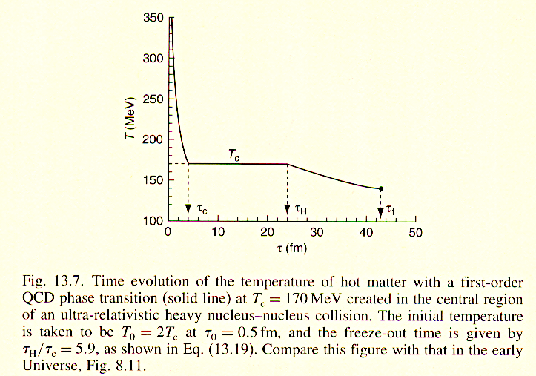
Time and temperature profile after collisions
Four characteristic temperatures
Initial (T_{i} ~300-600MeV)
  As going to higher collision energy, this temperature goes higher.
QGP (T_{QGP} ~200-300MeV)
Critical (phase transition) or chemical freezeout (T_{C} ~170MeV)
  Particle composition (μ_{b}) is fixed
Thermal freezeout (T_{F}~100MeV)
  Momenta of particles are fixed
  System expansion velocity (β) is fixed
Pre-equilibrium
Gluon Plasma
QGP phase
Mixed phase
Hadronization +
Expansion
T_{i}
T_{QGP}
T_{F}
Numbers above will be shown by data

Slide 19
Several physical quantities in HI collisions
p_{T}
Transverse momentum (p_{T})
  Momentum component normal to the beam direction in center-of-mass frame
Number of participant nucleons (N_{part})
  Calculable from impact parameters
  A measure of energy density
Number of nucleon collisions (N_{coll})
  Number of nucleon collisions in an event
  Nucleons are considered to collide individually in high energy collisions
Centrality: Event class variable proportional to impact parameters
  0%: b=0, Central collisions
  100%: b=bmax, Peripheral collisions
p_{T}
Participant nucleons
Spectator nucleons
N_{coll}, N_{part} in Au+Au
N_{coll}
0% centrality
N_{part}
100% centrality
b [fm]

Slide 20
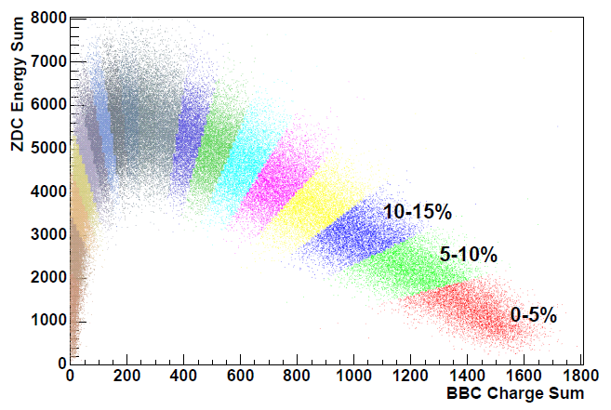
Event triggering and event selection
Calorimeter/Tracker
Use of spectator-participant model
  When inelastic collision occurs, spectators and participants nucleons fly to different rapidities
Fixed target experiment
  Spectator nucleons and all uninteracted beams can be detected at hadron calorimeter at zero-degree with respect to beam direction
  Higher trigger efficiency
Collider experiment
  Zero-degree with respect to beam direction can’t be blocked (otherwise, beam is dumped)
  Trigger/select events using neutrons at HadCal at very forward rapidity and charged particles at other rapidity
  Lower trigger efficiency
projectile
Spectator nucleons
Hadron Cal
Participant nucleons
target
ZDC charge sum
BBC charge sum
1/8/2021
T. Sakaguchi @ Saga U Lecture

Slide 21
Review of RHIC/LHC results
Key observables: Three temperature measurements, Hard probes (photons, jets, heavy quarks), and particles flows

Slide 22
Thermal freezeout temperature
T_{f} = ~120MeV
Blast-wave fit to π/K/proton p_{T} spectra simultaneously
  A model of simple system expansion
Temperature (T_{f}) and boost velocity (β_{T}) are obtained
  As going to central, system keeps expanding until cooled down more

Slide 23
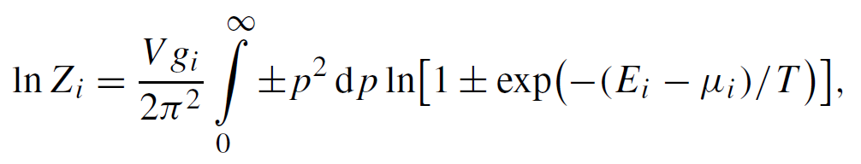

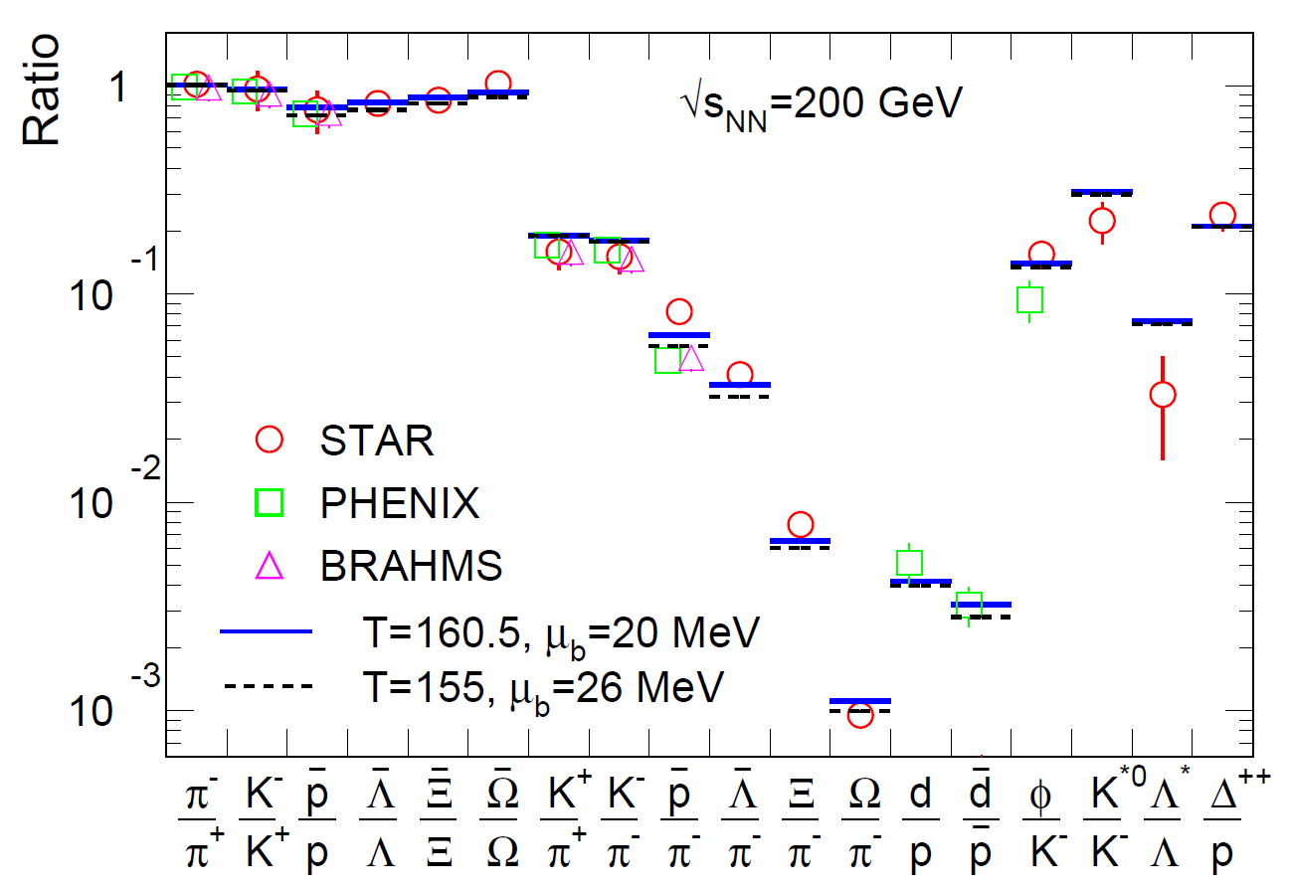
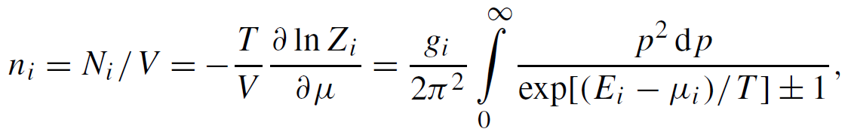
Chemical freezeout temperature
T_{C} = ~160MeV
Temperature and Baryo-chemical potential (∝baryon density) at freezeout is estimated from particle ratios and by using Grand Canonical Stat Model
Spin DOF
Chemical potential μ_{i}
μ_{b}: Baryon, μ_{I3}: Isospin
μ_{S}: Strangeness, μ_{C}: Charm
Number of particles: n_{i}
See, e.g., A. Andonic, et al., NPA 772(2006)167

Slide 24
RHIC/LHC chemical freezeout position

Slide 25
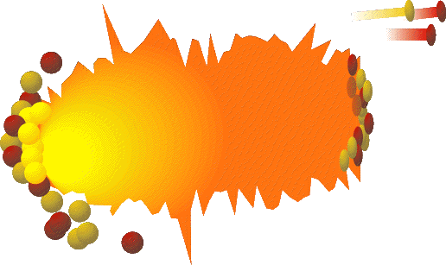
QGP temperature from thermal photons
Emitted from all the stages after collisions
Penetrate the system unscathed after emission
  Carry out thermodynamical information such as temperature
Photons will be produced by Compton scattering or q-qbar annihilation at LO
Small Rate: Yield ∝ αα_{s}
e⁺
e⁻
γ∗
γ
Π_{em}: photon self energy
Product of Bose distribution and transition probability
Slope at E>>T tells temperature (T~200MeV)

Slide 26
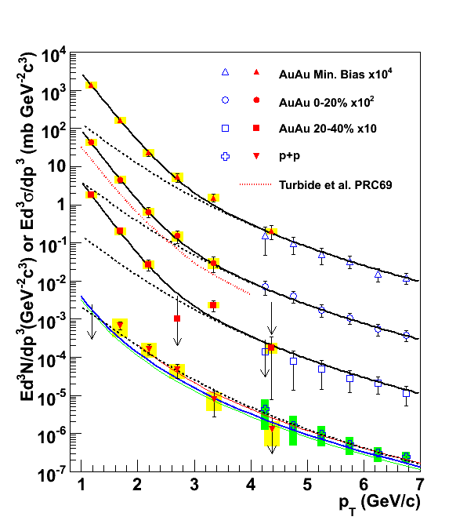
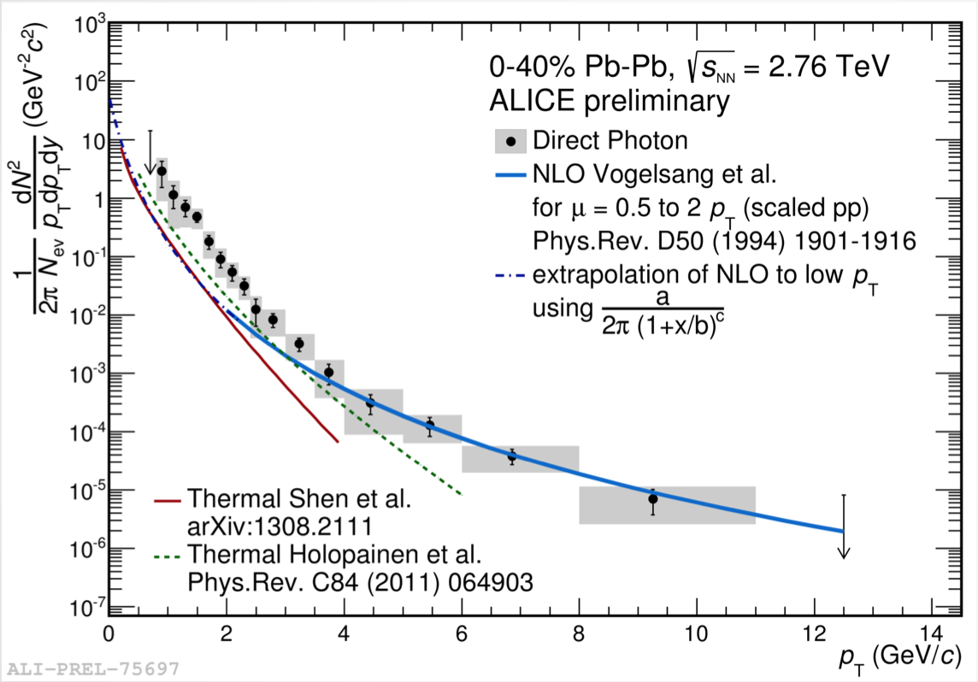
QGP temperature from thermal photons
RHIC, Au+Au 200GeV: T_{ave} = ~220 MeV = 2.5 trillion K
LHC, Pb+Pb 2.76TeV: T_{ave} = ~304 MeV = 3.5 trillion K
PRL104,132301(2010), arXiv:0804.4168
ALICE, NPA 904 (2013) 573c
Au+Au

Slide 27
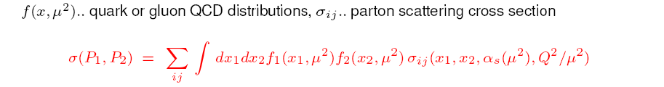
New probes available since RHIC：
Probes from initial hard scattering (jets, heavy quarks）
C
P1
x₁P₁
Yield in A+A collisions ∝ Ncoll × p+p collisions
Ncoll: number of binary N-N collisions.
c
x₂P₂
X
P2
d

Slide 28
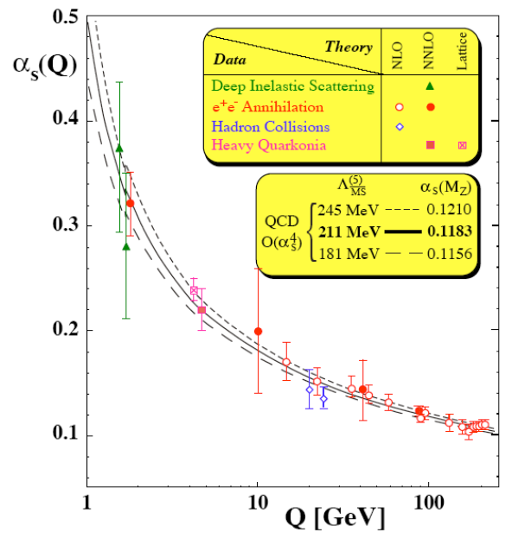
Probing non-perturbative region by perturbative probes
Yield of jets or heavy quarks can be calculated using perturbative QCD (pQCD)
Exploring non-perturbative region with perturbative probes
Thermal region
QGP
Perturbative QCD
(pQCD) doesn’t work
Hard region
Jets, Heavy quarks
Perturbative QCD
(pQCD) works

Slide 29
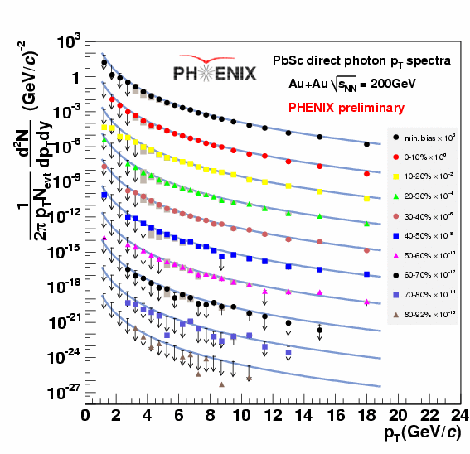
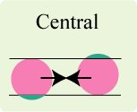
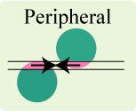
A pQCD probe is well-calibrated
Yield in A+A collisions ∝ Ncoll × p+p collisions
Yields of jets, photons, and Z, W-bosons are well-reproduced by pQCD calculation
This fact were confirmed both at RHIC and LHC
Yields in Au+Au, Pb+Pb scale with number of binary-nucleon collisions (N_{coll})
CMS, JHEP 07 (2020) 116
Blue line: N_{coll} scaled p+p cross-section
PHENIX, PRL109, 152302(2012)

Slide 30
Jets in p+p (primordial hard scattering)
Yield in A+A collisions ∝ Ncoll × p+p collisions

Slide 31
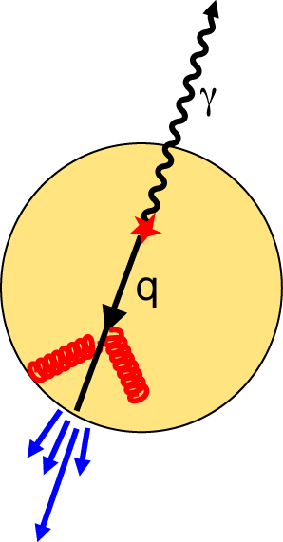
Jets in QGP
Hard scattered partons lose their energies in the QGP via gluon radiation or parton collisions
Jets that are fragments of the partons accordingly reduce their energies
Yield in A+A collisions ∝ Ncoll × p+p collisions
g

Slide 32
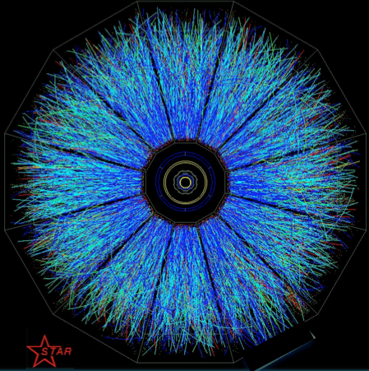
Jets in QGP
Hard scattered partons lose their energies in the QGP via gluon radiation or parton collisions
Jets that are fragments of the partons accordingly reduce their energies
Yield in A+A collisions ∝ Ncoll × p+p collisions
Reconstruction of jets in HI collisions is extremely difficult because of this!

Slide 33
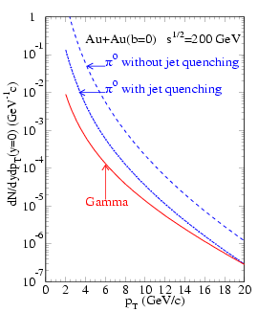
Observing leading particles from Jets
High p_{T} hadrons (π⁰ etc.) are leading particles from jets
  A large fraction of jet momentum are carried
Energy loss of the partons at RHIC are initially observed by high p_{T} π⁰
p+p
Au+Au
π⁰ without energy loss
π⁰ with energy loss
Yield [GeV⁻¹c]
Energy loss =Yield suppress
p_{T} [GeV/c]
X.-N., Wang, PRC 58 (1998)2321

Slide 34
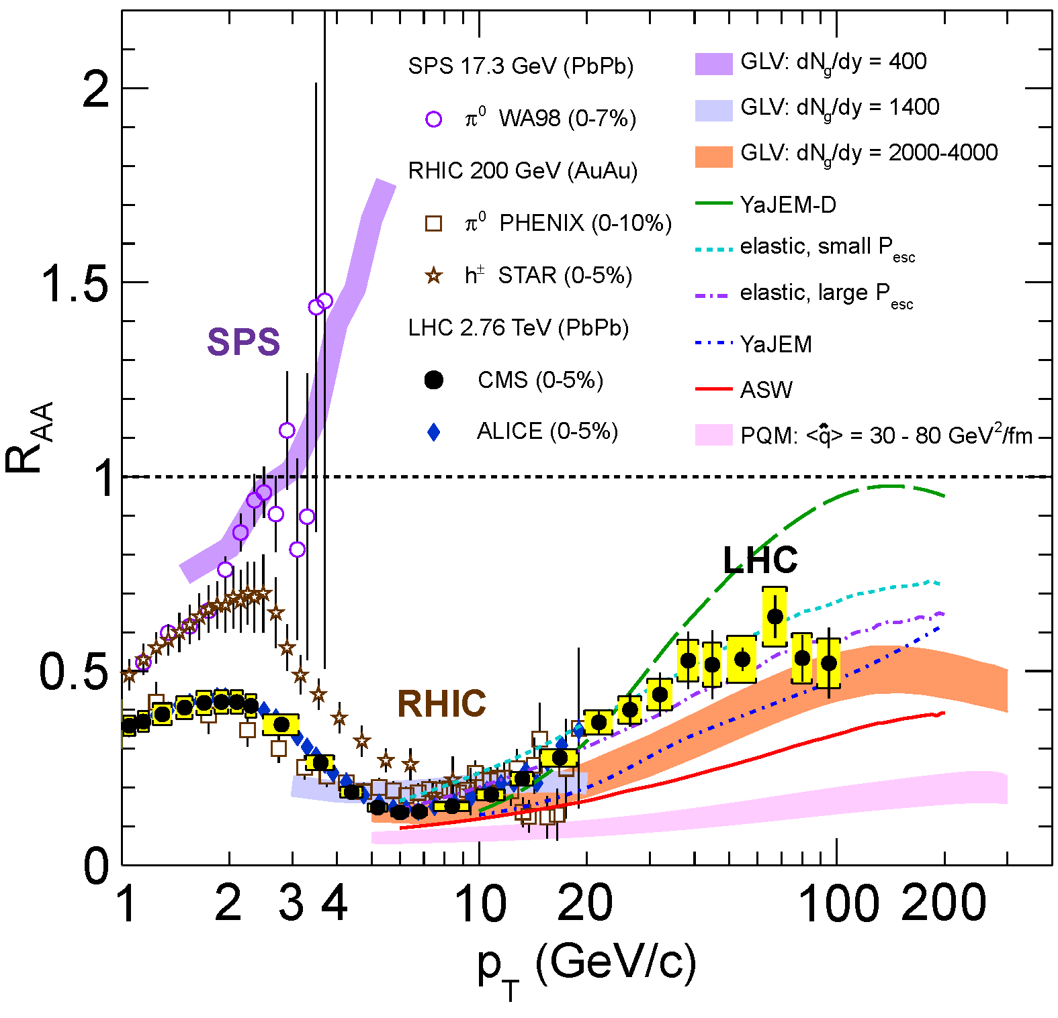
Yield suppression of leading particles
Nuclear Modification Factor (R_{AA})
  (Yield in A+A collision)/(Yield in p+p collision × Ncoll)
  R_{AA} =1: No nuclear effect
  R_{AA} <1: Suppression due to energy loss, etc.
  R_{AA} >1: multiple scattering, etc.
R_{AA} <1 for RHIC and LHC, >1 for SPS (√s_{NN}=17GeV)
R_{AA} = 0.2 at LHC: 30% loss of original p_{T}
π⁰ and h^{+/-}, PHENIX, PRL 88, 022301 (2002)
photons

Slide 35
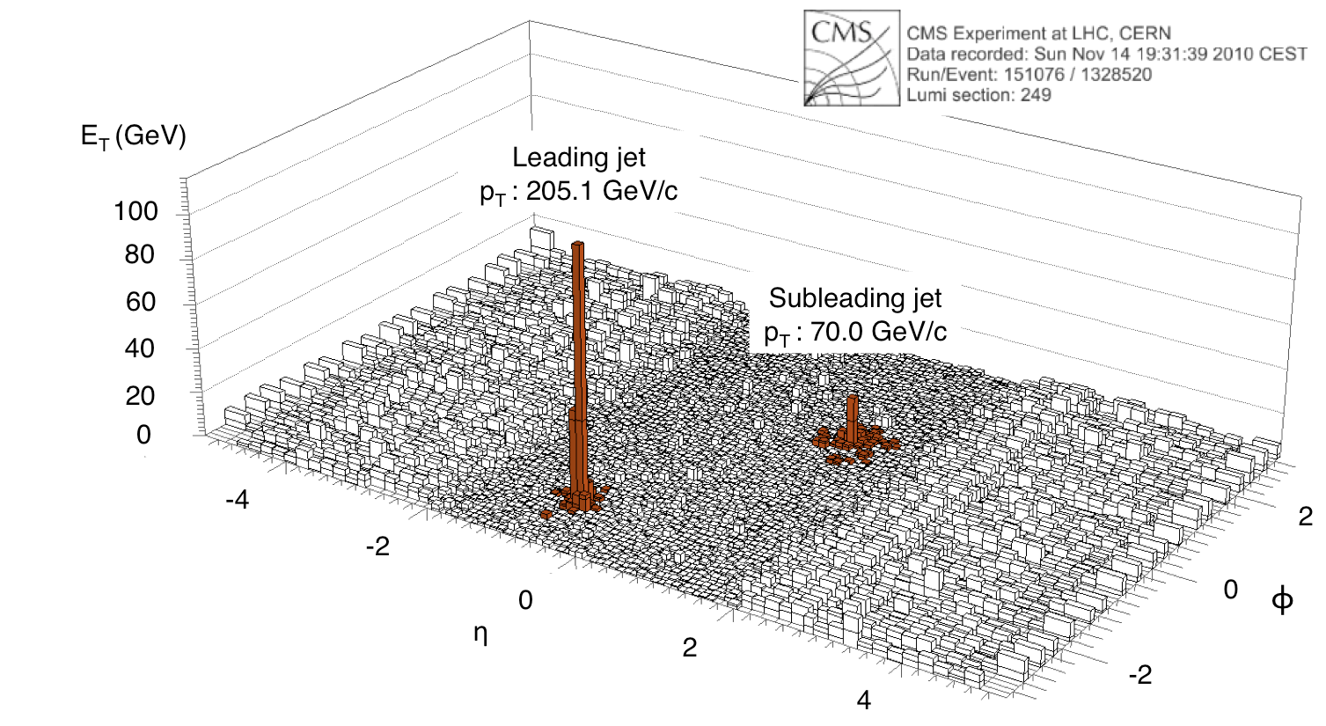
Jet reconstruction became possible at LHC
Hard scattering probability is so large at LHC that the observation of reconstructed jets and their energy loss became possible
Back-to-back jets are observed. Energy of sub-leading jets is significantly lower than that of leading jets
CMS, PRC84, 024906(2011)
Jet Production: Yield ∝ α_{s}²
g

Slide 36
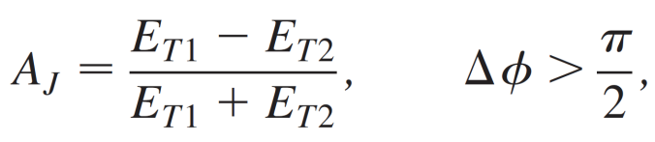
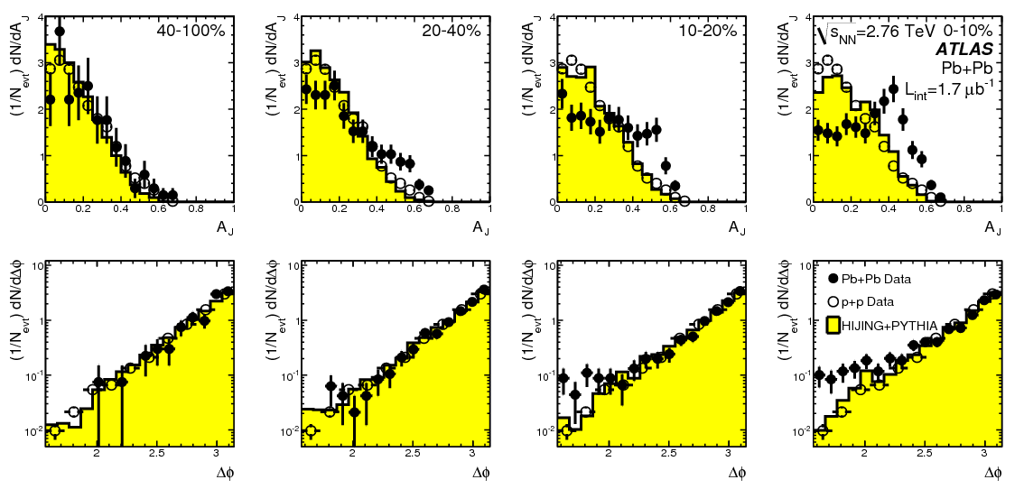
Jet reconstruction became possible at LHC
ATLAS has successfully measured asymmetry of energies of back-to-back jets
  Open points are p+p data
  Filled points are Pb+Pb data
  Yellow histogram is estimated distribution for Pb+Pb without energy loss
Central Pb+Pb points deviate from p+p and estimated Pb+Pb distribution without energy loss
ATLAS, PRL105, 252303(2010)
Peripheral
Central
~30-40% loss
of jets energy

Slide 37
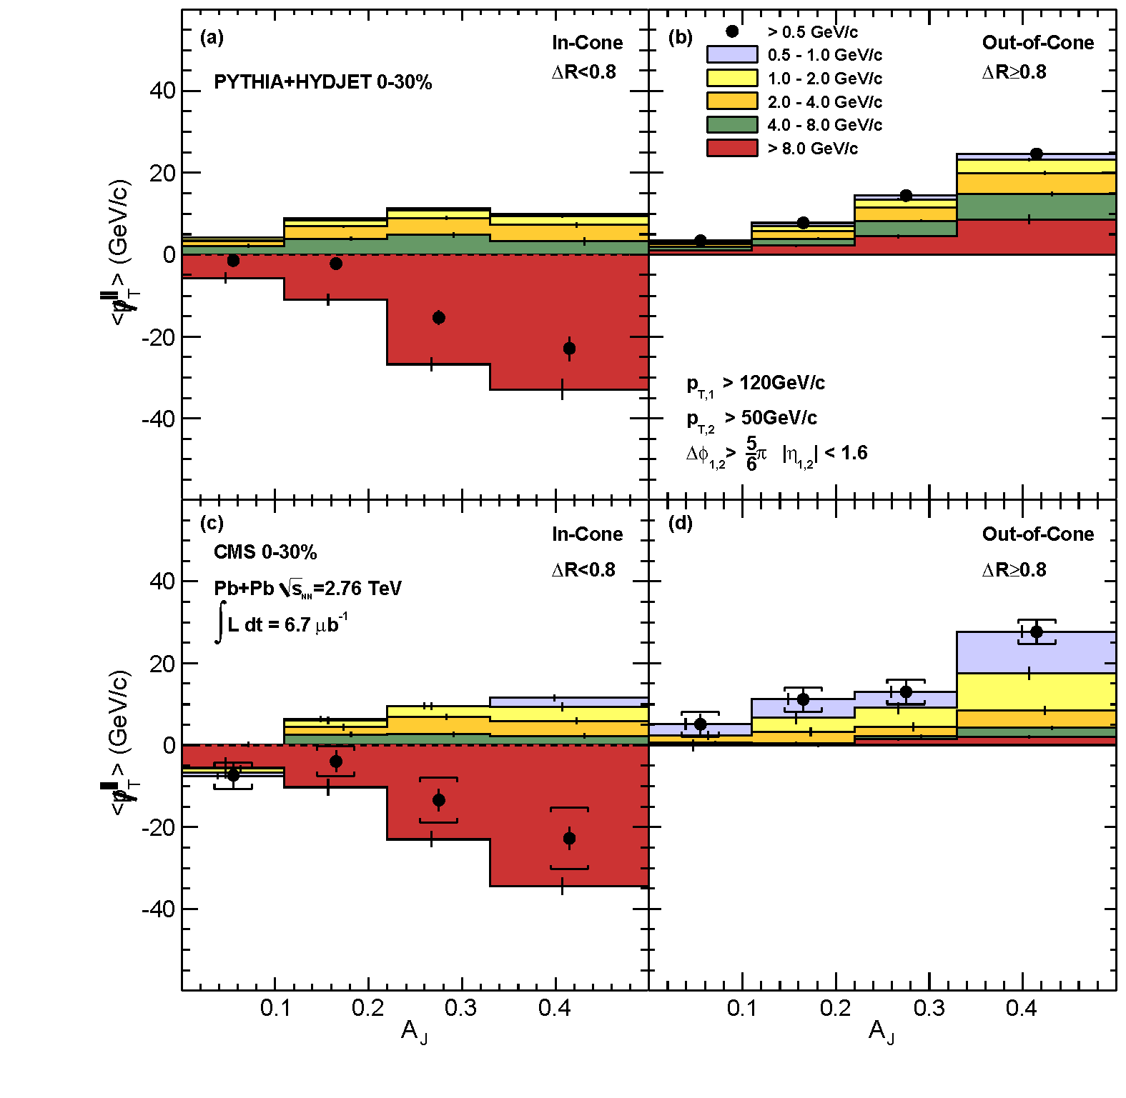
Where the lost energy went?
CMS, PRC84, 024906(2011)
In-Cone
Out-of-Cone
Split into phase spaces within reconstructed jets and look for momentum distributions
  ΔR<0.8 (In-Cone), ΔR>0.8 (Out-of-Cone)
Plotted difference of leading Jets and momentum sum in given phase spaces, against A_{J}
Upper panel shows simulation results from PTYHIA + HI background + energy loss
Lower panel shows data. Trend is rather similar
Simulation
Data
ΔR=0.8
Large A_{J} enriches the jet with large energy loss

Slide 38
Photon-jet, Z-jet at LHC
Z
Z
Measurement of prompt photons and Z-boson reached high precision at highest beam energy (LHC)
Photon-jet and Z-jet now became tools to do precision parton energy loss physics (look for momentum imbalance)
Tag photons or Z-bosons and look for the jet in opposite direction
  Deficit of jets energy is the loss in QGP
Photon Production: Yield ∝ αα_{s}

Slide 39


Another Densimeter/thermometer: Heavy Quarkonia
Heavy quarkonia (like charmonium, J/ψ) are produced only in the initial hard scattering (needs large Q²)
As the temperature of the system increases, light quarks in the medium screen the potential between q-qbar
  Quarkonia bound state will be dissociated (melted)
  Similar to Debye screening in EM plasma
Suppression of the J/ψ is a signature of QGP formation
  First proposed by Matsui and Satz (Phys. Lett. B 178 (1986) 416)
  Look for l⁺l⁻ decay channel
Different binding energy/radii →
Different dissociation temperatures
State | J/ψ (1S) | χ_{c} 1P | ψ (2S)
m (GeV) | 3.10 | 3.49 | 3.69
r₀ (fm) | 0.56 | 0.81 | 1.15
ΔE (GeV) | 0.64 | 0.23 | 0.06

Slide 40
J/ψ suppression at SPS (sqrt(s)=17GeV)
NA50 Collaboration, PLB477(2000)28
J/ψ yield was assessed in terms of J/psi to Drell-Yan ratio
  Drell-Yan is q + q bar → l⁺ + l⁻
As going to higher energy density, the ratio goes down
  χ_{c} (→ γ + J/ψ) melts first, and then J/ψ

Slide 41



J/ψ R_{AA} at RHIC and LHC
Measurement at RHIC and LHC are compared.
  More suppression in more central collisions both at RHIC and LHC.
Result at high p_{T}, y=0 is consistent with Debye screening scenario
Result at low p_{T} calls a question: regeneration of J/ψ due to copious c-cbar pairs in small phase-space?
c
c
c
c
c
c
High p_{T}, y=0:
R_{AA}(2.76TeV) < R_{AA}(200GeV)
Low p_{T}, y=0:
R_{AA}(2.76TeV) > R_{AA}(200GeV)
Low p_{T}, |y|>1 or 2:
R_{AA}(5.02, 2.76TeV) > R_{AA}(200GeV)

Slide 42


Bottomonia spectroscopy at LHC
b-bbar yield is much lower than c-cbar → regeneration rarely
Expectation is Υ(1S) R_{AA} > Υ(2S) R_{AA} > Υ(3S) R_{AA}
Nicely confirmed by the CMS measurement in 2011
2011 150 /μb
CMS, PRL 109, 222301 (2012)
p + p Pb+Pb
Υ(1S)
Υ(1S)
Υ(2S)
Υ(3S)
Υ(2S)
Υ(3S)

Slide 43


Collective flow of particles
In non-central collisions, the collision area is not isotropic
  Different pressure gradient produces momentum anisotropy of emitted particles
Measure the angular distribution of the particles with respect to the reaction plane
  2nd order Fourier coefficient shows the elliptic flow
Spatial asymmetry eccentricity
Mom. Asymmetry elliptic flow
Larger pressure gradient in plane

Slide 44

Fluctuation of nucleon positions yields…
Fluctuation of nucleon position yields higher order anisotropy of particles
  Higher order flow （v₃, v₄, … v_{n})
Higher order flows are sensitive to the properties of the matter
  Equation of state E=E(P), shear viscosity (η) to Entropy density (s) ratio (η/s)
Φ₃
Φ_{n} : Event Plane
Φ₂

Slide 45


Elliptic to multi-order flow result (v₂, v₃, v₄)
Au+Au √s_{NN}=200GeV
Large flow is observed as a function p_{T}
  As particles become heavier, the flows become smaller in low p_{T}
As expected, v3 and v4 have also been observed
PHENIX, arXiv:1412.1038(nucl-ex)
PHENIX, PRL99, 052301(2007)
Au+Au √s_{NN}=200GeV
20-60% centrality

Slide 46


Analogy to cosmology
Fluctuation of temperature in cosmic microwave background
  A trace of phase transition.
An input to cosmological model
From NASA and Rev. of Part. Phys.

Slide 47


v_{n} results with hydrodynamics model
PHENIX (RHIC) and ATLAS (LHC) v_{n} are compared with a hydrodynamics model
  QGP as fluid consisting of partons
The model reproduces the higher order flow at RHIC, LHC very well
  Almost perfect fluid is realized at RHIC（η/s from quantum limit: ~1/4π）
RHIC
LHC
B. Schenke, S. Jeon and C. Gale, PRC 85, 024901 (2012)
C. Gale et al., PRL110, 012302(2013)

Slide 48
Extreme end of heavy ion physics
New paradigm in LHC/RHIC era
Thanks to high energy that made possible to create high enough energy density even at small system collisions.

Slide 49

Similarity in A+A, p+A and p+p?
p+p and p+A collisions have been used as a reference to investigate the phenomena in A+A collisions
In very high energy collisions, the situation is different?

Slide 50


Flow in p+p collisions?
The flow was found in p+p collisions for the first time at LHC at √s = 7 TeV
p+p data and PYTHIA8 shows a different angular distribution of emitted particles in high multiplicity event (2nd order component is prominent)
p+p MinBias
CMS, JHEP09(2010)091
p+p high mult. events
(Ntrk>110)

Slide 51





Flow in p+Pb?
Yes! Similar distribution was observed at p+Pb@5.02TeV
HIJING is an event generator of HI collisions. It doesn’t assume QGP production in this small system
CMS, PLB718(2013)795

Slide 52



Subtracting jet-like correlation results in:
2nd-order Fourier component is clearly visible
Jet contribution is estimated from the one in low-multiplicity events
2.7×10⁻³ % cent.
-
=
ATLAS, PRC90, 044906(2014)

Slide 53






Flow in p/d/He+Au at RHIC (a milepost)
v₂ and v₃ are measured in three small systems in most central collisions at 200GeV.
Results are best described by hydro models, which suggests small QGP production.
Quarkonia suppression/jet energy loss have not been observed
Nature Physics 15, 214 (2019)

Slide 54



Future facility related to heavy ion collisions
RHIC has last upgraded HI experiment: sPHENIX (2023-2025)
  Construction of Electron-Ion collider (EIC) follows as soon as in ~2026.
LHC will run HI in Run3 and Run4 (-2030)
  Upgrade of experiments, especially ALICE, will be performed to study QGP in detail
FCC (Future circular collider, proposed) at CERN
  100TeV in p+p, 39TeV in Pb+Pb
  More free-gas type QGP?
NICA/FAIR/J-PARC/HIAF (2026-)
  Shooting similar energy of AGS
  Luminosity is ~10⁵ higher than AGS
  Highest baryon (nuclear) density is expected
ITS
MFT
FIT
TPC
RHIC LHC
CBM@FAIR
NICA@Dubna
J-PARC-HI

Slide 55
Final words
High energy heavy ion physics expanded its goal with the evolution of hadron physics and high energy physics
  Nuclear matter → partonic matter (Quark Gluon Plasma: QGP)
Probes to study the QGP have also changed from soft particles to pQCD objects
  High influence from high energy physics
Results so far tells the QGP has been created in HI collisions at RHIC and LHC, possibly also at SPS.
  High enough temperature, large energy loss of jets, strong coupling of partons (collective motion)
Small system collisions at high energy became of interest
  p+A, and even in p+p
Two major future directions include “higher energy” and “lower energy but high luminosity” HI collisions. Both have new aspects.

Slide 56
Fieldwork (if you have spare time)
Pick one of two topics below
ALICE has a detector upgrade plan for LHC Run3 and Run4. Summarize the upgrade plan and discuss new physics knowledge to gain (pick your favorite of two) expected from the upgrade, compared to what we have learned with the current detector system.
FCC has ~10 times higher center mass of energy available compared to LHC. Summarize the new probes (pick your favorite of two) to be available at the FCC. Also discuss what kind of new physics knowledge that the new probes can bring in, compared to what we have learned at LHC.

