Slide 1
Simplified Dark Matter Models in GAMBIT
Christopher Chang
University of Queensland

Slide 2
Today’s Talk:
GUM: from Lagrangian to Likelihoods in Global Scans [arXiv: 2107.00030]
What is it?
How does it work?
What can you do with it?

Slide 3
Today’s Talk:
GUM: from Lagrangian to Likelihoods in Global Scans [arXiv: 2107.00030]
What is it?
How does it work?
What can you do with it?
Simplified Dark Matter Models study
Which models?
Preliminary Dark matter constraints (Collider coming soon)

Slide 5
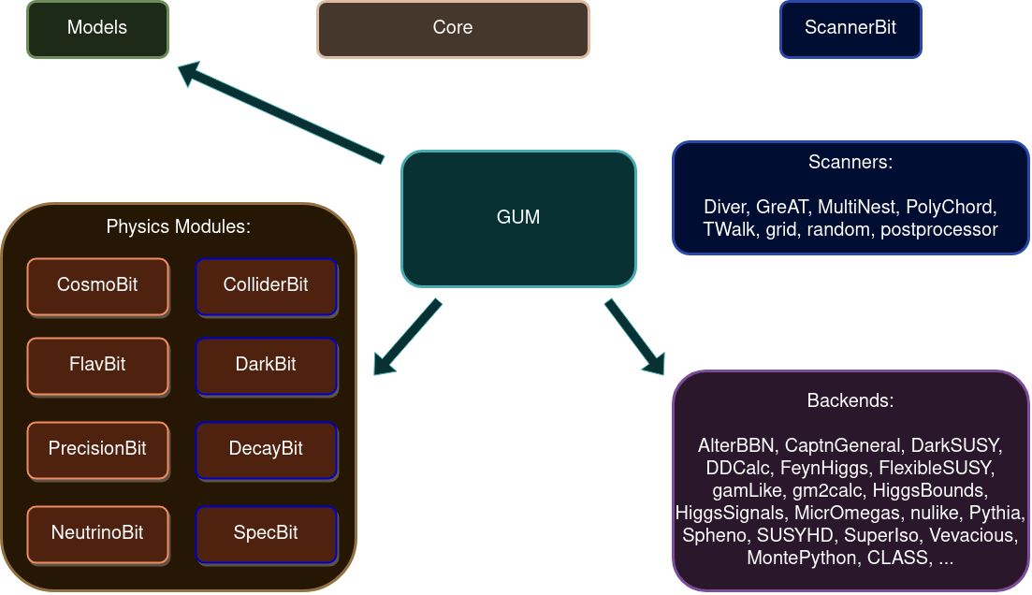

Slide 6
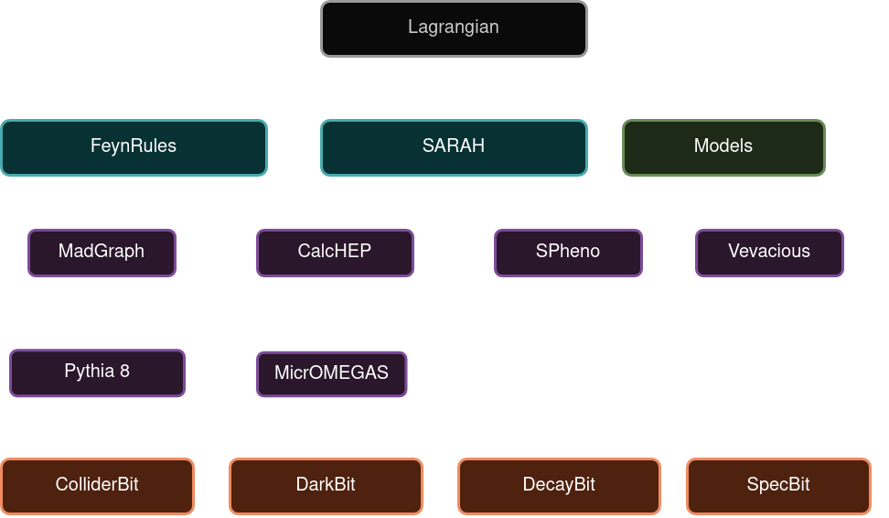

Slide 7
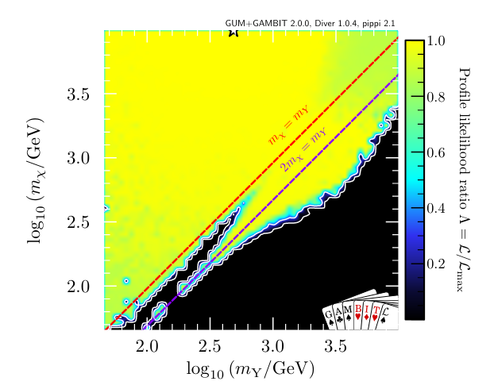
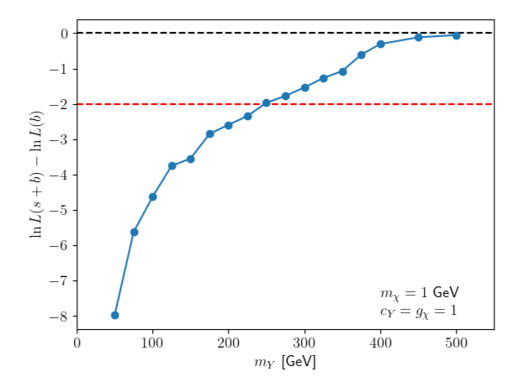
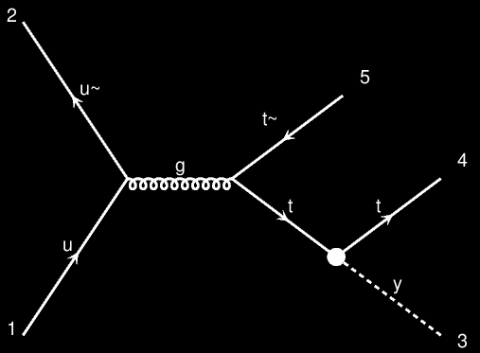
What kind of results can we get?
Collider:
ATLAS 139 invfb 2lep+MET+jets search
Dark Matter:
Relic Density Upper Bound
Indirect Detection: FermiLAT dwarf galaxies
Direct Detection: XENON1T 2018, LUX 2016

Slide 8
arXiv: 2107.00030

Slide 9
Simplified Dark Matter Model Study:
A simplified model is an effective theory describing the interactions of a small number of new particles.
In this case, a dark matter particle and a mediator particle.
Can be described by particle masses and couplings
Notes:
Simplified Models are less (but not entirely) model independent.
They are most useful as they would allow us to classify a new particle detection for what type of particles it could be.
They do not need to be renormalizable, satisfy a certain symmetry, or be complete (e.g. might need additional Higgs to produce the mass of these particles).

Slide 10
Simplified Dark Matter Model Study:
6 different s-channel models in total, classified by the particle spins
Mediator: Real Scalar and Vector
Dark Matter: Complex Scalar, Vector and Dirac Fermion
Assumed no mixing with the Higgs
Notes:
Simplified Models are less (but not entirely) model independent.
They are most useful as they would allow us to classify a new particle detection for what type of particles it could be.
They do not need to be renormalizable, satisfy a certain symmetry, or be complete (e.g. might need additional Higgs to produce the mass of these particles).

Slide 11
Constraints Applied:
Relic abundance upper limit:
Calchep: A.Belaev et. al. [arXiv:1207.6082] and MicrOmegas: G. Belanger et. al. [arXiv:1305.0237]
XENON1T and LUX direct detection limits:
DDcalc: P. Athron et. al. [arXiv:1808.10465]
FermiLAT gamma rays from dwarf galaxies:
gamLike: T.Bringmann [arXiv:1705.07920]
Notes:
Simplified Models are less (but not entirely) model independent.
They are most useful as they would allow us to classify a new particle detection for what type of particles it could be.
They do not need to be renormalizable, satisfy a certain symmetry, or be complete (e.g. might need additional Higgs to produce the mass of these particles).

Slide 12
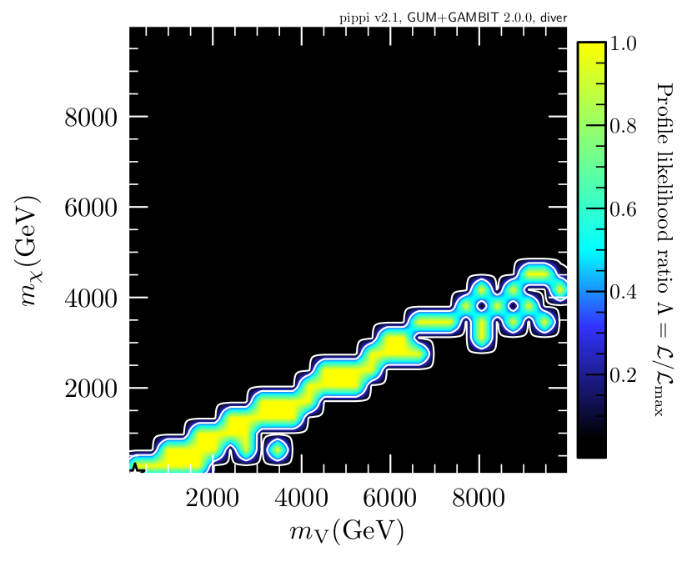
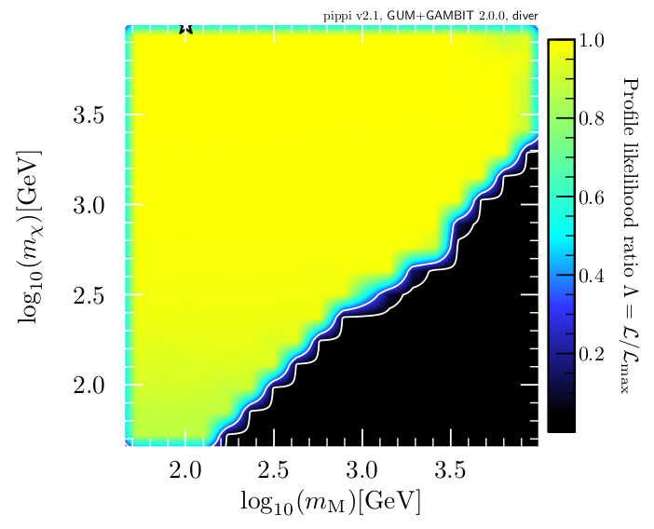
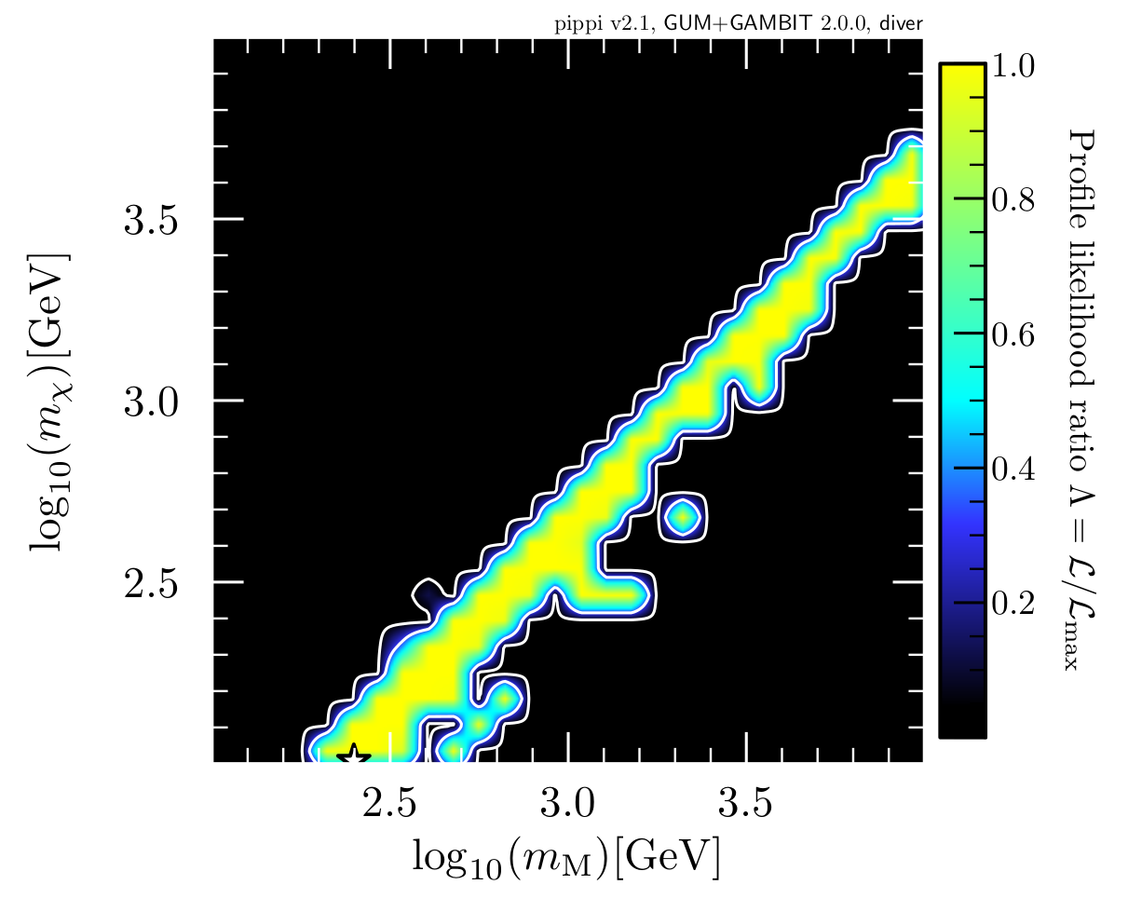
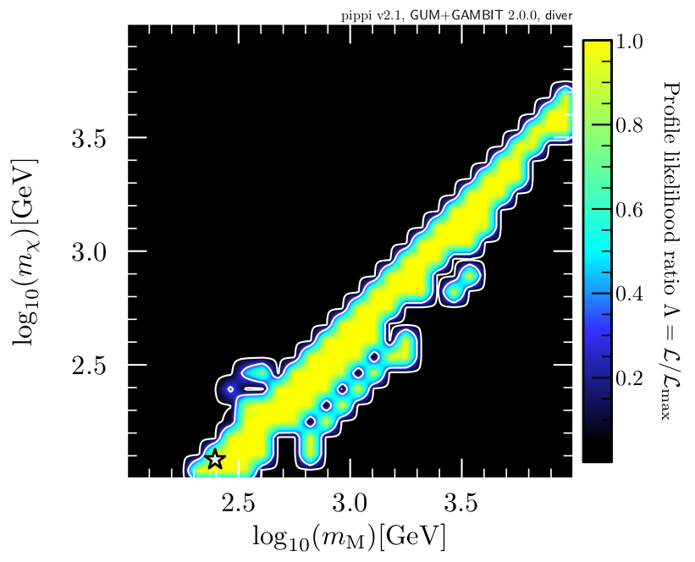
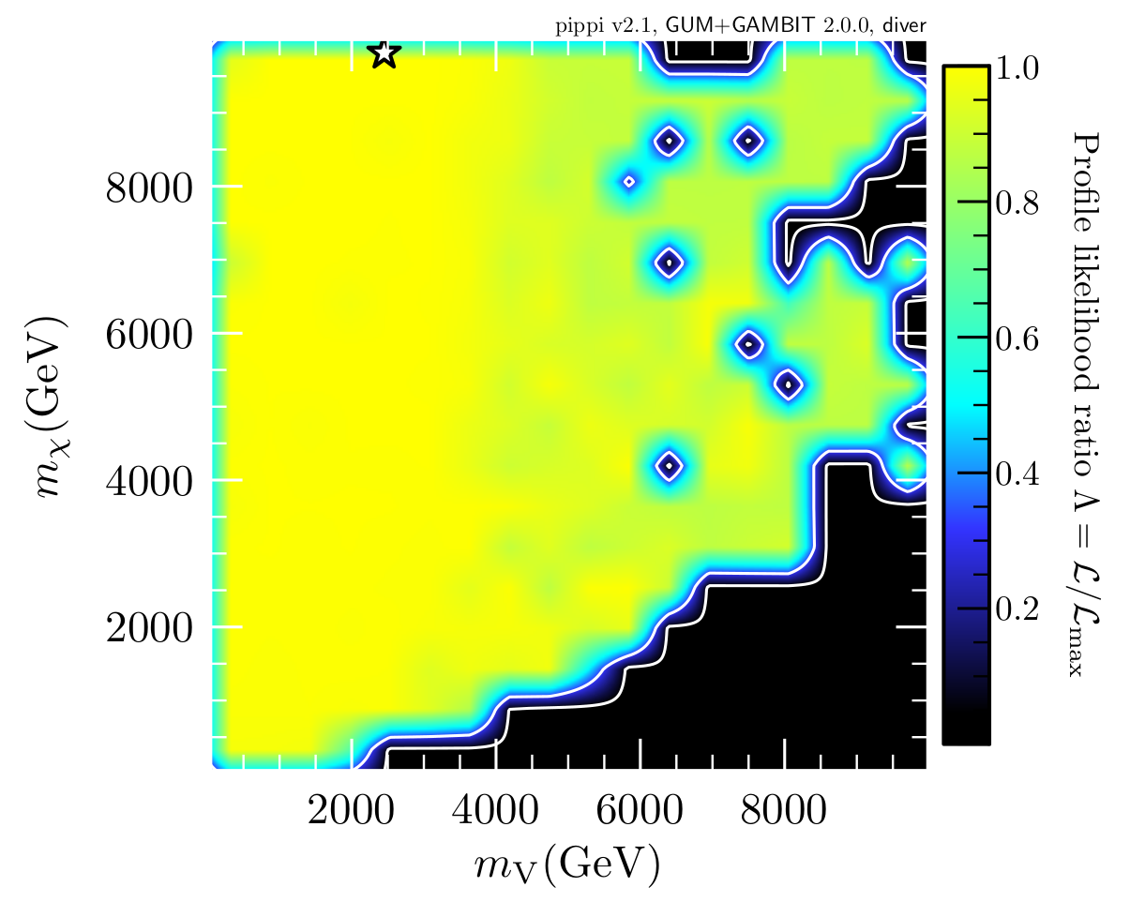
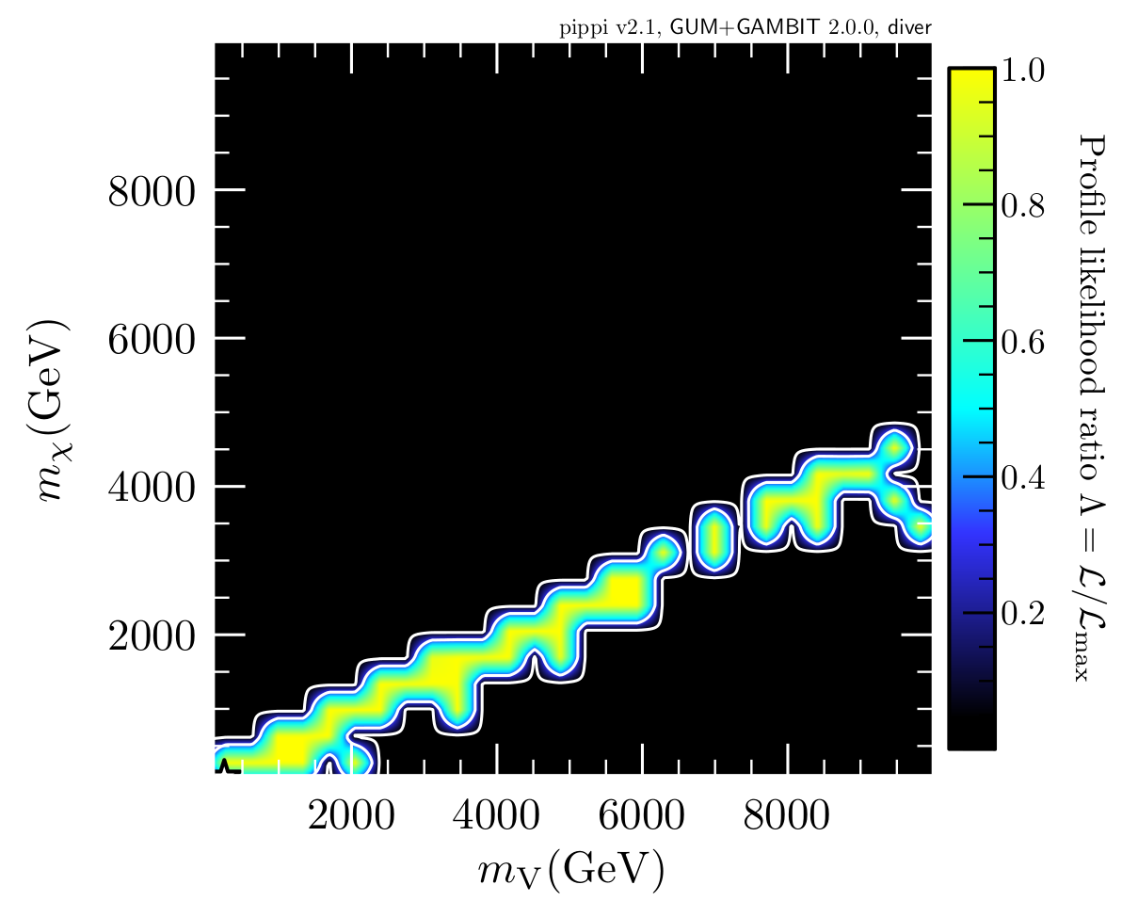
Scalar Mediated:
Scalar DM Dirac Fermion DM Vector DM
2 sigma exclusion limits are from the relic abundance upper limits.

Slide 13
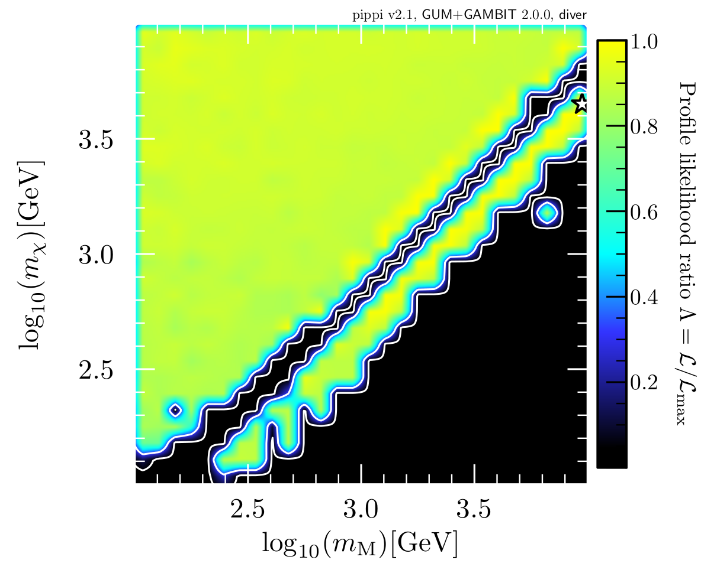
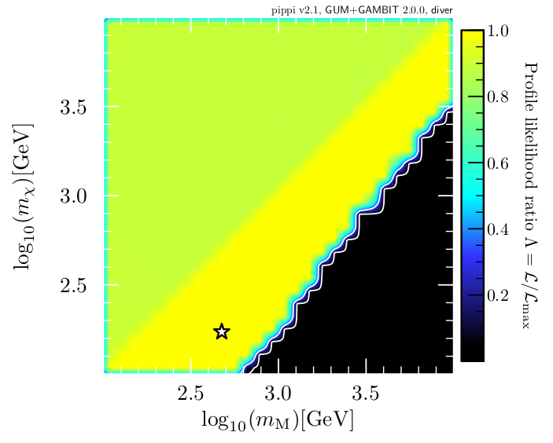
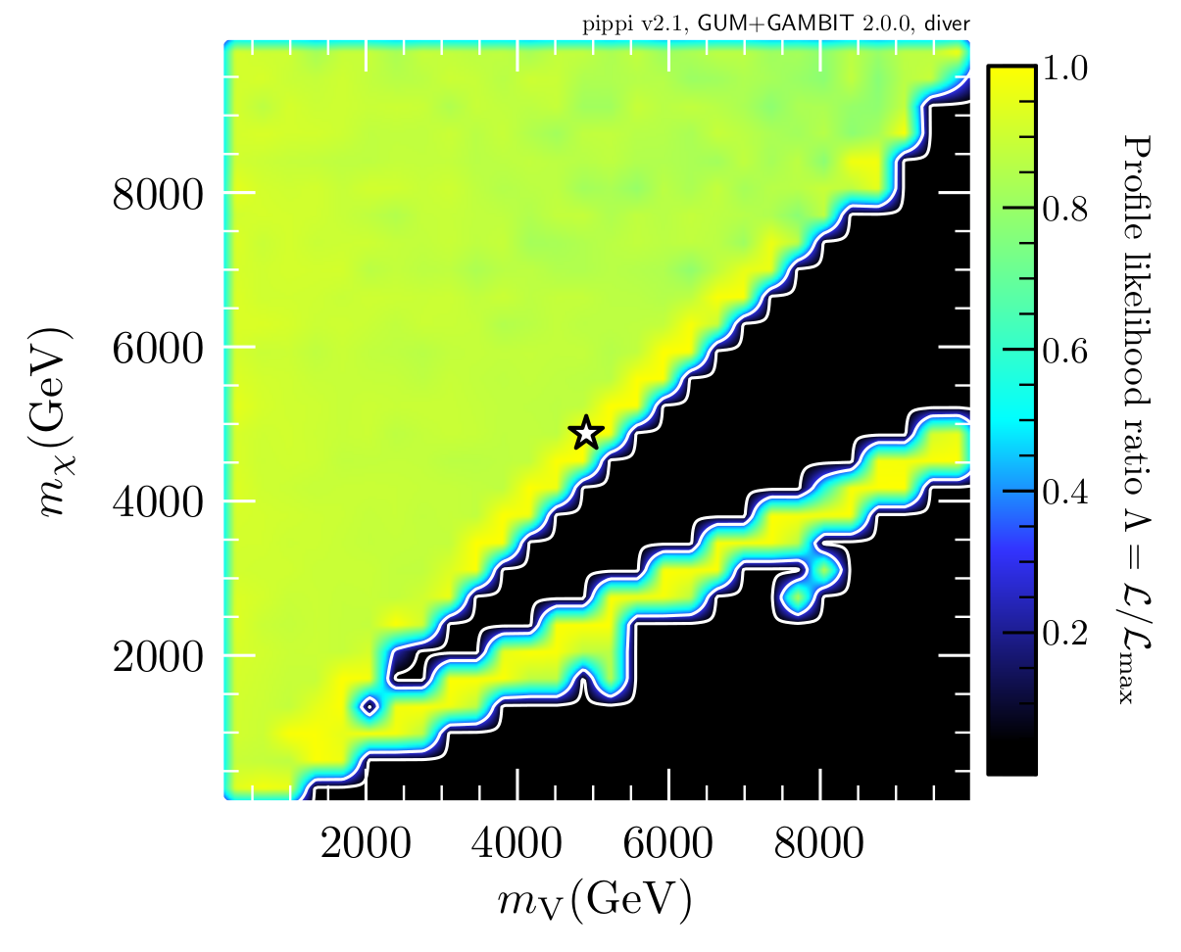
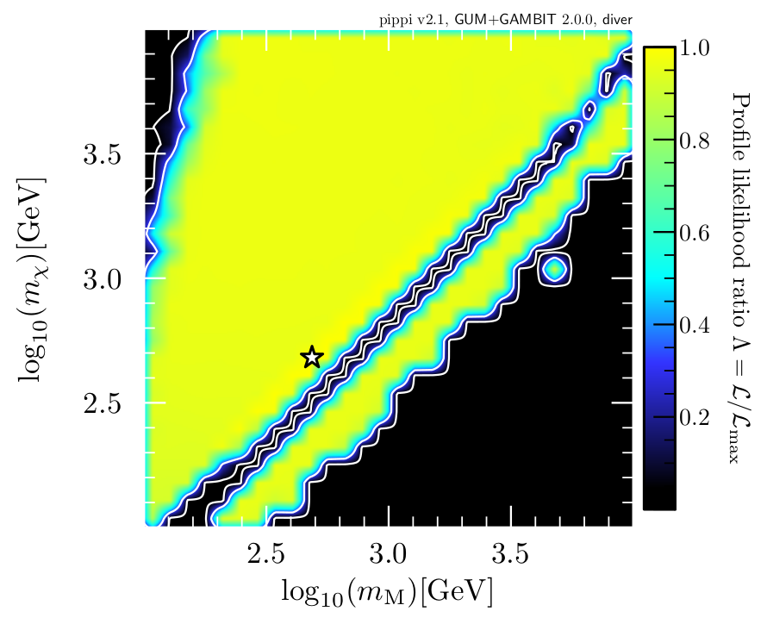
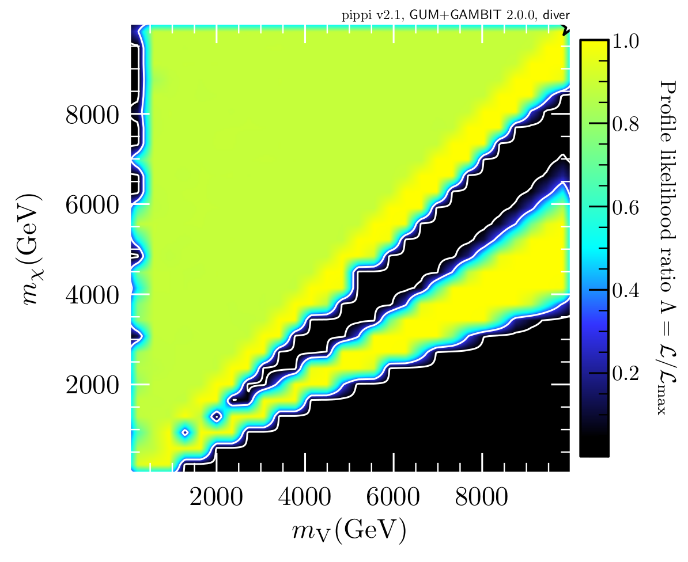
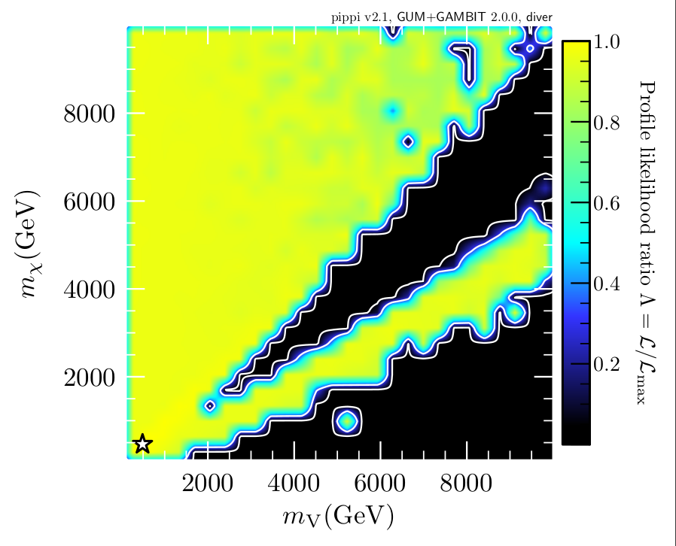
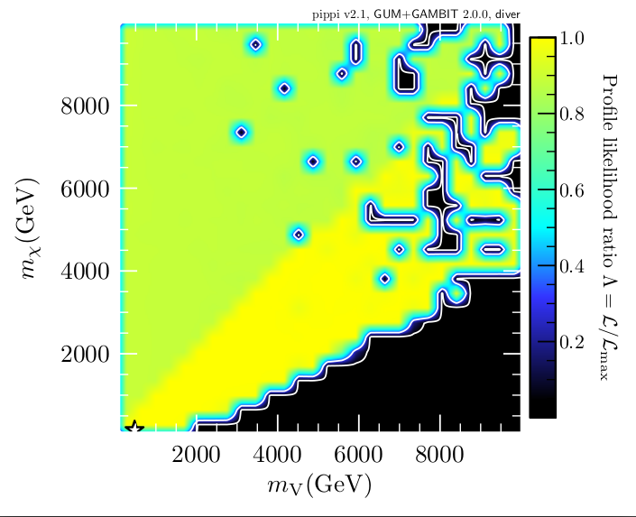
Vector Mediated:
Scalar DM Dirac Fermion DM Vector DM
2 sigma exclusion limits are from the relic abundance upper limits.
The slight preference as mediator mass exceeds DM mass is due to gamma ray indirect detection limits

Slide 14
Summary
GUM: new addition to GAMBIT for auto-generation for global scans
The paper is just recently released on arXiv:2107.00030
A simplified model study can demonstration of the power of GUM
Relic density upper limits dominate dark matter constraints
Can escape limits around resonance and often when DM mass > mediator mass

