Slide 1
Leptophilic Gauge Bosons at ILC Beam Dump Experiment
Atsuya Niki (U. Tokyo)
Collabolate with Kento Asai and Takeo Moroi
Phys. Lett. B 818 136374 (2104.00888 [hep-ph])
Asia-Pacific Workshop on Particle Physics and Cosmology 2021, 4 August 2021

Slide 2
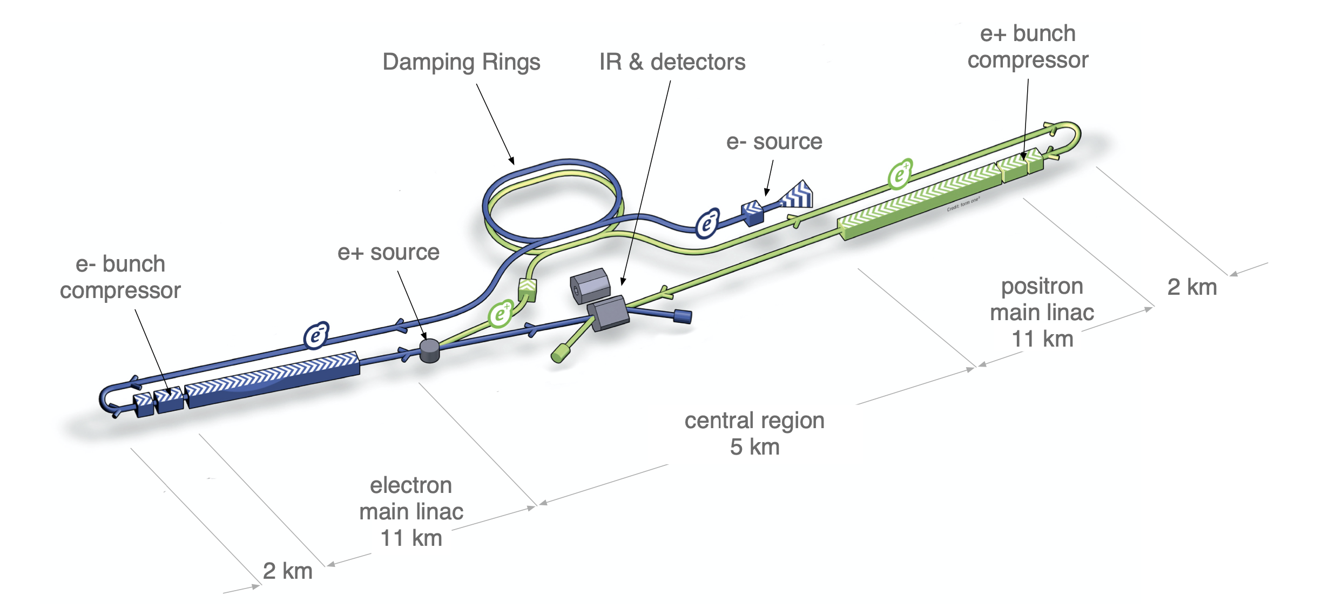
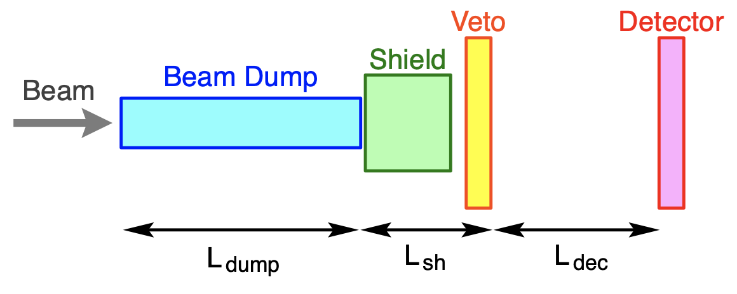
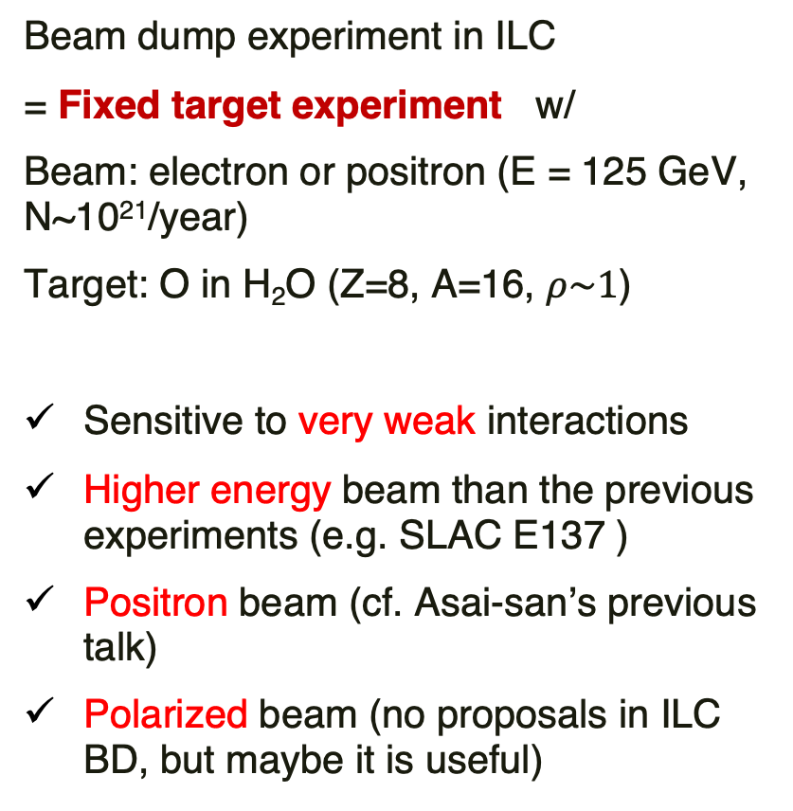
ILC Beam Dump Experiment
Beam dump experiment in ILC
= Fixed target experiment w/
Beam: electron or positron (E = 125 GeV, N~10²¹/year)
Target: O in H₂O (Z=8, A=16, $ρ\sim 1$)
Sensitive to very weak interactions
Higher energy beam than the previous experiments (e.g. SLAC E137 )
Positron beam (cf. Asai-san’s previous talk)
Polarized beam (no proposals in ILC BD, but maybe it is useful)
Beam dumps
1306.6327
X
S. Kanemura et al., 1507.02809

Slide 3
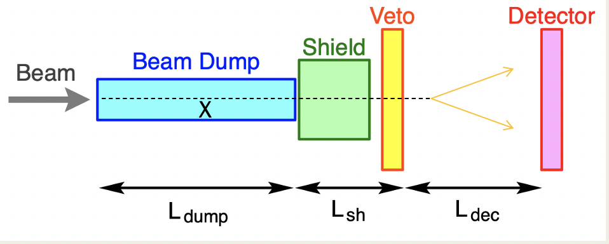
Models
Fixed target experiment has advantage to search for weakly coupling particles.
In our experimental setup (visible decay search), long-lived particle which decays into SM charged particles can be searched with few BG.
Some papers about ILC beam dump experiment are submitted as following:
In our work, we consider the leptophilic gauge boson, which may be weakly coupled to SM and long-lived particle
Model | production | paper
Dark Photon | Bremsstrahlung | S. Kanemura et al., 1507.02809
Dark Photon | Annihilation | K. Asai et al., 2105.13768
Axion | Bremsstrahlung | Y. Sakaki et al., 2009.13790
Axion | Annihilation Primakoff | K. Asai et al., 2105.13768

Slide 4
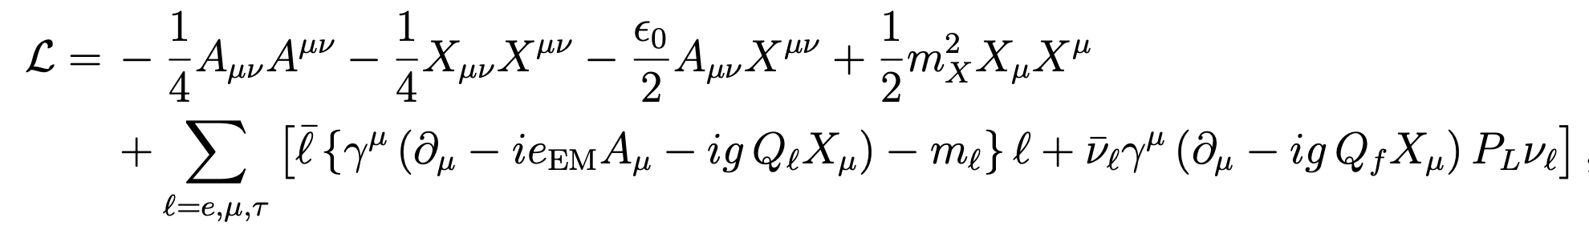
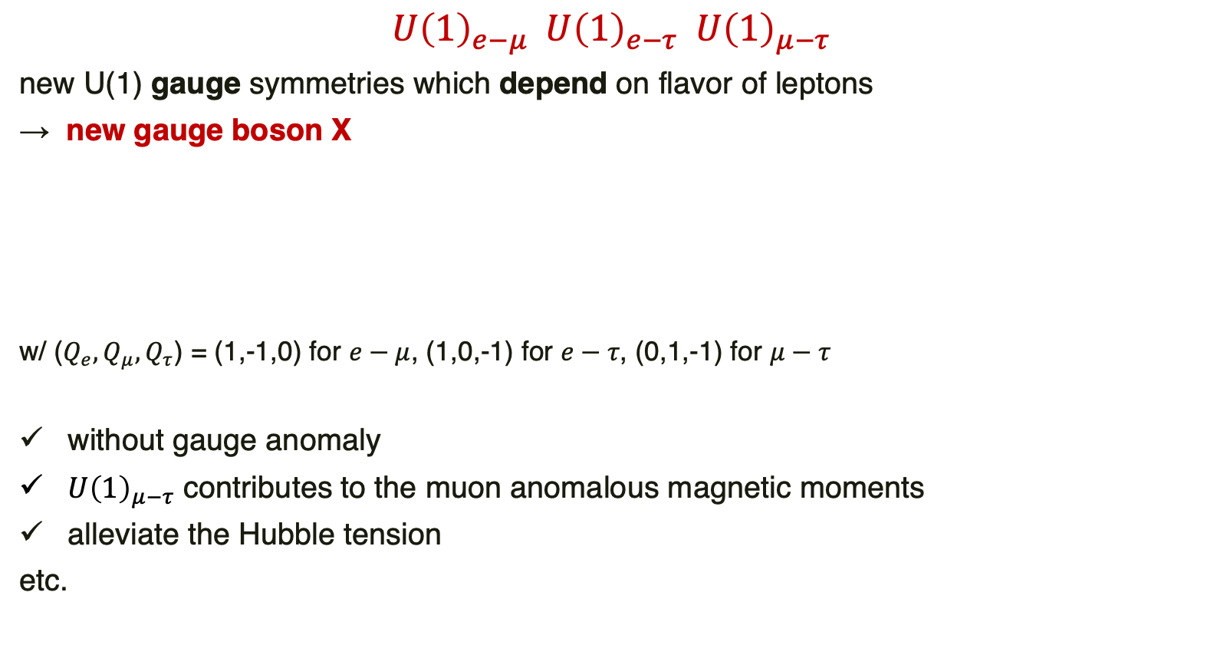
Leptophilic Gauge Bosons
$$U{\left(1\right)}_{e−μ} U{\left(1\right)}_{e−τ} U{\left(1\right)}_{μ−τ}$$
new U(1) gauge symmetries which depend on flavor of leptons
→ new gauge boson X
w/ ($Q_{e}, Q_{μ}, Q_{τ}$) = (1,-1,0) for $e−μ$, (1,0,-1) for $e−τ$, (0,1,-1) for $μ−τ$
without gauge anomaly
$U{\left(1\right)}_{μ−τ}$ contributes to the muon anomalous magnetic moments
alleviate the Hubble tension
etc.
Unknown parameters

Slide 5
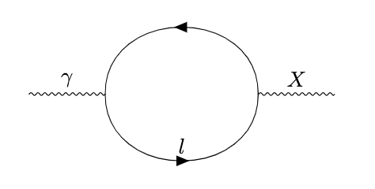
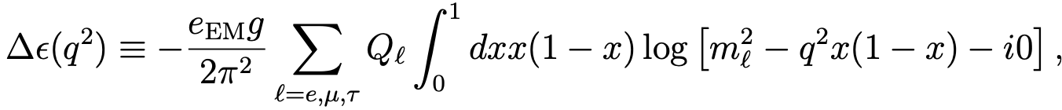
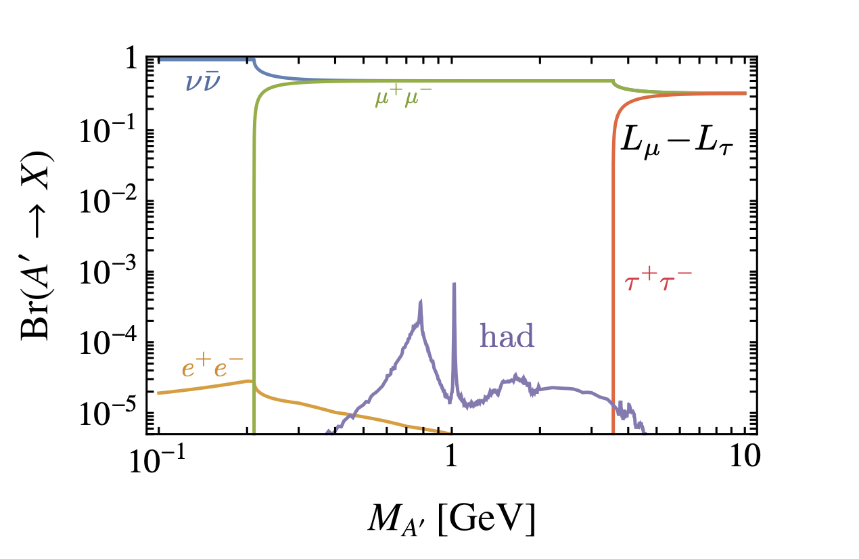
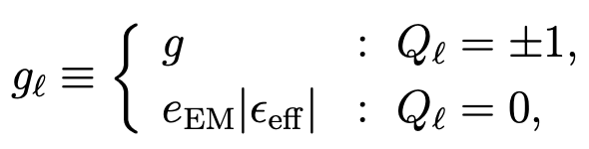

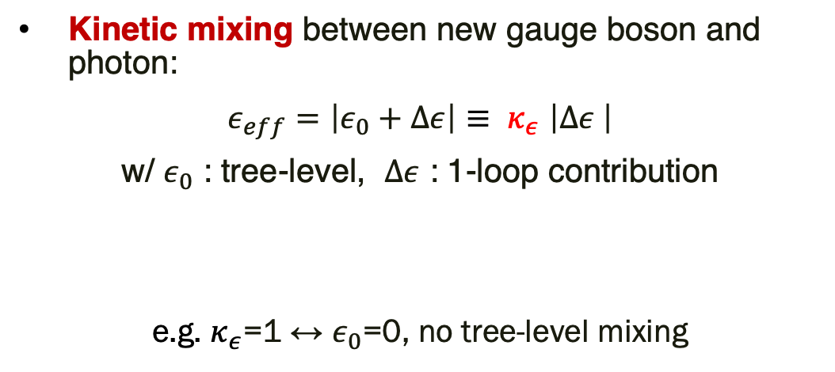
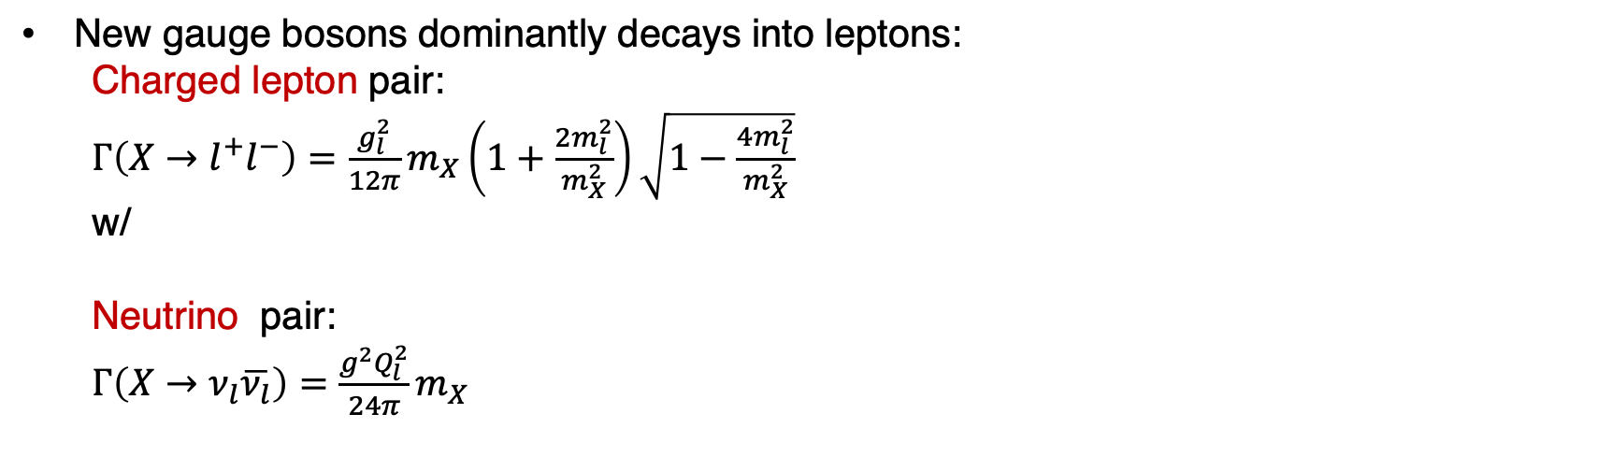
Kinetic mixing between new gauge boson and photon:
$ε_{eff}=\left|ε_{0}+Δε\right|{≡ κ}_{ε}\left|Δε \right|$
w/ $ε_{0}$ : tree-level, $Δε$ : 1-loop contribution
e.g. $κ_{ε}$=1 ↔︎ $ε_{0}$=0, no tree-level mixing
e.g. $U{\left(1\right)}_{μ−τ}$ 1803.05466
New gauge bosons dominantly decays into leptons:
Charged lepton pair:
$Γ\left(X→l^{+}l^{−}\right)=\frac{g_{l}^{2}}{12π}m_{X}\left(1+\frac{2m_{l}^{2}}{m_{X}^{2}}\right)\sqrt{1−\frac{4m_{l}^{2}}{m_{X}^{2}}}$
w/
Neutrino pair:
$Γ\left(X→ν_{l}\overline{ν_{l}}\right)=\frac{g^{2}Q_{l}^{2}}{24π}m_{X}$

Slide 6
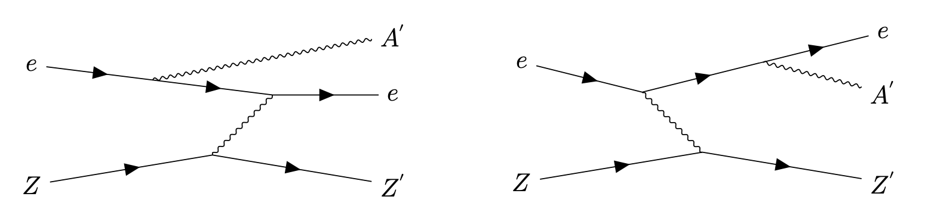
Production of Leptophilic Gauge Bosons
Leptophilic gauge bosons are produced by Bremsstrahlung process from e⁻ , e⁺ beam:
Event rate N_{sig} is given by the following formula and can be calculated numerically:
We calcuarete N_{sig} at each (m_{X}, g) numerically and show the contours which correspond to 10⁻²,1,10² events on the (m_{X}, g) plane.
ISR
FSR
Z: nucleus, A’: new gauge boson

Slide 7


Discovery Reaches at ILC BD
$$U{\left(1\right)}_{e−μ}, { κ}_{ε}=1$$
$U{\left(1\right)}_{e−τ}$ $, { κ}_{ε}=1$
TEXONO
Beam energy
TEXONO
: 125 GeV
: 250 GeV
: 500 GeV
Previous beam dump
experiments
Previous beam dump
experiments
N_{sig}=10²
N_{sig}=10²
N_{sig}=1
N_{sig}=1
N_{sig}=10⁻²
N_{sig}=10²
Color ↔︎ Beam energy: 125 GeV (green), 250 GeV (red), 500 GeV (blue)
Line shape ↔︎ event rate: 10⁻² (dotted), 1 (solid), 10² (dashed line)
Discovery reaches are similar because new gauge bosons directly couples to electron in both of the models.

Slide 8
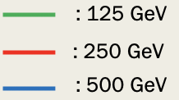

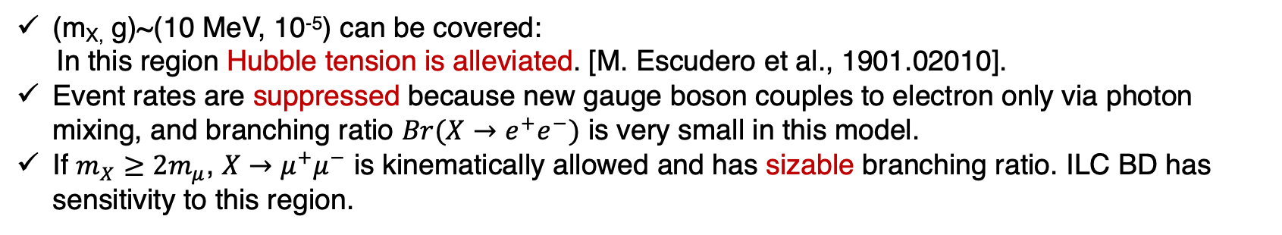


$$U{\left(1\right)}_{μ−τ}$$
$$U{\left(1\right)}_{μ−τ}, { κ}_{ε}=1$$
$$U{\left(1\right)}_{μ−τ}, { κ}_{ε}=5$$
N_{sig}=1
N_{sig}=10⁻²
N_{sig}=1
N_{sig}=10⁻²
BBN
SN1987A
(m_{X,} g)~(10 MeV, 10⁻⁵) can be covered:
In this region Hubble tension is alleviated. [M. Escudero et al., 1901.02010].
Event rates are suppressed because new gauge boson couples to electron only via photon mixing, and branching ratio $Br(X→e^{+}e^{−})$ is very small in this model.
If $m_{X}≥2m_{μ}$, $X→μ^{+}μ^{−}$ is kinematically allowed and has sizable branching ratio. ILC BD has sensitivity to this region.

Slide 9
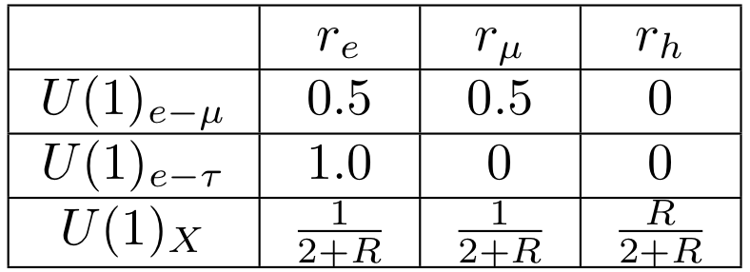
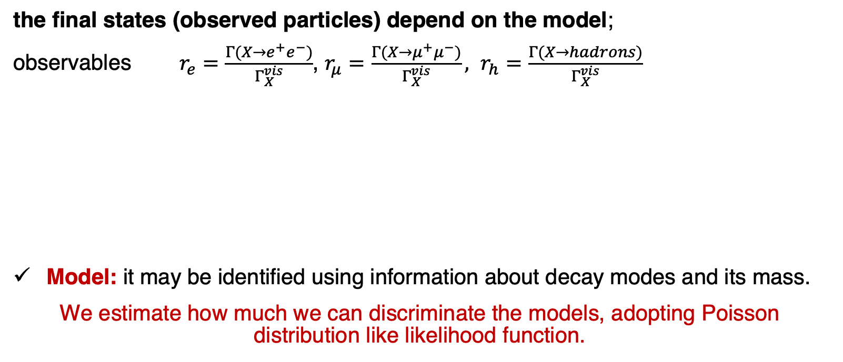
Discrimination of Models after the Discovery
the final states (observed particles) depend on the model;
observables $r_{e}=\frac{Γ(X→e^{+}e^{−})}{Γ_{X}^{vis}}$, $r_{μ}=\frac{Γ(X→μ^{+}μ^{−})}{Γ_{X}^{vis}}, r_{h}=\frac{Γ(X→hadrons)}{Γ_{X}^{vis}}$
Model: it may be identified using information about decay modes and its mass.
We estimate how much we can discriminate the models, adopting Poisson distribution like likelihood function.
w/ R: R-ratio

Slide 10




e.g. $U{\left(1\right)}_{e−μ}$ Gauge Boson
$$U{\left(1\right)}_{e−μ}, { N}_{sig}=10,{ (n}_{e},n_{μ},n_{h})=\left(5,5,0\right),$$
$U{\left(1\right)}_{e−μ}, { N}_{sig}=20$, ${ (n}_{e},n_{μ},n_{h})=\left(10,10,0\right)$
Dark Photon
Dark Photon
600 MeV
500 MeV
$$U{\left(1\right)}_{e−τ}$$
$$U{\left(1\right)}_{e−τ}$$
White line: theoretical prediction of dark photon model
White points: Dark photon prediction with mass = 400, 450, 500, 550, 600 MeV from below
We can discriminate $U{\left(1\right)}_{e−τ}$ model 95% level with 10 signals.
With 20 signals and $m_{X}≥500 MeV$, we can discriminate dark photon model.

Slide 11
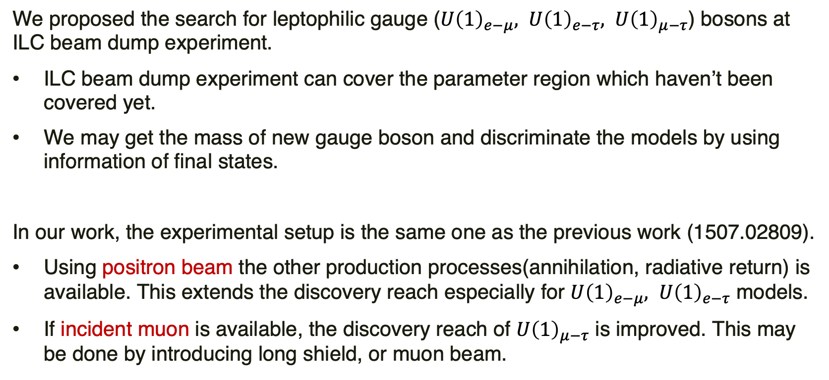
Summary
We proposed the search for leptophilic gauge ($U{\left(1\right)}_{e−μ}, U{\left(1\right)}_{e−τ}, U{\left(1\right)}_{μ−τ}$) bosons at ILC beam dump experiment.
ILC beam dump experiment can cover the parameter region which haven’t been covered yet.
We may get the mass of new gauge boson and discriminate the models by using information of final states.
In our work, the experimental setup is the same one as the previous work (1507.02809).
Using positron beam the other production processes(annihilation, radiative return) is available. This extends the discovery reach especially for $U{\left(1\right)}_{e−μ}, U{\left(1\right)}_{e−τ}$ models.
If incident muon is available, the discovery reach of $U{\left(1\right)}_{μ−τ}$ is improved. This may be done by introducing long shield, or muon beam.

Slide 12
Backup

Slide 13
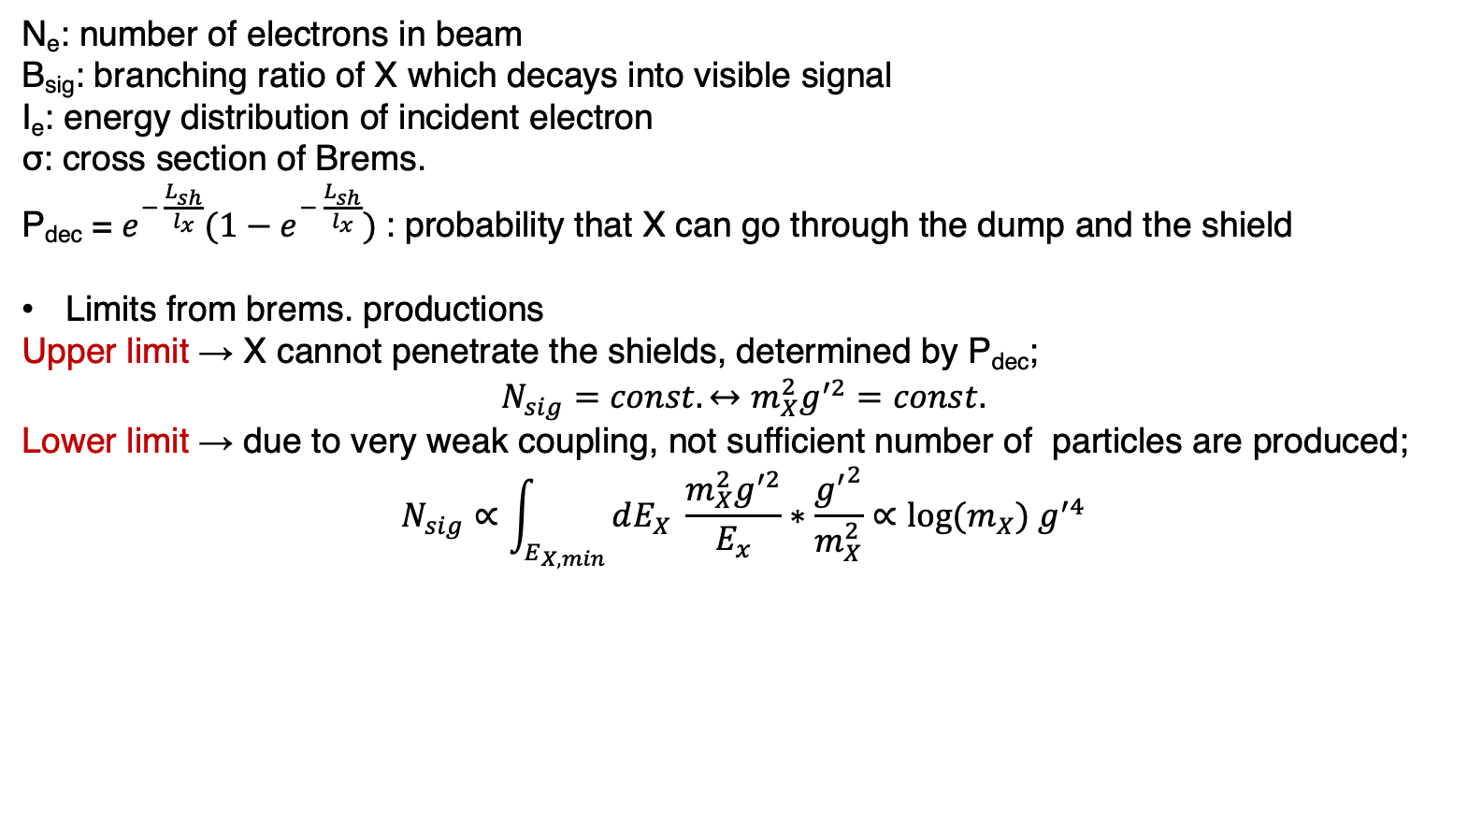
Event rate
N_{e}: number of electrons in beam
B_{sig}: branching ratio of X which decays into visible signal
I_{e}: energy distribution of incident electron
σ: cross section of Brems.
P_{dec} = $e^{− \frac{L_{sh}}{l_{x}}}(1−e^{− \frac{L_{sh}}{l_{x}}})$: probability that X can go through the dump and the shield
Limits from brems. productions
Upper limit → X cannot penetrate the shields, determined by P_{dec};
$$N_{sig}=const. ↔m_{X}^{2}g^{′2}=const.$$
Lower limit → due to very weak coupling, not sufficient number of particles are produced;
$$N_{sig}∝\int_{E_{X,min}}{dE_{X} \frac{m_{X}^{2}g^{′2}}{E_{x}}∗\frac{{g^{′}}^{2}}{m_{X}^{2}}}∝{log⁡(m}_{X}) g^{′4}$$
P_{dec}
σ

Slide 14
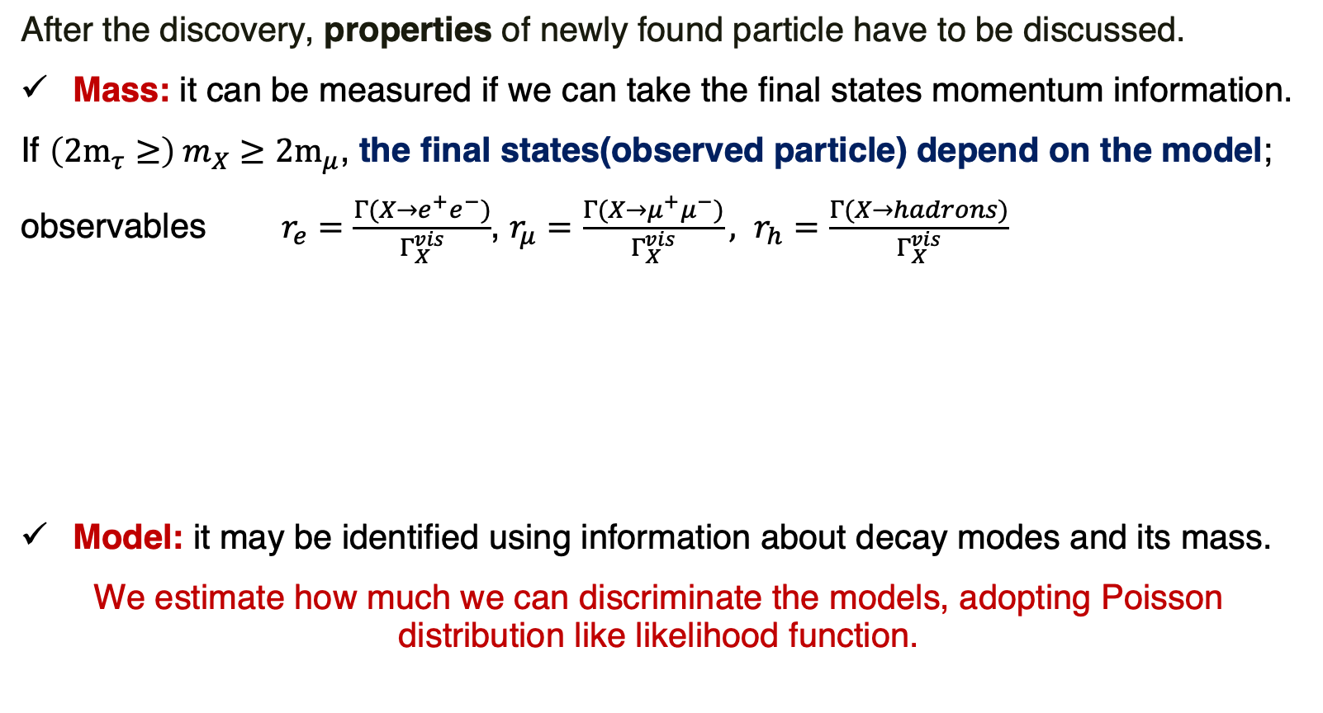
Discrimination of Models
After the discovery, properties of newly found particle have to be discussed.
Mass: it can be measured if we can take the final states momentum information.
If $\left(2m_{τ}≥\right) m_{X}≥{2m}_{μ}$, the final states(observed particle) depend on the model;
observables $r_{e}=\frac{Γ(X→e^{+}e^{−})}{Γ_{X}^{vis}}$, $r_{μ}=\frac{Γ(X→μ^{+}μ^{−})}{Γ_{X}^{vis}}, r_{h}=\frac{Γ(X→hadrons)}{Γ_{X}^{vis}}$
Model: it may be identified using information about decay modes and its mass.
We estimate how much we can discriminate the models, adopting Poisson distribution like likelihood function.

Slide 15



e.g. $U{\left(1\right)}_{e−τ}$ Gauge Boson
$$U{\left(1\right)}_{e−τ}, { N}_{sig}=5,{ (n}_{e},n_{μ},n_{h})=\left(5,0,0\right),$$
$U{\left(1\right)}_{e−τ}, { N}_{sig}=10$, ${ (n}_{e},n_{μ},n_{h})=\left(10,0,0\right)$
600 MeV
Dark Photon
Dark Photon
500 MeV
Dark Photon
White line: theoretical prediction of dark photon model
White points: Dark photon prediction with mass = 400, 450, 500, 550, 600 MeV from below

