Slide 1
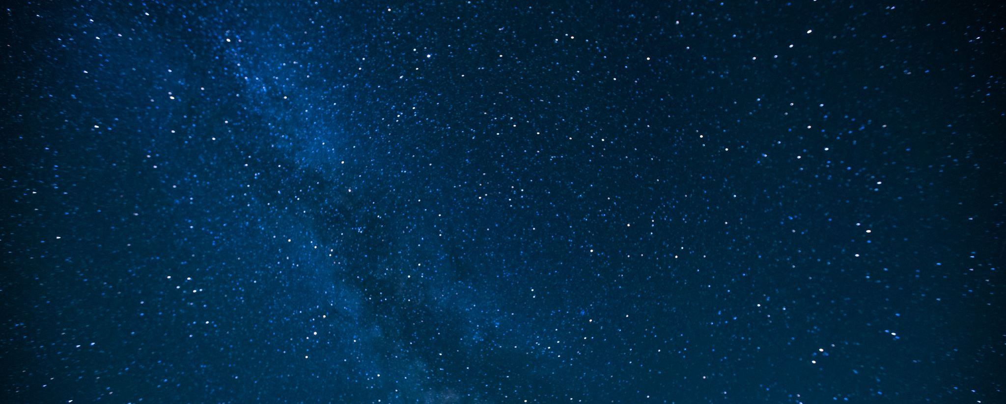
Improving Dark Matter Capture in Neutron Stars
Michael Virgato
Asia-Pacific Workshop on Particle Physics and Cosmology 2021
Based on works: N.F. Bell, G. Busoni, S. Robles and MV: 2004.14888, 2010.13257
+ T.F. Motta and A Thomas: 2012.08918
+ F. Anzuini: 2108.02525

Slide 2
Neutron Stars as Probes for Dark Matter
Neutron Stars are highly efficient at capturing Dark Matter due to
Extreme densities $\sim 0.3$ fm⁻³
Velocities boosted to $v_{χ}\sim 0.3c−0.7c$
Treat spin-dependent/independent interactions agnostically
Effectively wipes out velocity/momentum suppression in interactions
Capture + Annihilation will heat star to infra-red temperatures (Baryakhtar et.al. 1704.01577, Raj et.al. 1707.09442)
Observations of old, cold Neutron Star can be used to set potential bounds
Michael Virgato
Notes:
Main reasons:
Highly efficient at capturing DM:
High densities
Large velocities
Recent interest due to capture + ann. Heating the star to infrared temperatures
High densities allow agnostic treatment of spin dependence
Large velocities wipe out any such suppression

Slide 3
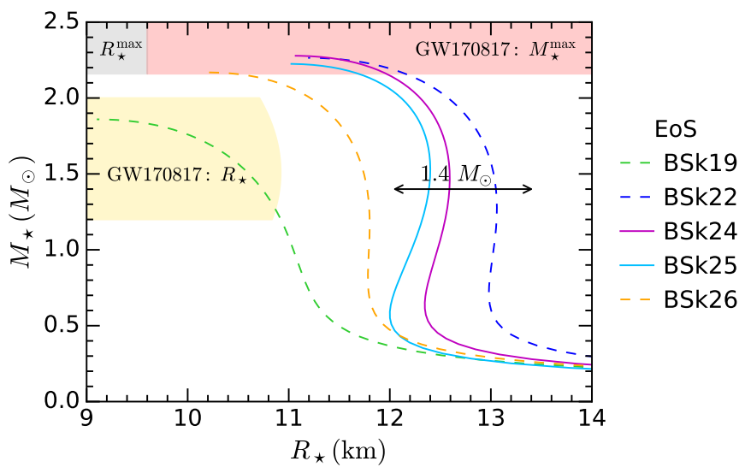
Neutron Star Model: $Npeμ$ matter
Unified Equation of State for cold, non-accreting matter using Brussels-Montreal functionals (Pearson el.al. 1903.04981)
Gives consistent description from crust to core
Authors provide helpful analytic fits
EoS config: | BSk24-1 | BSk24-2 | BSk24-3 | BSk24-4
$$ρ_{c} (g cm^{−3})$$ | $$5.95×{10}^{14}$$ | $$7.76×{10}^{14}$$ | $$1.04×{10}^{15}$$ | $$1.42×{10}^{15}$$
$$n_{b}^{c} ( fm^{−3})$$ | $$0.330$$ | $$0.430$$ | $$0.594$$ | $$0.670$$
$$M_{⋆} (M_{⊙})$$ | $$1.000$$ | $$1.500$$ | $$1.900$$ | $$2.160$$
$$R_{⋆} (km)$$ | $$12.215$$ | $$12.593$$ | $$12.419$$ | $$11.965$$
$$B(R_{⋆})$$ | $$0.763$$ | $$0.648$$ | $$0.548$$ | $$0.467$$
$$dτ^{2}=B\left(r\right)dt^{2}−…$$
Benchmark Config.
Bell, Busoni, Robles and M V2010.13257
Michael Virgato
Notes:
Npemu matter at zero temperature
Use BSk unified EoS from Brussels-Montreal group
Unified desription
Fits allow easy solution of TOV equations
Of these chose BSk24
Chose 1.5 Msol as benchmark configuration
Chose BSk24 because:
Slightly better fit to obs data than 25
Others ruled out but titdal deformability constraints/ presence of Direct urca processes

Slide 4
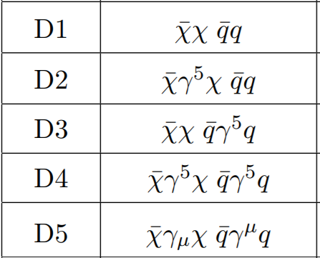
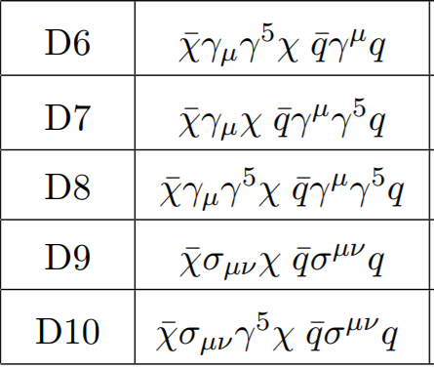
Effective Field Theory for Dark Matter
Focus on Dimention-6 EFT operators for Dirac fermion DM
Michael Virgato
Notes:
Choose to use EFT to remain model independent for DD comparison
Do assume Dirac fermion

Slide 5
Dark Matter Capture Process
DM capture in celestial bodies well established (Press and Spergel ’85, Griest and Seckel ’86, Gould ’87, Goldman et.al. ’89, Gould ‘89)
Including Multiple Scattering (Bramante et.al. 1703.04043 , Dasgupta et.al. 1906.04204)
NSs require:
Relativistic kinematics (targets and DM)
Correct treatment of degenerate targets (Garani et.al 1812.08773)
Baryon strong interactions
Consider NS in Local neighbourhood:
Maxwell-Boltzmann velocity dispersion: $v_{d}∼270 km/s$
NS relative velocity to DM halo: $v_{⋆}∼230 km/s$
$$χ$$
$$v_{χ}∼v_{d}$$
$$NS$$
Michael Virgato
Notes:
Capture well established
Even in NS
Used to consider collapse to black hole
Recent interest in heating NS
What separates from other objects like the sun
Relativity (special and general)
Pauli-blocking (often approximated)
Interacting Baryons
Take NS in local neighbourhood
DM halo has MB dist with vel disp
NS moves with relative velocity
Infalling DM gets boosted

Slide 6
Dark Matter Capture Process
DM capture in celestial bodies well established (Press and Spergel ’85, Griest and Seckel ’86, Gould ’87, Goldman et.al. ’89, Gould ‘89)
Including Multiple Scattering (Bramante et.al. 1703.04043 , Dasgupta et.al. 1906.04204)
NSs require:
Relativistic kinematics (targets and DM)
Correct treatment of degenerate targets (Garani et.al 1812.08773)
Baryon strong interactions
Consider NS in Local neighbourhood:
Maxwell-Boltzmann velocity dispersion: $v_{d}∼270 km/s$
NS relative velocity to DM halo: $v_{⋆}∼230 km/s$
DM boosted to $\sqrt{v_{e}^{2}+v_{d}^{2}}∼v_{e}∼0.3c−0.7c$
$$χ$$
$$χ$$
$$v_{χ}∼v_{e}$$
$$v_{χ}∼v_{d}$$
$$NS$$
Michael Virgato
Notes:
Well established
What we require
Take NS in local neighbourhood
DM halo has MB dist with vel disp
NS moves with relative velocity
Infalling DM gets boosted
Leaves calulcation independent of initial velocity

Slide 7
Dark Matter Capture Process
DM capture in celestial bodies well established (Press and Spergel ’85, Griest and Seckel ’86, Gould ’87, Goldman et.al. ’89, Gould ‘89)
Including Multiple Scattering (Bramante et.al. 1703.04043 , Dasgupta et.al. 1906.04204)
NSs require:
Relativistic kinematics (targets and DM)
Correct treatment of degenerate targets (Garani et.al 1812.08773)
Baryon strong interactions
Consider NS in Local neighbourhood:
Maxwell-Boltzmann velocity dispersion: $v_{d}∼270 km/s$
NS relative velocity to DM halo: $v_{⋆}∼230 km/s$
DM boosted to $\sqrt{v_{e}^{2}+v_{d}^{2}}∼v_{e}∼0.7c$
$$χ$$
$$χ$$
$$χ$$
$$v_{χ}<v_{e}$$
$$v_{χ}∼v_{d}$$
$$NS$$
Michael Virgato
Notes:
Well established
What we require
Take NS in local neighbourhood
DM halo has MB dist with vel disp
NS moves with relative velocity
Infalling DM gets boosted
Scatters with target and captured if

Slide 8
Capture Rate
Total capture rate is then $C=\frac{4π}{v_{⋆}}\frac{{ ρ}_{χ}}{m_{χ}}Erf\left(\sqrt{\frac{3}{2}}\frac{v_{⋆}}{v_{d}}\right)\int_{0}^{R_{⋆}}{dr r^{2} }\frac{\sqrt{1−B\left(r\right)}}{B\left(r\right)}Ω^{−}\left(r\right)$ $Ω^{−}\left(r\right)=\int{dt dE_{n} ds}ζ\left(r\right)\frac{dσ}{dcosθ_{cm}}\frac{E_{n}}{2π^{2}m_{χ}}\sqrt{\frac{B\left(r\right)}{1−B\left(r\right)}}\frac{s}{β\left(s\right)γ\left(s\right)}f_{FD}(E_{n})(1−f_{FD}\left(E_{n}^{′}\right))$
DM flux
Simplifying functions:
$$β\left(s\right)=s −\left(m_{χ}^{2}+m_{n}^{2}\right) \\ γ\left(s\right)=\sqrt{β^{2}\left(s\right)−4m_{n}^{2}m_{χ}^{2}}$$
Gravitational Focusing
Interaction Rate:
Number density correction: $\frac{n_{n}\left(r\right)}{n_{free}}$
(Garani et al. 1812.08773)
( $→1$ for interacting baryons)
Pauli Blocking
Relativistic kinematics
Differential cross section
Bell, Busoni, Robles and MV 2004.14888
Michael Virgato
Notes:
DM flux integrated over
Gravitational focusing
Interaction rate
Relativistic kinematics factor
Number density correction due to free fermi gas treatment
Cross section, particle physics input
Pauli blocking factor to account for empty final states

Slide 9
Geometric Limit
Maximum rate of capture given by geometric limit $C_{geom}∼3.84×{10}^{25}s^{−1}\left(\frac{1GeV}{m_{χ}}\right)$
Corresponds to cross sections above a threshold value $σ_{th}\sim \left\{\begin{aligned}σ_{ref}\frac{GeV}{m_{χ}}, m_{χ}<1GeV \\ σ_{ref}, {1 GeV< m}_{χ}<{10}^{6} GeV \\ σ_{ref}\frac{m_{χ}}{{10}^{6}GeV}, {10}^{6} GeV<m_{χ }\end{aligned}\right.$ ${ σ}_{ref}∼{10}^{−45}cm^{2}$
Pauli Blocking
Intermediate
Multi-scatter
(Raj et.al. 1707.09442)
Michael Virgato
Notes:
There is a maximum limit to the capture rate
Different scalings in different mass regions

Slide 10
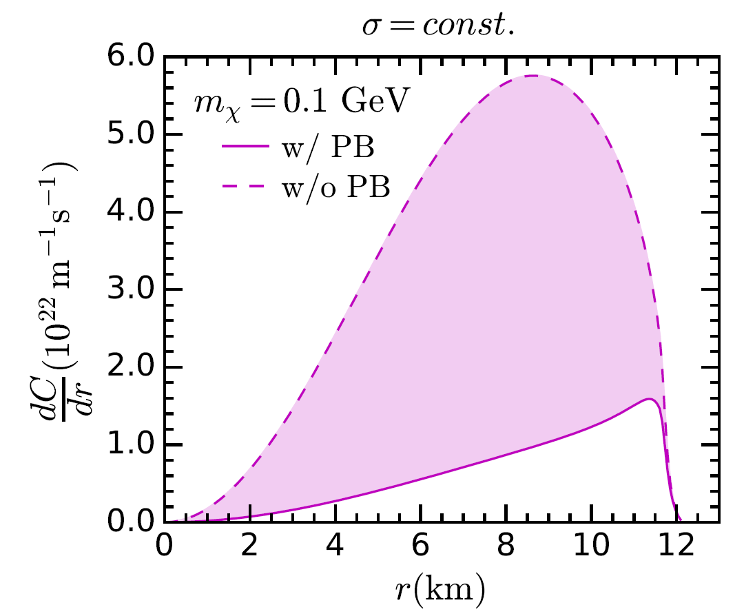
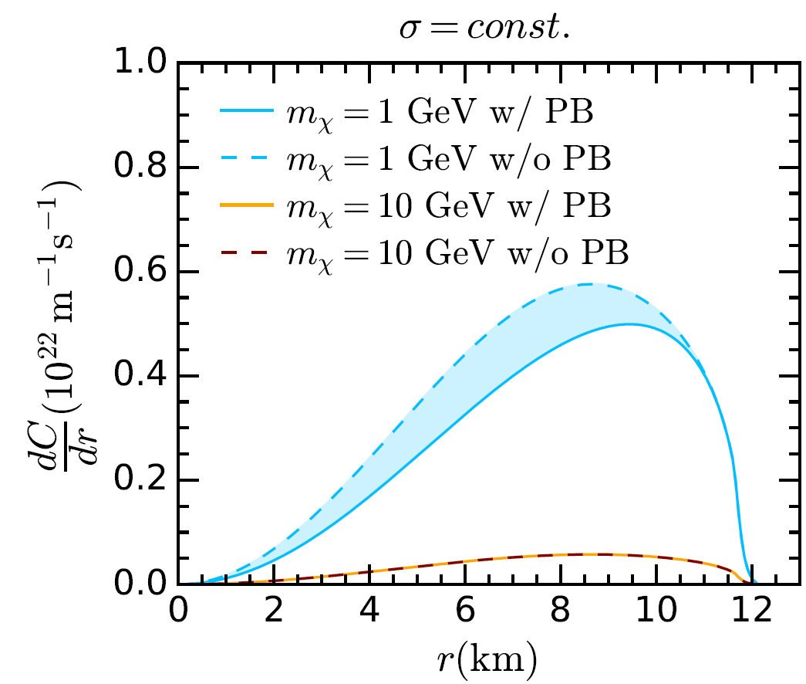
Pauli Blocking ($m_{χ}<1 GeV)$
Require momentum transfers
$$p_{final}=p_{initial}+q>p_{F}$$
Only targets close to Fermi-Surface interact
Effect seen in radial profile of differential capture rate
Increasing $μ_{F}$
Michael Virgato
Bell, Busoni, Robles and MV 2004.14888
Notes:
PB region
Min momentum transfer required to eject above Fermi mom
Only those close to fermi surface can interact
Effect on cap rate seen in differential radial profs

Slide 11
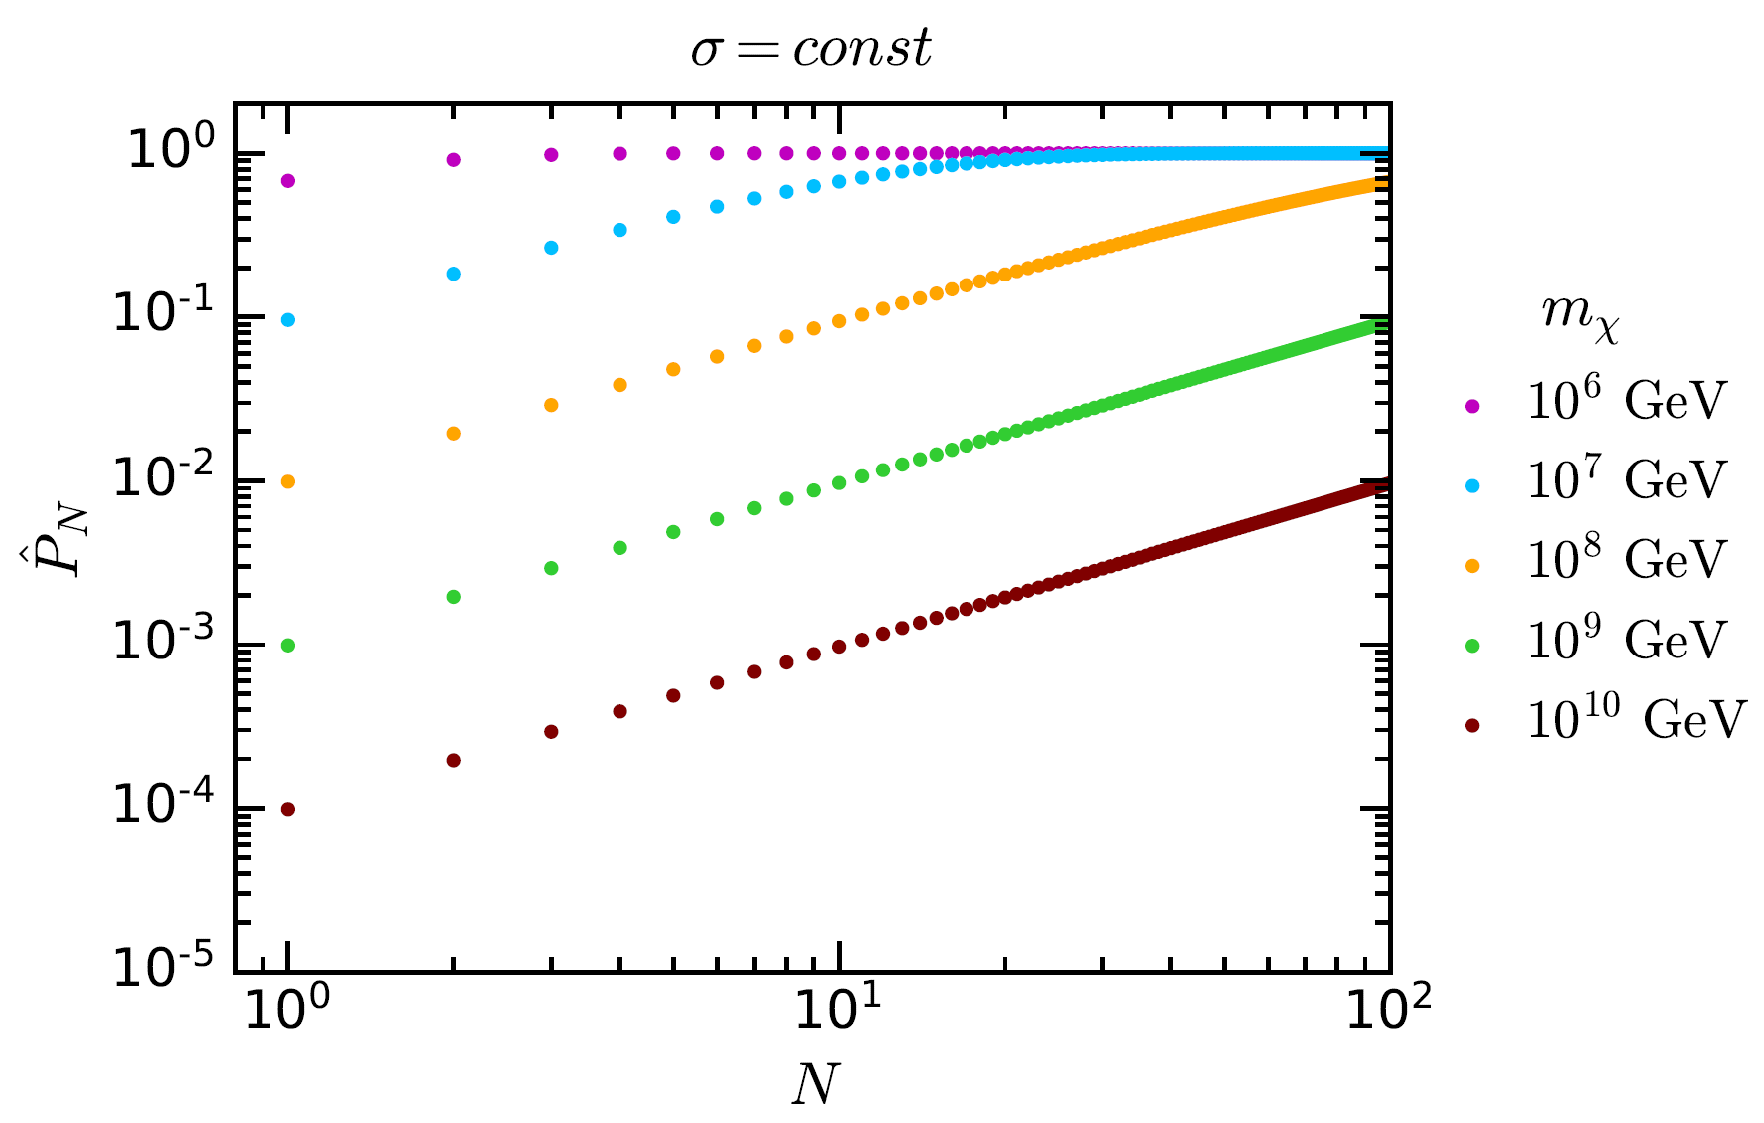
Multiple Scattering ($m_{χ}>{10}^{6} GeV$)
$${\hat{P}}_{1}$$
Min. energy loss required not achieved in single scatter
Include factor${\hat{P}}_{1}$ in master equation
Cumulative probability of capture after N interactions
Michael Virgato
Bell, Busoni, Robles and MV 2004.14888
Notes:
Multi scatter
Min energy loss not ensured
Need multiple scatterings
Show cumulative probability that capture occurs in N scatters
P1 drops
Mstar a fitted parameter

Slide 12
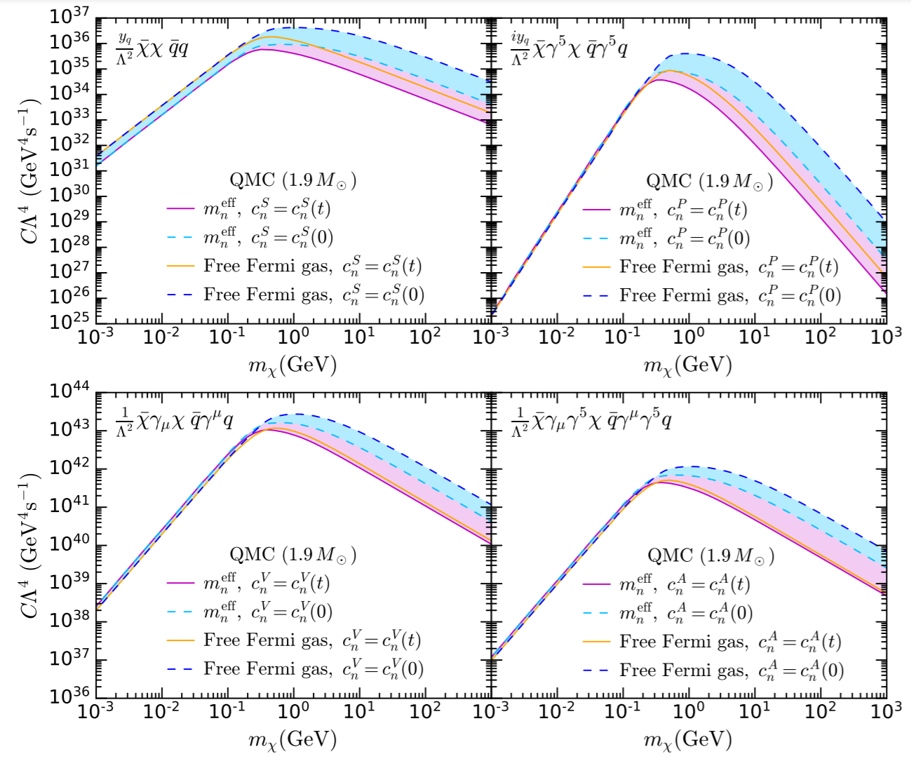
Nucleon Form Factors and Strong Interactions
Nucleon form factors are momentum dependent: $c_{N}^{i}→\frac{c_{N}^{i}}{{\left(1−\frac{t}{Q_{0}^{2}}\right)}^{2}}$ $Q_{0}∼0.9 GeV$
Nucleons are strongly interacting: $m_{N}→m_{N}^{eff}$ $ζ(r)→1$
Note: QMC EoS used here, not BSk-24 (Motta et.al. 1904.03794)
Michael Virgato
Bell, Busoni, Motta, Robles, Thomas and MV 2012.08918
Notes:
Evaluate FFs at relevant energy scale as opposed to in DD
Nucleons not point-like
Leads to lower momentum transferred being favoured
Also include nucleons strongly interacting
QMC relativistic and self consistently accounts for this
Overall shift for interactions propto m_n
Changes kinematics of problem
Low mass region:
Little effect as mom. Transfer already small
Large mass:
Interaction rate spectrum becomes peaked at lower mom. Transfers leading to suppressions in both cases
Effects not additive as kinematics no-trivially changed

Slide 13
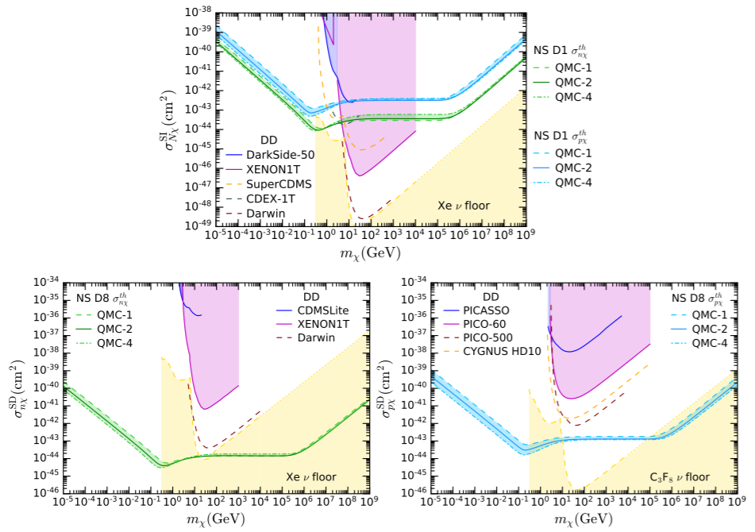
Nucleon Threshold Cross Sections
Pauli Blocking:
$$σ_{th}∝1/m_{χ}$$
SI
Multiple Scattering:
$$σ_{th}∝m_{χ}$$
SD
SD
Anzuini, Bell, Busoni, Motta, Robles, Thomas and MV 2108.02525
Michael Virgato

Slide 14
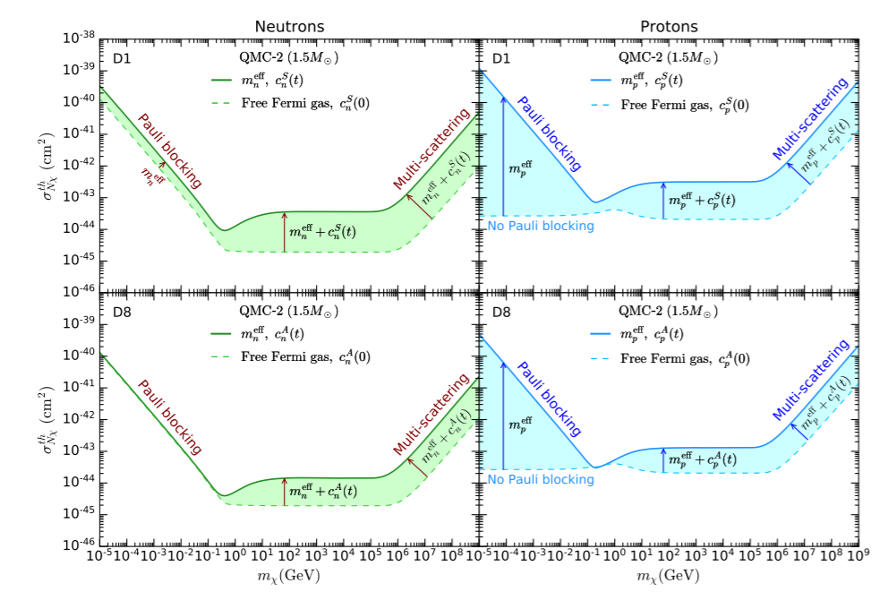
Nucleon Threshold Cross Sections
Dashed lines:
Free-Fermi Gas
No momentum dep. FF
Solid:
Interacting Baryons
Momentum dep. FF
Anzuini, Bell, Busoni, Motta, Robles, Thomas and MV 2108.02525
Michael Virgato
Notes:
Compare Free-Fermi, 0 mom transfer FF to interacting baryons +mom dep FF
Threshold cross section supressed in intermediate and high DM mass ranges
Protons, Free Fermi leads to non-degen, no pauli blocking

Slide 15
Summary
Neutron Stars offer unique laboratory to study Dark Matter
The capture rate is a key ingredient
We consistently incorporate important pieces of physics including:
Neutron Star internal structure
Relativistic Kinematics
Pauli Blocking
Multiple Scattering
Strong Interactions and Momentum dependent Form Factors (for baryons)
Michael Virgato

Slide 16
Thank you
Questions?
Michael Virgato

