Slide 1
Cloud Cooling Bounds on Intermediate Mass and Light Primordial Black Holes
arXiv:2007.02213​
arXiv:2009.11837
arXiv:2105.06099
arXiv:2111.08699
Philip Lu
Seoul National University
November 26-28, 2021

Slide 2
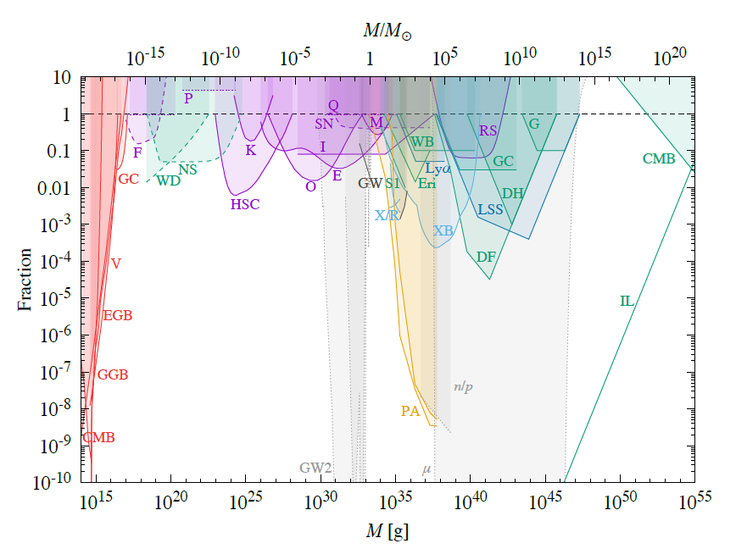
PBH Bounds
Carr et al. 2020

Slide 3
PBH Heating Constraint
Thermal Equilibrium
Require heating rate equal to cooling rate
Ignore heating from standard sources
Total heating (PBH) vs local heating (particle DM)
PBH allowed fraction
Lower limit
Bhoonah et al. 2018
Wadekar and Farrar 2019

Slide 4
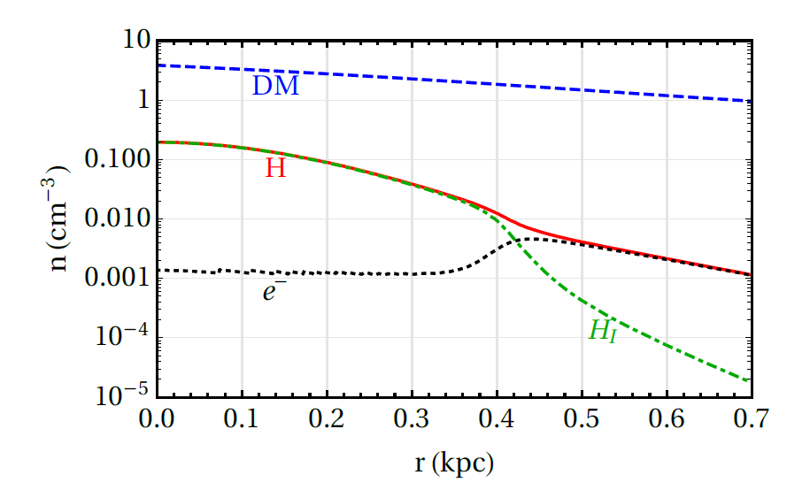
Target System: Leo T
Dwarf Galaxy
Well-studied and modeled
No significant star formation
No coherent rotation detected
Properties
Average DM density: 1.75 GeV/cm^3
Average H1 density: 0.07 GeV/cm^3
Velocity dispersion: 7 km/s
Wadekar and Farrar 2019
Faerman et al. 2013

Slide 5
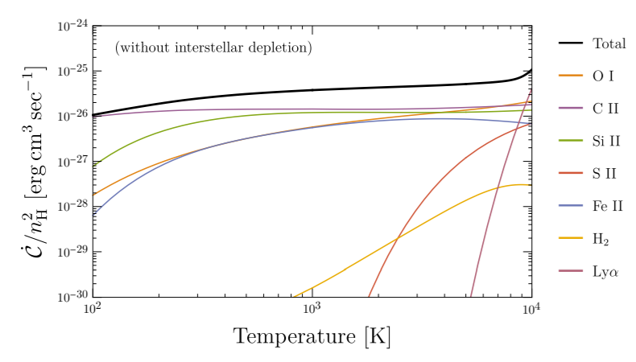
Cloud Cooling
Cooling rate:
Cooling Function:
Kim 2020
Wadekar and Farrar 2019
Kim 2020

Slide 6
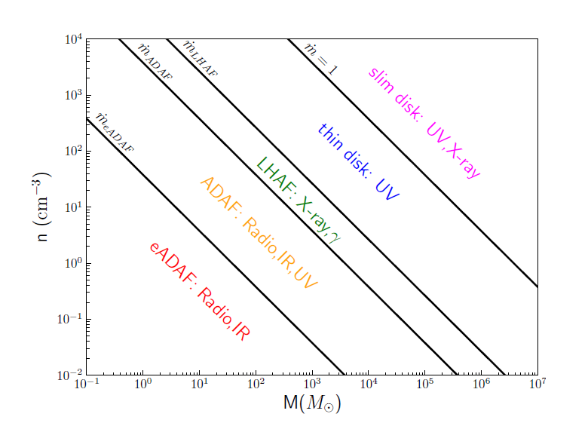
Cloud Heating Processes
Accretion disk luminosity
Bondi-Hoyle accretion
ADAF
Thin disk
Optical Depth
Winds
Stopping Power
Dynamical Friction

Slide 7
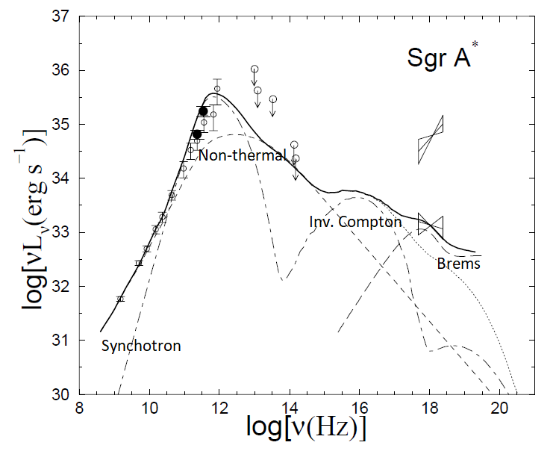
Advection Dominated Accretion Flow (ADAF)
One Zone Model
Four components:
Thermal synchrotron
Non-thermal synchrotron
Inverse Compton
Bremsstrahlung
Yuan et al. 2003

Slide 8
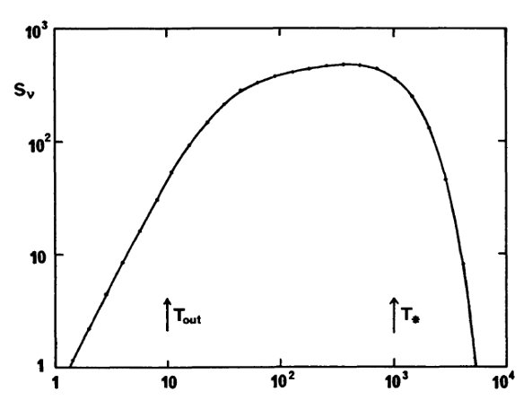
Thin disk (α-disk)
Requires large accretion rate to form
Efficient conversion of mass into radiation
Bulk of emission between T_{out} and T*
Peaks at 10s of eV
Analytically modeled
Pringle 1981

Slide 9
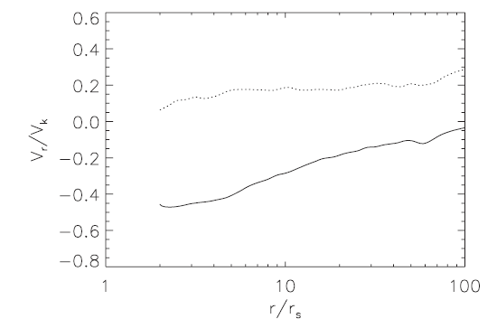
Winds
Power-law inflow:
Corresponding Outflow
Estimate wind energy as fraction of binding energy
Yuan et al. 2013

Slide 10
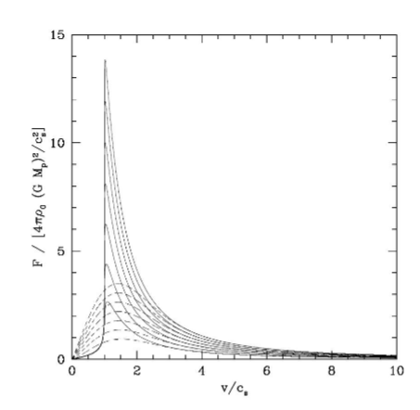
Dynamical Friction
Friction force:
Gaseous medium vs collisionless
Low power
Ostriker 1999

Slide 11
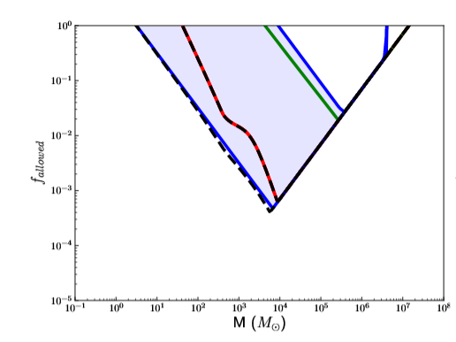
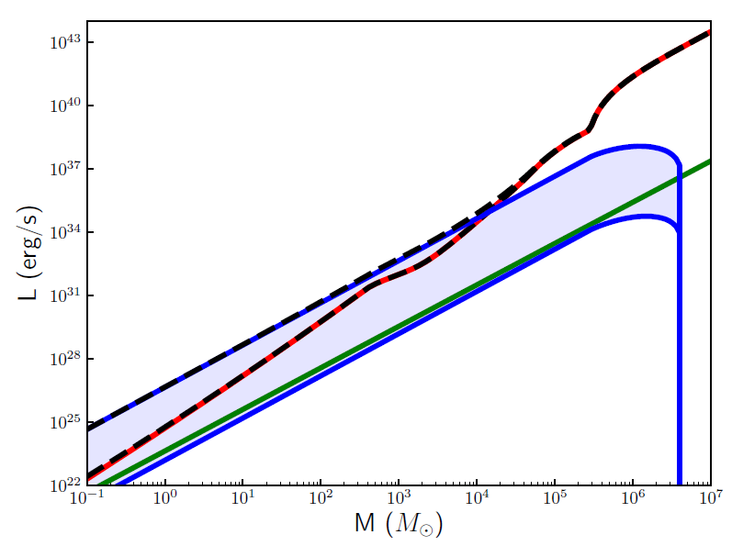
Individual Heating Contributions

Slide 12
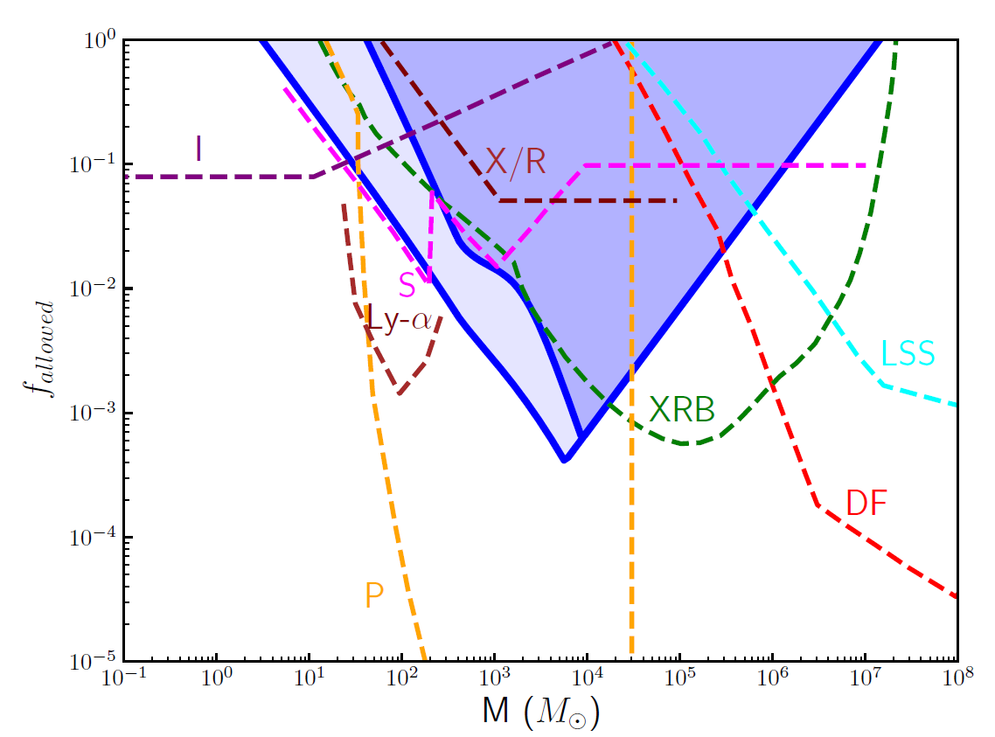
Initial Constraints
arXiv:2007.02213​
arXiv:2009.11837

Slide 13
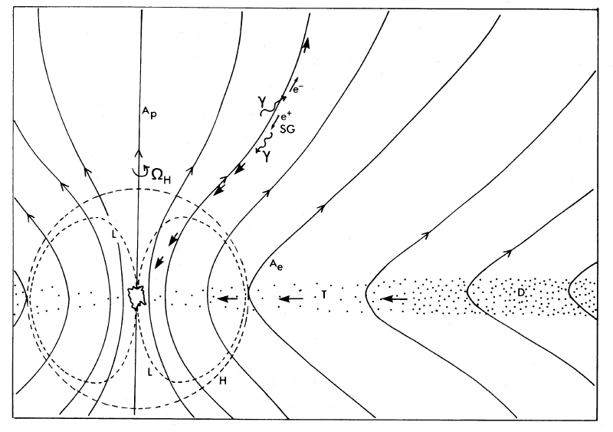
Spinning PBH
Spin decreases Innermost Stable Circular Orbit (ISCO) radius
Increased plasma temperature resulting in higher accretion disk emission
Possibility of Blandford-Znajek jets
Blandford and Znajek 1977

Slide 14
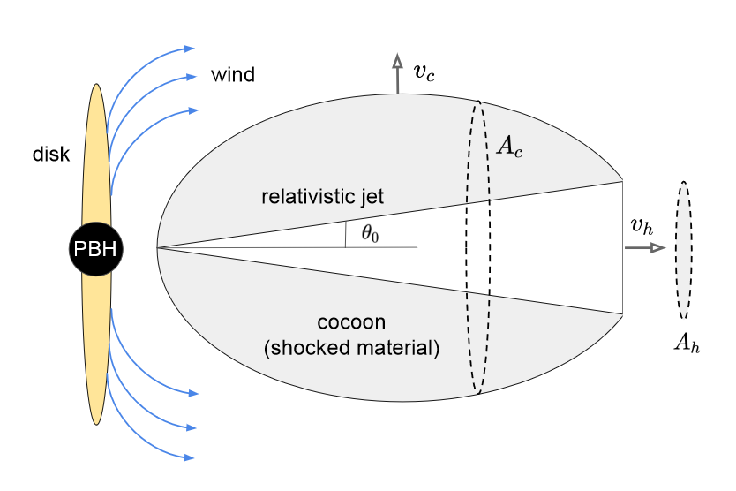
Winds and Jets as Outflows
Parameterized emission with efficiency factor
Magnetically Arrested Disk (MAD) suggest 𝜖_{j}=1 (high eff.)
Outflows from Quasars suggest 𝜖_{j}=0.005 (low eff.)
Additional factors from duty cycles, heating efficiency implicitly included
Volodymyr Takhistov

Slide 15
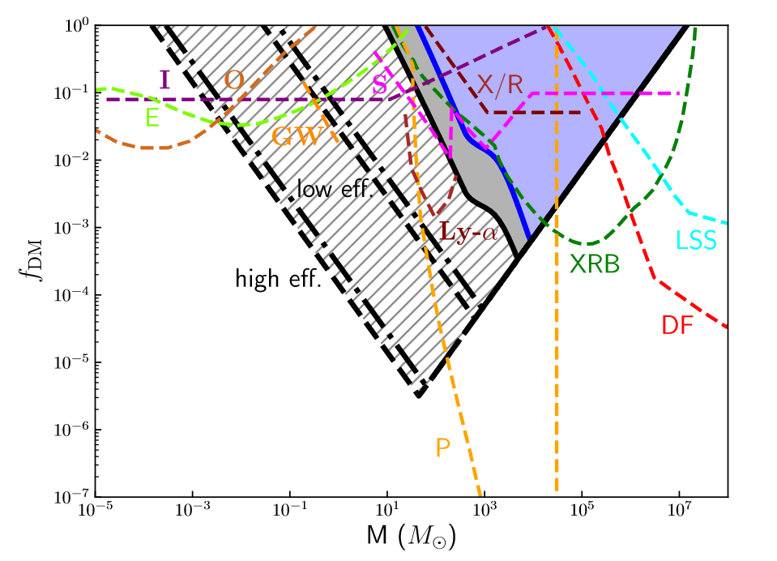
Shock Heating Limits
arXiv:2111.08699

Slide 16
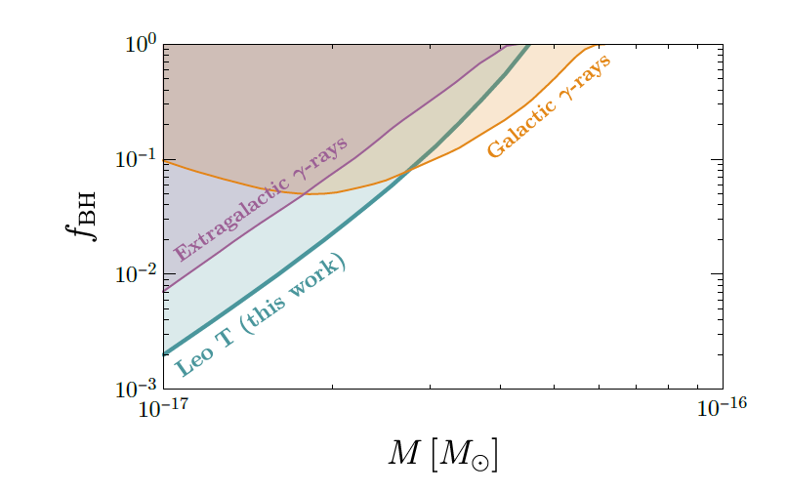
Application to Evaporating PBHs
Competitive bound for light PBH
Uses similar cloud cooling argument
Assumed positrons/electrons were permanently trapped
We reanalyzed and included spin.
Figure taken from Kim 2020

Slide 17
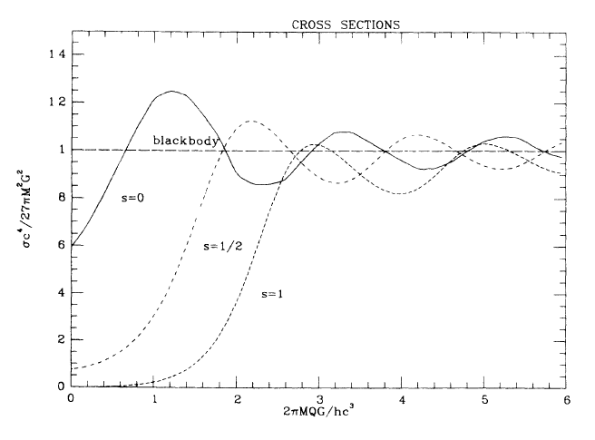
Hawking Evaporation
Approximate blackbody emission for non-spinning PBH
Effective temperature:
MacGibbon and Webber 1990

Slide 18
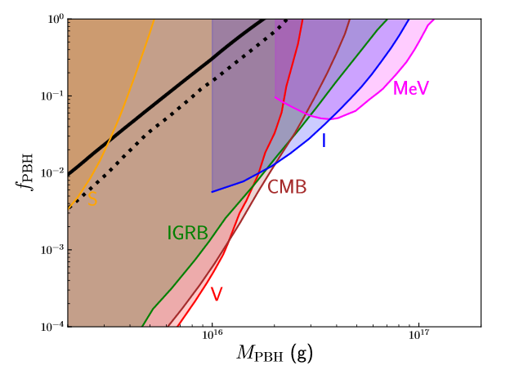
Light PBH Constraints
arXiv:2105.06099

Slide 19
Conclusions
1. New competitive bound on intermediate mass from cloud cooling. This bound is cosmology independent and complementary to other bounds.
2. Spinning black holes have increased emissions resulting in more stringent bounds
3. Outflows from winds or jets can form shocks, efficiently heating the jets.
4. Without the assumption of ion trapping, the bound on light PBH from Hawking evaporation is much weaker than previously claimed.

Slide 20
Light PBH Constraints
Questions?

