Slide 1
2021.11.26 WPPC in Jeju
Gravitational Wave as a Probe of Dark Matter Physics
Han Gil Choi
Seoul National University
Based on
“A New Probe of Dark Matter-Induced Fifth Force with Neutron Star Inspirals”
Han Gil Choi and Sunghoon Jung, PHYSICAL REVIEW D 99, 015013 (2019)
“Small-scale shear: peeling off diffuse subhalos with gravitational waves”
Han Gil Choi, Chanung Park and Sunghoon Jung, arXiv : 2103.08618[astro-ph.CO]

Slide 2
Outline
Part I
Probing Dark Matter Physics with Binary Neutron Star Inspirals
Part II
Probing Diffuse Dark Matter Haloes with Diffractive Lensing of GW

Slide 3
Part I
Probing Dark Matter Physics with Binary Neutron Star Inspirals

Slide 4
I. Motivation
Fundamental Forces
Standard Model
General Relativity
Electromagnetic
Gravity
Weak Nuclear
Strong Nuclear
Unsolved problem of physics
Beyond/modified standard theories are required.
Dark matter physics
$⇒$ Precision test of standard theories
Role of Gravitational Wave (GW) physics?
$⇔$ Is precision measurement possible?

Slide 5
I. Motivation
Potential of precision measurement?
It looks too Noisy…

Slide 6
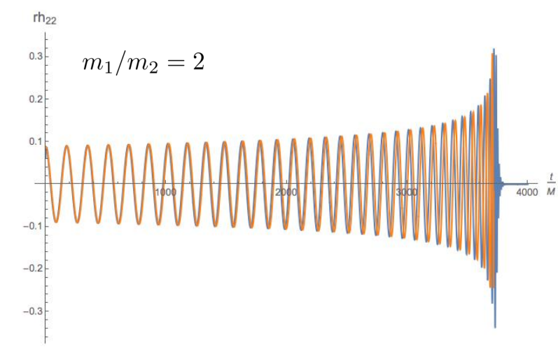
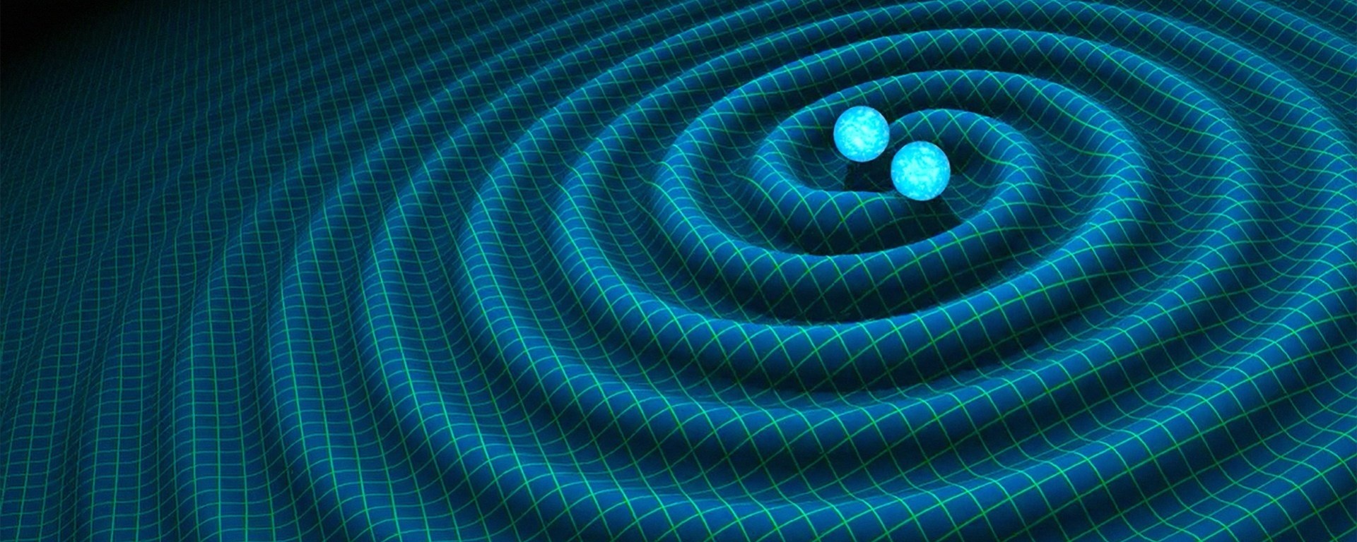
II. Binary Inspirals and Chirp mass
Newton’s gravity : $2πf=\sqrt{\frac{GM}{r^{3}}}=const$ , stable orbit
Total mass determines orbital motion.
Einstein’s gravity : GW emission -> Inspiral motion
Chirp mass :
Chirp mass determines inspiral motion.
Binary neutron star inspiral
GW chirps

Slide 7
III. Chirp mass precision
From the frequency evolution,
GW detectors are sensitive to $N_{cyc}$ $⇒$ Precision on the Chirp mass :
$∴$ Large $N_{cyc}$ $⇒$ High chirp mass precision
Real data example.
GWTC-1(2019)
 | Type |  | Duration | SNR | $$N_{cyc}$$
GW150914 | BH-BH | 28 | 0.1 sec | 20 | 10 | 0.1
GW170817 | NS-NS | 1.2 | 100 sec | 30 | 3000 | 0.001
cf) Cutler 1993
GW is sensitive to any effect perturbing chirp mass!
$→$Applications to DM physics?!

Slide 8
IV. Dark Matter Physics
Ultra light DM
Large particle number $n_{φ}=\frac{ρ_{DM}}{m_{φ}}$
Large de Broglie wavelength$≃{\left(m_{φ}v\right)}^{−1}≃1$kpc
$→$Wave-like dark matter
$→$Slowly varying background of binary neutron star
Assume very weak couplings to Neutron
Higgs portal DM
Neutron mass is shifted proportional to $φ$

Slide 9
V. Time dependent mass shift
Neutron mass becomes time dependent.
$\frac{m_{n}\left(t\right)−{\overline{m}}_{n}}{{\overline{m}}_{n}}∝φ\left(t\right)=φ_{0}cos⁡(m_{φ}t)$
$T_{φ}∝m_{φ}^{−1}≃1 year$
$⇒$ Time dependent shift of chirp mass of binary neutron star
* (chirp mass)$∝$(binary total mass)$∝m_{n}$
Change of chirp mass $→$ Change of Inspiral motion $→$ Change of GW $N_{cyc}$

Slide 10
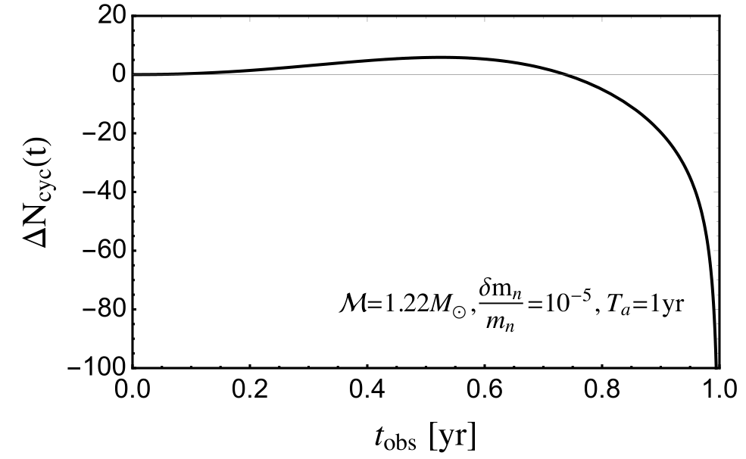
V. Time dependent mass shift
$∴$ Chirp mass precision $≃$ Sensitivity to $φ$

Slide 11
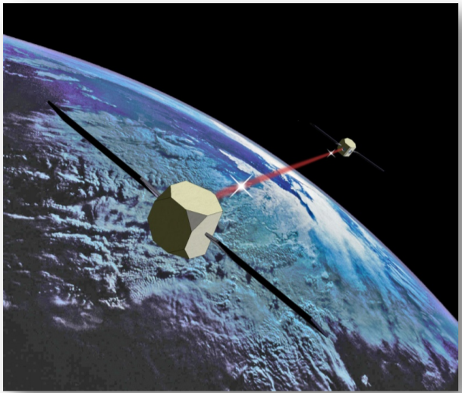
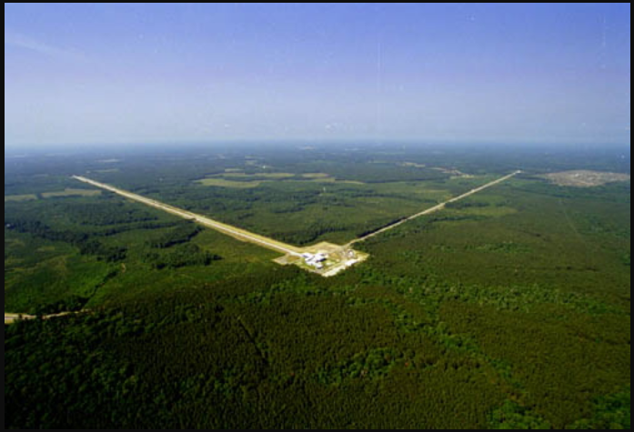
VI. Prospect
(Mid band)
(High band)
Atom Interferometer(MAGIS)
LIGO
Mid band (0.1 Hz)+ high band (100 Hz) joint observation is required.
Mid band $→$ long signal -> Large $N_{cyc}$
High band $→$ Resolve parameter degeneracies
LIGO + MAGIS :
(Far future)
ET + BBO :

Slide 12
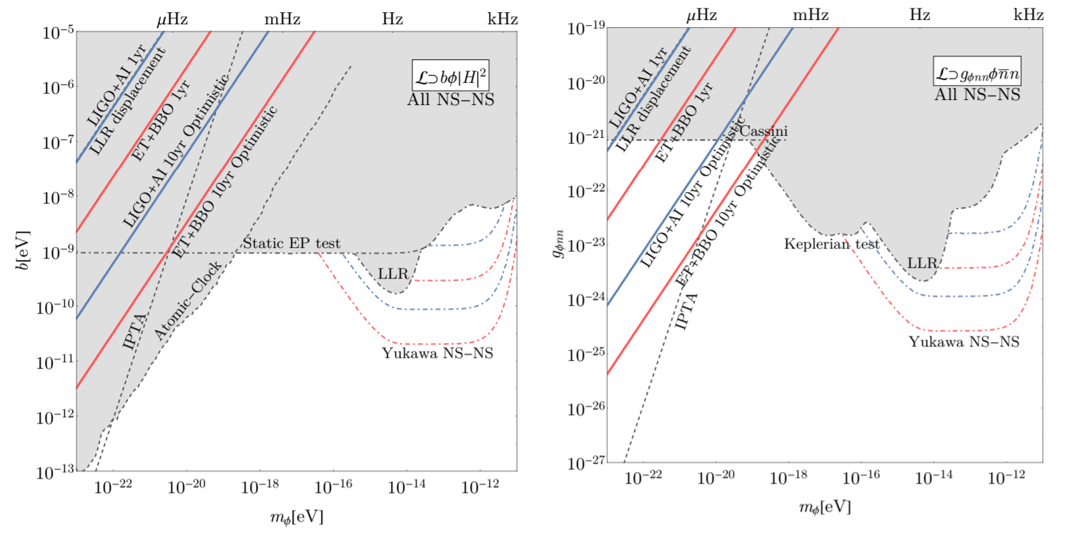
VI. Prospect
Existing constraint : Shaded regions, Our results : solid line
In GW is not as sensitive as
other probes like Atomic Clocks.
can be constrained very well.

Slide 13
Part II
Probing Diffuse Dark Matter Haloes with Diffractive Lensing of GW

Slide 14
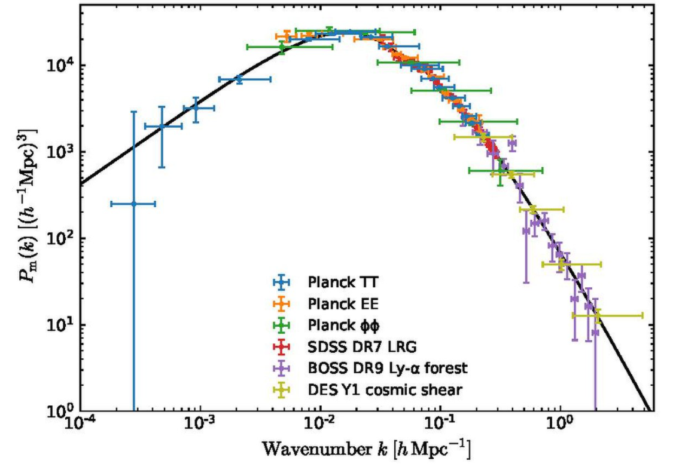
Small scale structures
Cosmological structures at small scale depends on Dark matter physics.
Primordial Black holes
Micro(or Mini) halos
Warm dark matter
Fuzzy dark matter
Self-Interacting dark matter
CDM

Slide 15
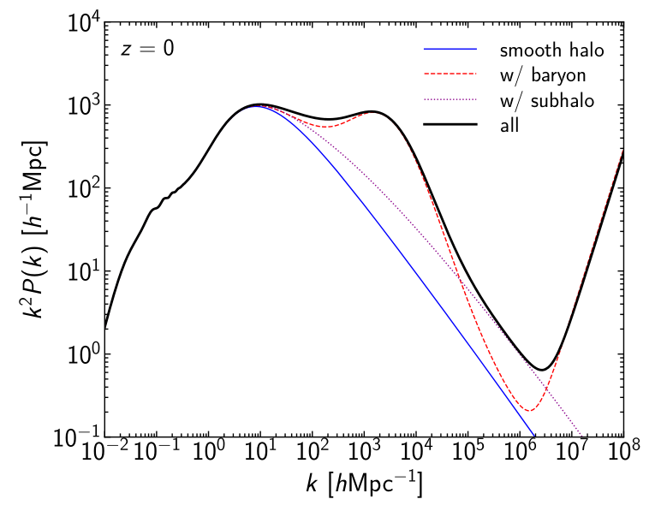
Small scale structures
Pure CDM theory also should be tested.
$⇒$ non-linear evolution, baryon physics
Oguri 2020

Slide 16
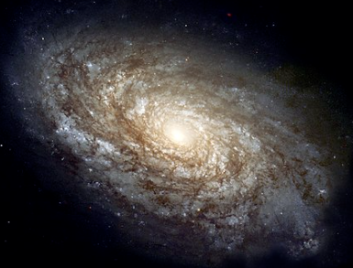
Small scale and Subhalo
Probing dark matter subhalo is the best option for small scale until now.
Current limit : $M_{sub}\sim {10}^{7}M_{⊙}$ ($k={10}^{3\sim 4}Mpc^{−1}$) (Nadler 2021)
Can we go below this limit?
Subhalo : halo inside the halo
Galaxy

Slide 17
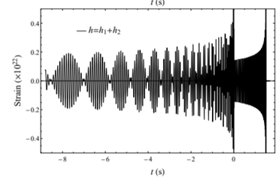
Lensing of GW chirp
Gravitational lensing of Gravitational Wave(GW) Chirps
: Sensitive to
Intermediate mass black hole (Lai 2018, Jung 2018)
Dwarf galaxy (Takahashi 2003, Dai 2018)
Hou 2020
$→$Interference between two lensed GWs from identical source.
Lensing of GW chirps might be able to probe subhalo as well.
Subhalos are too diffuse->
Lensing signal might be too weak to be detected.
But future GW detectors might be powerful enough.
1.5 s

Slide 18
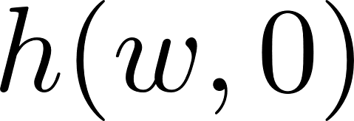
Diffractive lensing : Wave optics
Gravitational Potential of DM halo
distorts the amplitude & phase of incident waves.
Wave propagation
Kirchhoff integral
Lensing amplification factor (F=1 for no lens)
: GW without lensing effects

Slide 19
Diffractive lensing : Apprx. Solution
With weak lensing conditions, We find that
$\overline{κ}(r)$ : Mean convergence(~density) of DM halo within a radius r
$F(w)$ is equivalent to DM Halo density profile $\overline{κ}(r)$.
We call this regime as ‘Diffractive lensing’.
One can get analytic F(w) if $\overline{κ}(r)$ is given by analytic function.

Slide 20
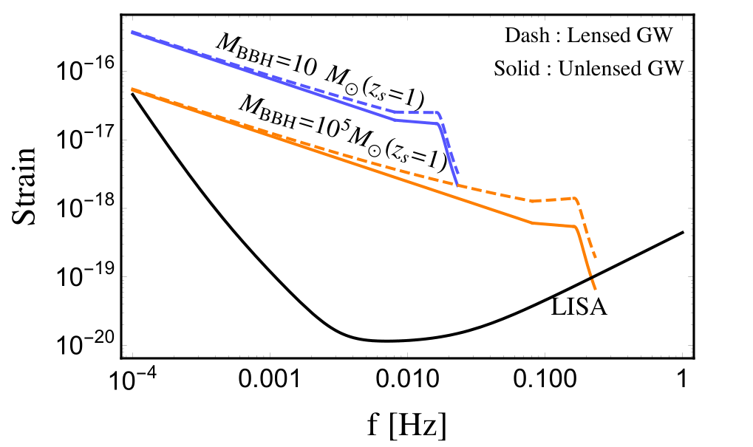
Lensed GW spectrum
$${10}^{6}$$
Although we don’t know intrinsic luminosity of GW, this Frequency dependent amplification can be detected.
Lensing by $\overline{κ}(r)∝r^{−1}$ lens ($M={10}^{5} M_{⊙},z_{l}=0.35)$

Slide 21
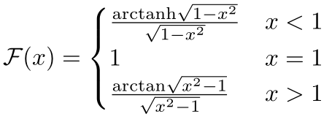
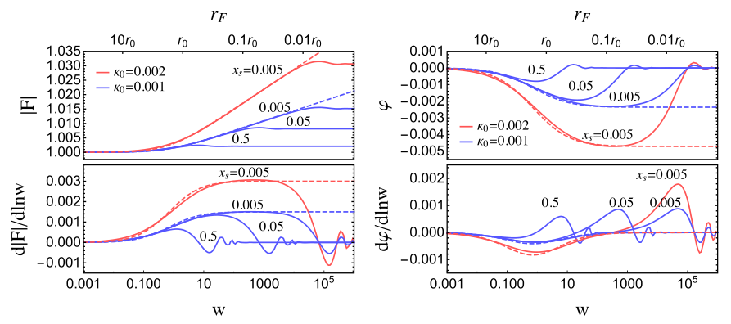
Diffractive lensing by NFW profile
Application to diffuse DM halo profile : Navarro-Frenk-White(NFW) profile
Solid : Numerical integration
Dashed : Analytic solution

Slide 22
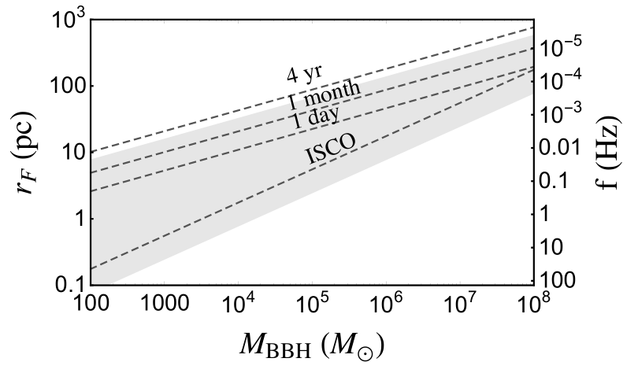
GW sources for Diffractive lensing
To get large enough $r_{F}=\sqrt{\frac{d_{eff}}{πf}}$,
-> GW chirps from massive Black hole binaries : low f, large $d_{eff}$
$$d_{eff}\sim 1 Gpc , z_{s}=1$$
Ex) ${10}^{5}M_{⊙}$ BBH spectrum $→$ Scan 1 pc to 50 pc by 1yr observation

Slide 23
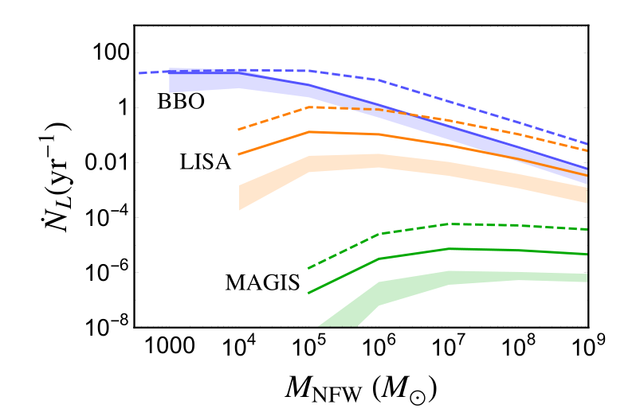
Detection prospect
We need powerful space-based GW detectors like BBO(0.1Hz), LISA(1 mHz).
BBO can detect ${10}^{3−4}M_{⊙}$ halo lensing O(10) events per year.
LISA and the others are less promising.
Lack of High Signal-to-Noise Ratio(>1000) BBH sources
In future, BBO will discriminate CDM and the other DM models.
BBH Merger rate
Solid : 0.01 $Gpc^{−3}yr^{−1}$
Shaded : astrophysical
(Bonetti 2018)

Slide 24
Conclusions
Chirp mass can be very precisely measured with mid-band GW detectors and can be used to probe DM effects.
GW observations of neutron star binaries will provide strong constraint on light DM(${10}^{−22\sim −20}$eV) which directly couples to energy.
Dark matter subhalos are very diffuse objects but might be able to distort GW signals by diffractive gravitational lensing where lensing amplification factor is directly mapped to the mass distribution through $r_{F}$(effective source size, or Fresnel length).
The future GW detector BBO will detect GW chirps of super massive binary black holes lensed by ${10}^{3\sim 4}M_{⊙}$ DM subhalo with a few tens of events per year.

Slide 26
Backup slides
Mass shift signals in other experiments
Lunar Laser Ranging (Earth-Moon mass shift)
Pulsar Timing Array (pulsar mass shift)

Slide 27
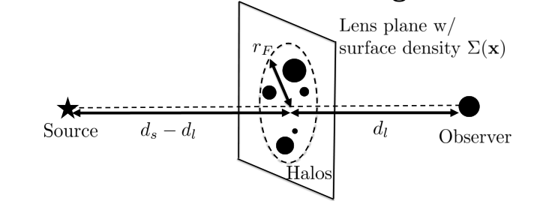
Backup slides
Diffractive Lensing Geometry

Slide 28
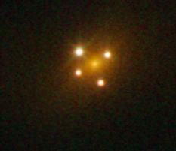
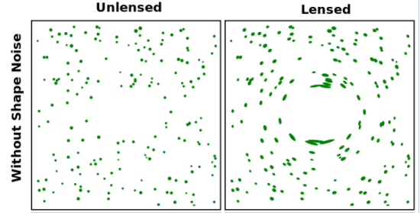
Strong lensing vs Weak lensing
Strong lensing
Q2237+030 by Hubble Telescope
Multiple images
Highly distorted image cf) Einstein’s ring
Image positions
(Relative) Image magnifications
Arrival time difference between images
Weak lensing
Single image
Set of weakly distorted images – Convergence($κ$) & Shear ($γ$)
$κ$ : Isotropic deformation ($∝$ matter density)
$γ$ : directional deformation ($∝$ tidal field)
Weak diffractive lensing also measures $κ$ and $γ$ !

Slide 29
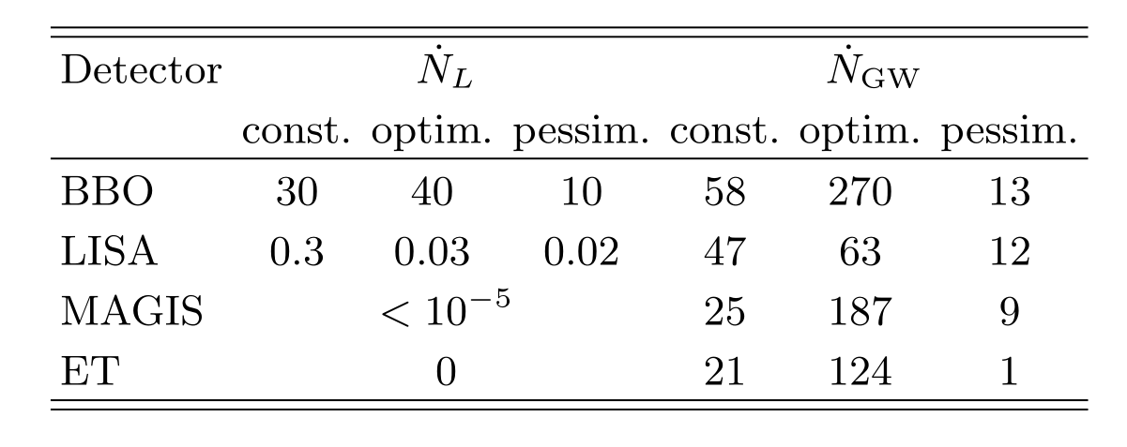
Backup slides
Lensing rate vs GW merger rate

Slide 30
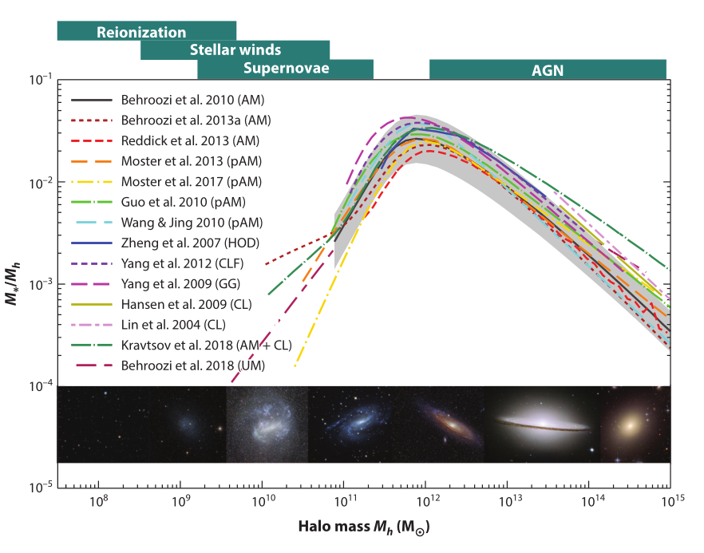

Slide 31
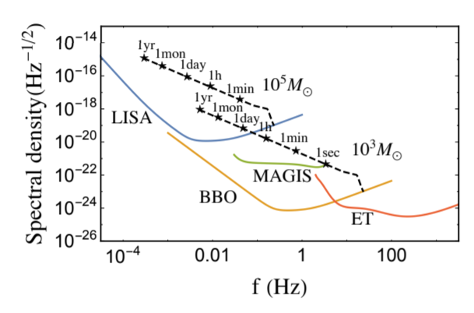

Slide 32
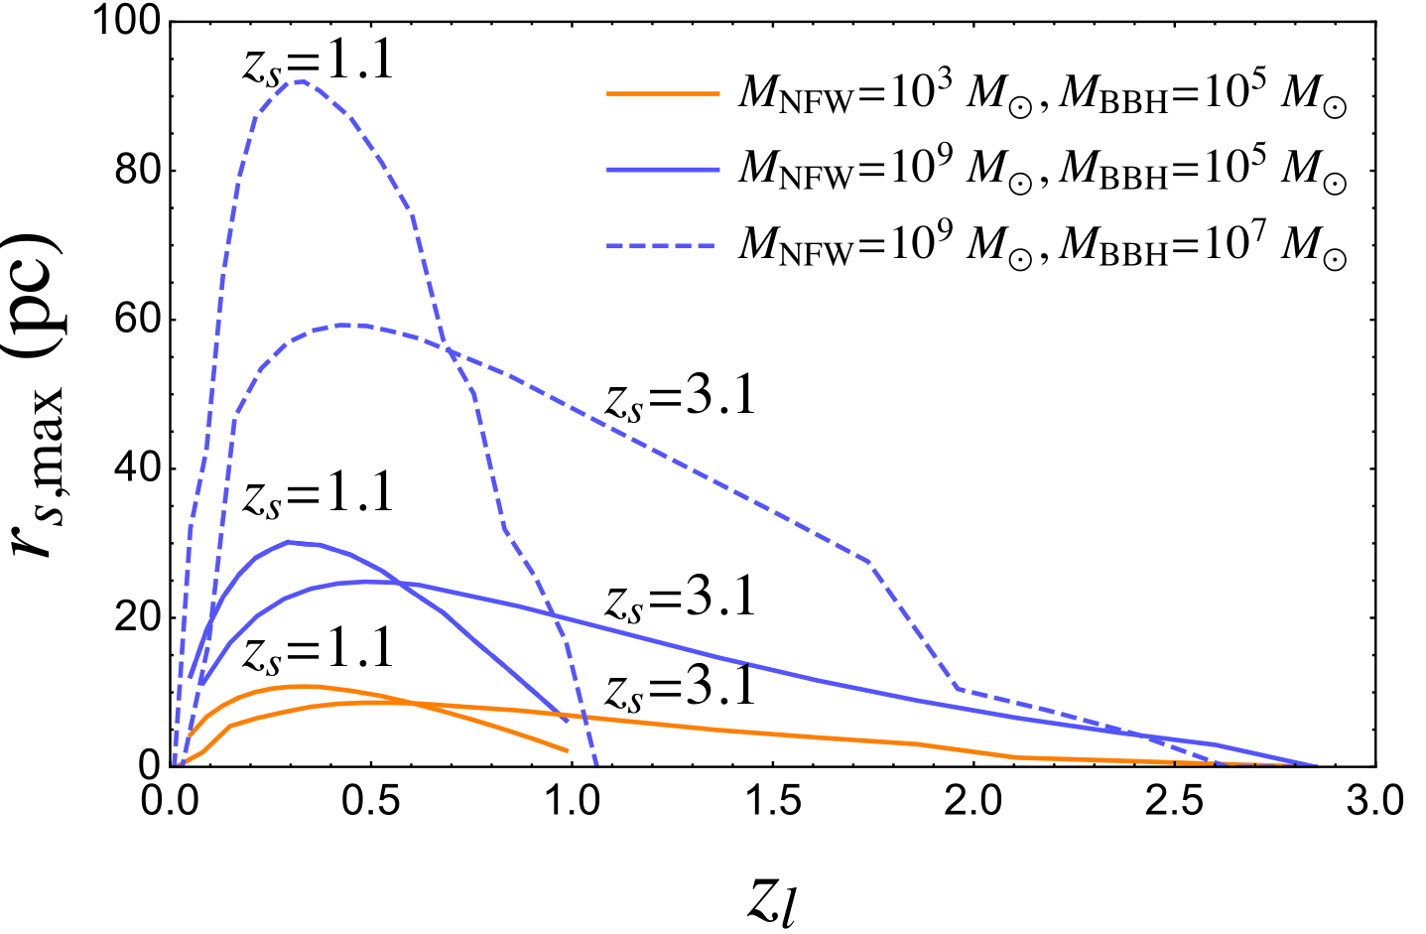
Backup slides
Lensing cross-section

Slide 33
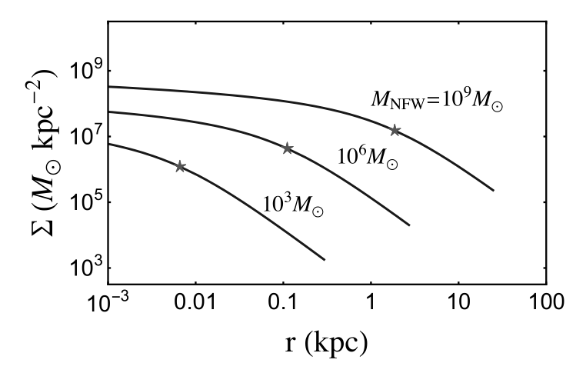
Backup slides
Surface density of NFW halo

Slide 34
Backup slides
Definition for Lensing potentials
Convergence
Mean Convergence
Shear
For NFW :

Slide 35
NFW Profile
Supplements
Reasonably good fitting model for dark matter halo in N-body simulations
3D profile
2D profile (Line-Of-Sight projection)
We parametrize halo mass with
(Navarro, Frenk, White 1996 )
(Keeton 2002)

Slide 36
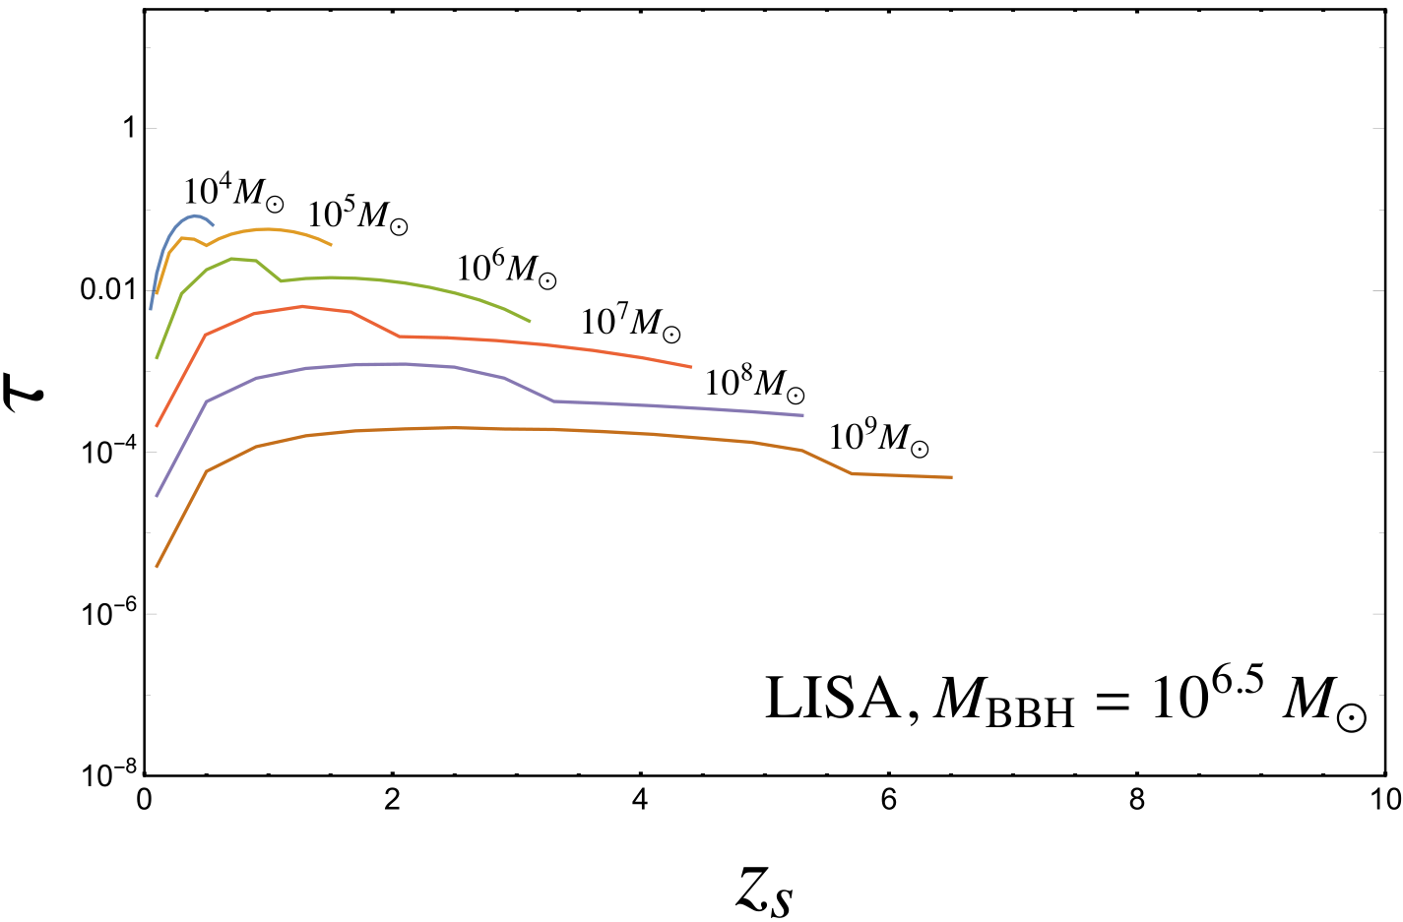
Lensing Optical Depth : LISA
LISA : $τ∼O(0.01)$ for ${10}^{5−6}M_{⊙}$ haloes
cf) strong lensing at LISA : $τ∼{10}^{−3}$ (Sereno 2010)

Slide 37
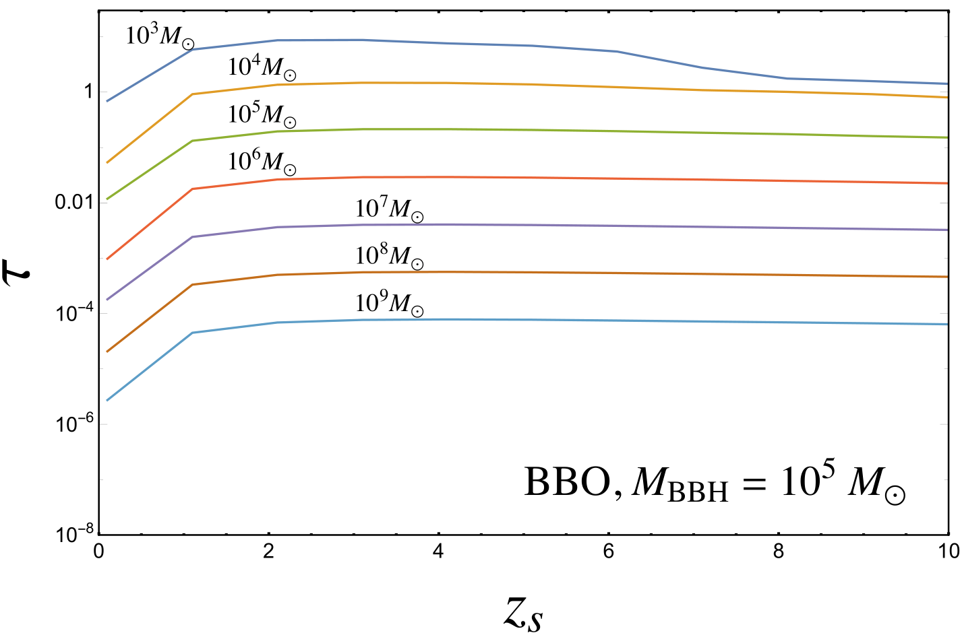
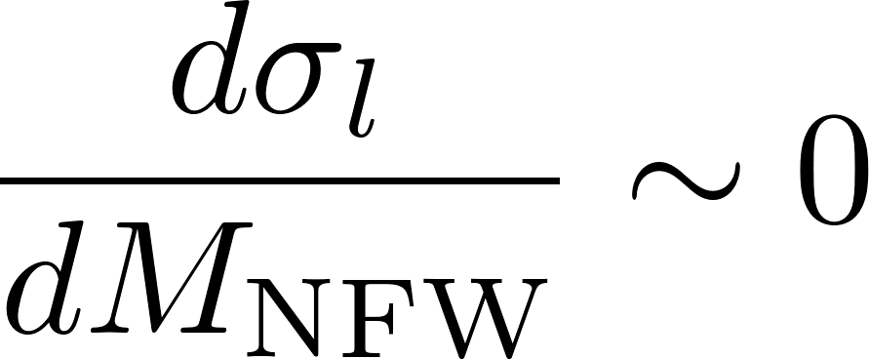
Lensing Optical Depth (BBO)
$τ∼O(1)$ for ${10}^{3−4}M_{⊙}$ haloes
cf) Optical depth of primordial black hole

Slide 38
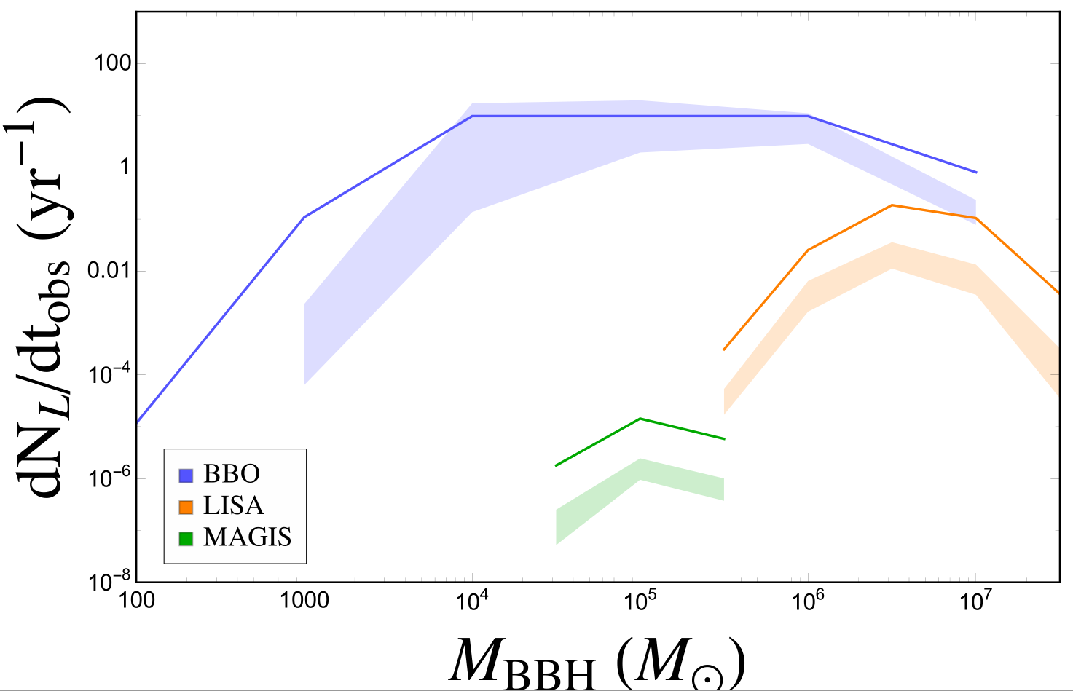
Lensing Event Rate
High SNR BBH contribute the most.
Low lensing rate of LISA due to Low merger rate of ${10}^{6−7}M_{⊙}$BBH

Slide 40
Backup
Gravitational lensing of chirping GW vs Light
Source size : less than au vs At least pc (QSO)
-> High coherence
Interaction : Mass only vs Interstellar medium etc…
-> Less confusion noise
Spectrum : highly predictable(mass, spin, orbital direction …) vs modeling ambiguity
-> Any deviation from expected spectrum can be signal
Wavelength : more than 1000 km(100 Hz) vs less then 10 m(1 MHz)
-> wave optics effects with macro objects
Observable : time series amplitude & spectrum vs Image & spectrum
-> Lensing need to be inferred only from specific change of spectrum

