Slide 1
Leptonic CPV from
(massive Sterile)
WPPC2021 on Nov 27, 2021
KPS on Oct 21, 2021
CUBES2 on Apr 21, 2021
IBS Seminar on Nov 24, 2020
C. S. Kim (Yonsei/Dongshin Univ.)

Slide 2
Contents
Introduction
Neutrino mass
Leptonic CPV (for Leptogenesis)
Conclusion
I will start my talk by introducing a few prominent unresolved problems in the SM.
Then I review how neutrinos get mass, Weinberg operator and various types of seesaw mechanism.
Then I will explain in detail about possible leptonic CPV from massive sterile neutrinos,
comparing already measured hadronic CPV, and show the prediction at BELL2.

Slide 3
1. Introduction
A. Major unresolved problems in particle physics – requiring BSM :
Neutrino oscillations and masses →
Baryon asymmetry of the Universe (BAU) → Leptonic CPV (& Leptogenesis)
Dark matter (DM)
Cosmological inflation ?
Dark energy ?

Slide 4

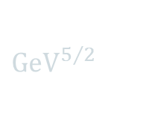
B. Assuming renormalizable BSM w/ heavy and/or weakly interacting particles
→ (3 types of) portals:
1. Vector portal w/ Dim( )
2. Scalar portal w/ Dim( )
3. Neutrino portal w/ Dim( )
$${\text{GeV}}^{2}$$
${GeV}^{5/2}$

Slide 5

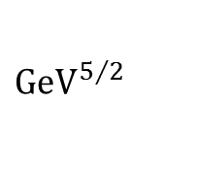

B. Assuming renormalizable BSM w/ heavy and/or weakly interacting particles
→ (3 types of) portals:
1. Vector portal w/ Dim( )
2. Scalar portal w/ Dim( )
3. Neutrino portal w/ Dim( )
$${\text{GeV}}^{2}$$
$${\text{GeV}}^{2}$$
${GeV}^{5/2}$

Slide 6
2. Neutrino Oscillation & Mass
A. within and beyond the SM

Slide 8
[PM,PLB67(1977)421]

Slide 9
B. Seesaw mechanism
→ require right-hand (singlet-sterile) neutrino
( + ) ← if Majorana particle
[PM,PLB67(1977)421]

Slide 10

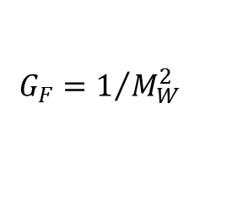
B. Seesaw mechanism
→ require right-hand (singlet-sterile) neutrino
( + ) ← if Majorana particle
(at scale < : Weinberg Operator)
[PM,PLB67(1977)421]
$$M_{N}$$
[SW,PRD22(1980)1694]
H
H
n
p
$$G_{F}=1/{M_{W}^{2}}$$
L
L
e

Slide 11

B. Seesaw mechanism
→ require right-hand (singlet-sterile) neutrino
( + ) ← if Majorana particle
(at scale < : Weinberg Operator)
(over the scale > )
[PM,PLB67(1977)421]
$$M_{N}$$
[SW,PRD22(1980)1694]
$$M_{N}$$

Slide 12
C. Various type of Seesaw mechanism
1. conventional seesaw
→ GUT-scale seesaw

Slide 13
C. Various type of Seesaw mechanism
1. conventional seesaw
→ GUT-scale seesaw
2. inverse seesaw
- --→ → GeV-scale seesaw
→
[FD,TK,JW,hep-ph/0512360]
[HC,SK,CSK,hep-ph/0710.2416]

Slide 14
3. anti-seesaw (pseudo-Dirac neutrinos)
[AG,WH,0906.1611]

Slide 15
3. Leptonic CPV (for Leptogenesis)
A. Hadronic CPV (eg. B and K decays)
[JHC,JC,VF,RT,PRL13(1964)138]
[YN,MK,TM,(2008)Nobel Prize]

Slide 16
Importance of strong phase:

Slide 17
Importance of strong phase:

Slide 18

B. CPV with (Majorana sterile) neutrinos (eg. In K, B decays)
CPV in
[GC,CSK,JZ,1311.7554]
[GC,CSK,JZ,1403.2555]
[CD,MC,CSK,1403.8009]
[GC,CD,CSK,JZ,1503.01358]
[GC,CSK,SM,JZ,2007.04115]

Slide 19
B. CPV with (Majorana sterile) neutrinos (eg. In K, B decays)
CPV in
[GC,CSK,JZ,1311.7554]
[GC,CSK,JZ,1403.2555]
[CD,MC,CSK,1403.8009]
[GC,CD,CSK,JZ,1503.01358]
[GC,CSK,SM,JZ,2007.04115]

Slide 20
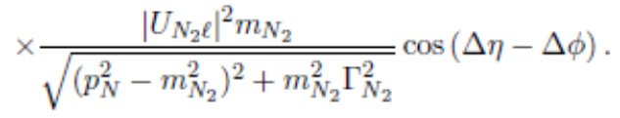

→
➔
➔
$$\left(m_{N_{1}}≈m_{N_{2}}\right)$$

Slide 21

→
➔
➔
$$\left(m_{N_{1}}≈m_{N_{2}}\right)$$

Slide 22
➔
➔

Slide 23
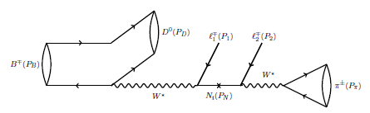
→ More realistic calculation (eg. for Belle-2)
[GC,CSK,SM,JZ,2007.04115]

Slide 24
4. Conclusion
1. Non-zero mass of neutrinos must be THE evidence of BSM.
2. Are active neutrinos Dirac or Majorana – the most important question?
3. Why so light? THE hint to seesaw and existence of sterile neutrinos!
4. Sterile neutrinos – mass, Dirac or Majorana, dark matter?
5. BAU and leptonic CPV – new source of CPV (other than tiny hadronic CPV).
6. Leptonic CPV and leptogenesis?

Slide 25
Leptogenesis
[EJC,CSK etal,1711.02865]

Slide 26

Neutrino Magnetic Moment
[JEK,1911.06883]
$$f≠0$$
If , either neutrino is composite or w/ (loop) quantum virtual correction !

Slide 27
감사합니다.
Thanks.
Danke.
Arigato.

