Slide 1
Hubble selection of the weak scale: from QCD quantum phase transition
TaeHun Kim,
Department of Physics & Astronomy, Seoul National University.
Work with Sunghoon Jung.
arXiv:2107.02801

Slide 2
Table of contents
Hubble selection
(Selection of the) Weak scale from QCD quantum phase transition
Discussion
Concluding remarks

Slide 3
Hubble selection: Setup
Inflation (prescribed inflaton sector) + very light scalar field $φ$
Quantum fluctuations of $φ$
$$\frac{1}{H}$$
$$\frac{1}{H}$$
$$\frac{1}{H}$$
$$\frac{1}{H}$$
$$\frac{1}{H}$$
$$\frac{1}{H}$$
$$\frac{1}{H}$$
$$\frac{1}{H}$$
$$\frac{1}{H}$$
$$\frac{1}{H}$$
$$\frac{1}{H}$$
$$\frac{1}{H}$$
$$\frac{1}{H}$$
$$\frac{1}{H}$$
$$\frac{1}{H}$$
$$\frac{1}{H}$$
$$\frac{1}{H}$$
$$\frac{1}{H}$$
Freezes after horizon crossing
$$\frac{1}{H}$$
$$\frac{1}{H}$$
$$\frac{1}{H}$$
$$\frac{1}{H}$$
$$\frac{1}{H}$$
$$\frac{1}{H}$$
$$\frac{1}{H}$$
$$\frac{1}{H}$$
$$\frac{1}{H}$$

Slide 4
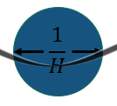
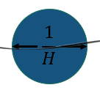
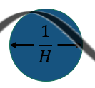
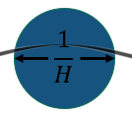
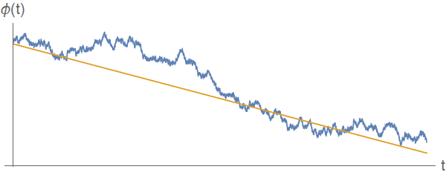
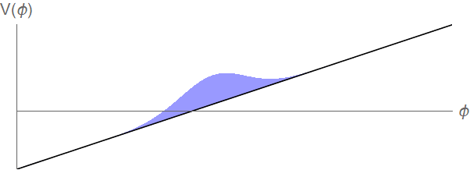
Hubble selection: Setup
For each Hubble patch
Continuous accumulation of “random kicks” from frozen modes
...
Time evolution
Randomness among the space
Global distribution
Stochastic evolution trajectory
Dynamics of the global distribution?

Slide 5
Hubble selection: Concept
Access to higher potentials by accumulated random kicks
Higher potential, higher Hubble rate, greater volume expansion
Can dominant volume of the universe be at higher potentials?
“Eternal inflation” applied for $φ$
Yes, it can, under several conditions.

Slide 6
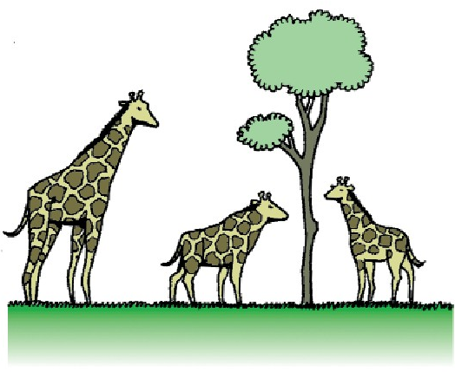
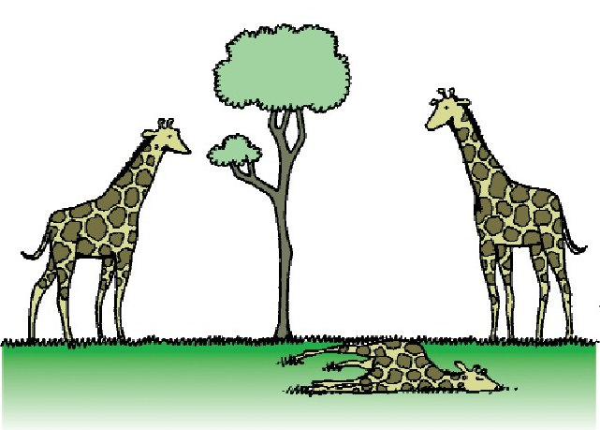
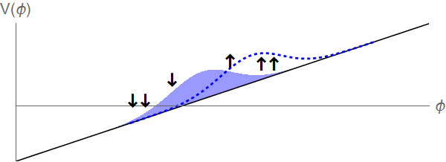
Hubble selection: Analogy
 | Natural selection | Hubble selection
Applied to | Organisms | Hubble patches
“Offspring” production | Reproduction | Hubble expansion
… rate differs by | Adaptation to environment | $$ΔH(φ)=\frac{ΔV(φ)}{6M_{P}^{2}H_{0}}$$
… originate from | Genetic divergence | Quantum fluctuation
Result | Dominance of genotype with higher reproduction rate | Dominance of Hubble patches with higher Hubble rate
Hubble selection
Unequal newly generated volume
Classical roll down
https://commons.wikimedia.org/wiki/File:Evoluci%C3%B3n_jirafa_espa%C3%B1ol.png

Slide 7
Hubble selection: Condition
Selection requires diversity
Effective for wide distribution (largely different field values among the space)
Conditions for Hubble selection:
Eternal inflation: time to develop the enough divergence
Super Planckian field range: able to ...
No Hubble selection for SM fields. Can work for typical relaxions
P. Graham, D. Kaplan, S. Rajendran, 2015

Slide 8
Hubble selection: Result
G. Giudice, M. McCullough, T. You, 2021
Equilibrium distribution
“Boundaries” of potential
Localization near the boundary: “Self-organized localization”
Top of the potential
Only equilibrium distribution matters
Eternal inflation: continuously dominated by “young population”

Slide 9
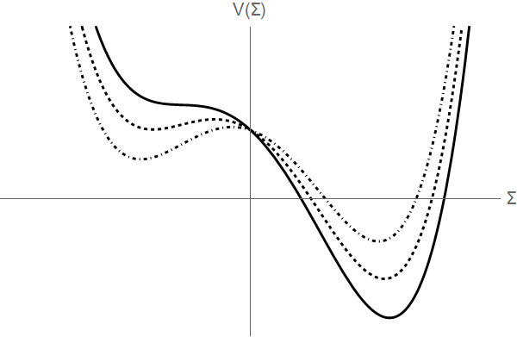
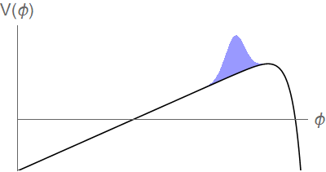
Hubble selection: Realization
$φ$ triggers 1st order quantum phase transition
Potential maximum at the critical point
“Can we find one that can select the weak scale?”

Slide 10
Weak scale from QCD phase transition
QCD chiral phase transition could be 1st order, at QCD scale
Depend on the strange quark mass
Not firmly established yet: “possibility”
Remains to be confirmed by lattice calculations.
Large hierarchy $M_{W}≪≪M_{Pl}$ → little hierarchy $Λ_{QCD}<M_{W}$

Slide 11
Weak scale from QCD phase transition
The model
$φ$ relaxion: scans the Higgs mass (or VEV $v_{h}$)
$h$ Higgs: $v_{h}$determines quark mass; triggers $Σ$’s phase transition at $v_{h}^{∗}=v_{h}\left(φ^{∗}\right)$
$Σ$ meson field: QCD d.o.f. below $Λ_{QCD}≃200$ MeV; undergoes 1st order PT
No Hubble selection for $h$ and $Σ$.
Their value & potential contribution solely determined by $φ$
$v_{h}$ scan
PT at $v_{h}^{∗}$
$φ$ relaxion
$h$ Higgs
$Σ$ meson field

Slide 12
Weak scale from QCD phase transition
$V=V_{φ}\left(φ\right)+V_{h}\left(φ\right)+V_{Σ}\left(h\left(φ\right)\right)$
$$V_{φ}=Λ_{φ}^{4}\cos\left(\frac{φ}{f_{φ}}\right)$$
$$V_{h}=\frac{1}{2}\left(M^{2}−gφ\right)h^{2}+\frac{λ_{h}}{4}h^{4}$$
$$V_{Σ}=… −Tr\left(ℋ\left(Σ+Σ^{†}\right)\right)$$

Slide 13
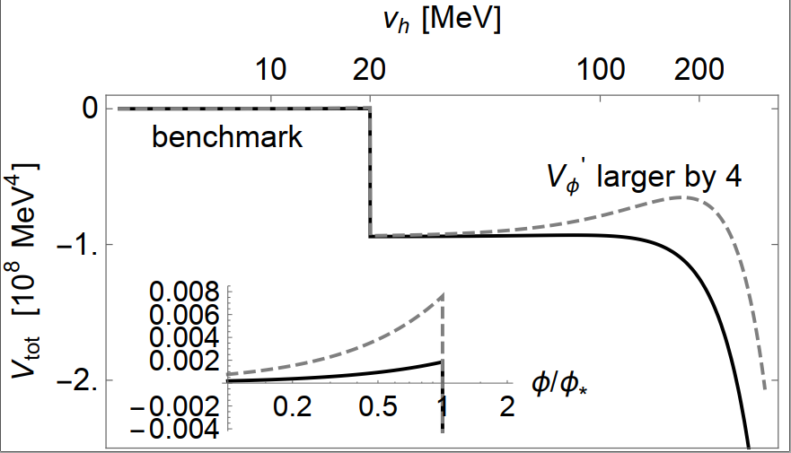
Weak scale from QCD phase transition
$$v_{h}^{∗}(φ^{∗})$$
$v_{h}$ scan
PT at $v_{h}^{∗}$
$φ$ relaxion
$h$ Higgs
$Σ$ meson field
Hubble
selection
$$ΔH(φ)=\frac{V_{φ}+V_{h}+V_{Σ}}{6M_{P}^{2}H_{0}}$$
Maximum at $v_{h}^{∗}=v_{h}\left(φ^{∗}\right)$
Potential maximum

Slide 14
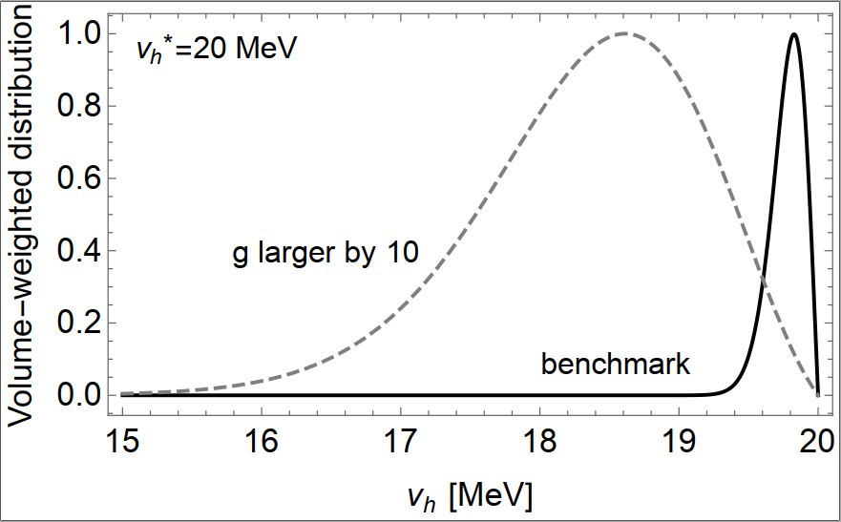
Weak scale from QCD phase transition
Successful benchmark
$H=v_{h}^{∗}≃20$ MeV $M=3×{10}^{−3}M_{P}$ $Λ_{φ}^{2}={10}^{−2}H M_{P}$ $g={10}^{−3}H^{2}/M_{P}$
Well localized $v_{h}$ near $v_{h}^{∗}≃20$ MeV

Slide 15
Discussion
QCD phase transition might have selected the weak scale.
$M=3×{10}^{−3}M_{P}$, well localized $v_{h}$. Naturalness problem solved? No.
$Λ_{φ}≪M$ is unstable against quantum correction: $V_{h}=\frac{1}{2}\left(M^{2}−gφ\right)h^{2}+\frac{λ_{h}}{4}h^{4}$.
“Tail wagging the dog” is not allowed.
Naturalness problem still exists.
Several attempts can translate the naturalness problem to (at least quantum stable) fine tuning problem.

Slide 16
Concluding remarks
Hubble selection: localization of the universe near the potential max.
Higher potential, higher Hubble rate. Analogous to natural selection.
Eternal inflation & super Planckian field range
QCD phase transition might have selected the weak scale
But naturalness problem still exists.
Let’s put more thought on the Hubble selection!

