Slide 1
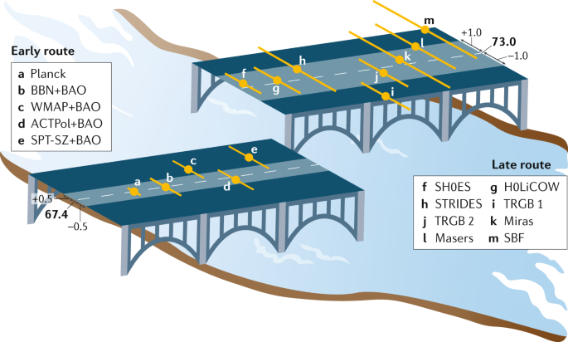



The present $H_{0}$ tension in cosmology
Lu Yin
CQUeST
Sogang University
Seminar: Yonsei University 2022/08/02

Slide 2

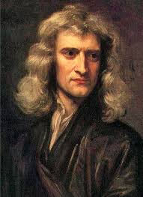
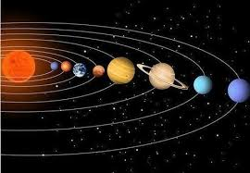
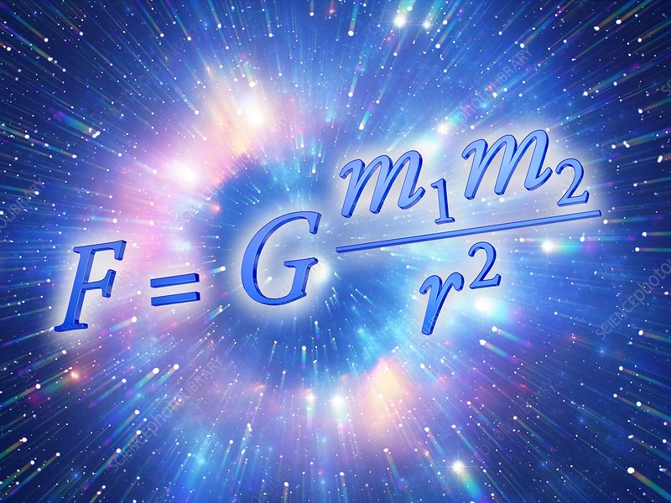
I think the Universe should be stable
Isaac Newton
Notes:
人类总想理解宇宙

Slide 3
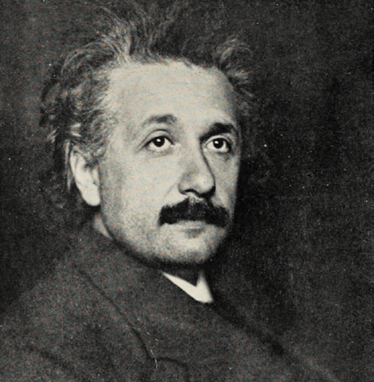
I think the Universe should be stable
Isaac Newton
I also think the Universe should be stable ( in 1917)
Albert Einstein

Slide 4
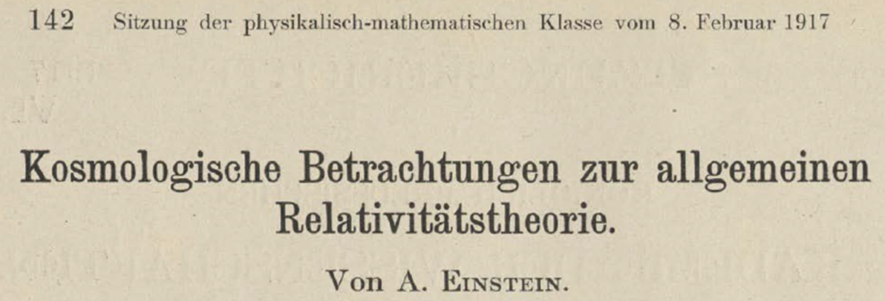
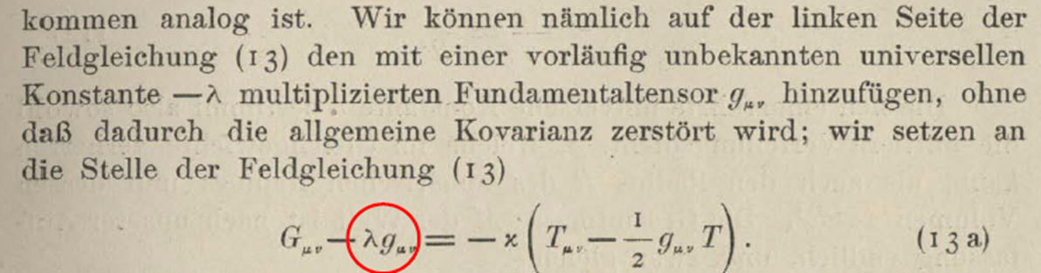
Cosmological considerations on the general
relativity theory
I also think the universe should be stable ( in 1917)
Einstein add a cosmological constant term in his Einstein’s Equations (1917)
Notes:
To achieve this goal

Slide 5
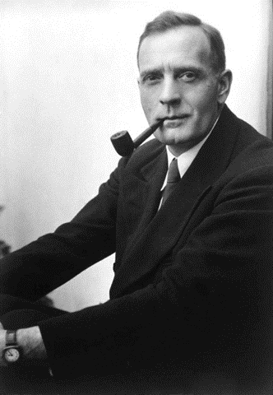
I think the Universe should be stable
Isaac Newton
I also think the Universe should be stable
( in 1917)
Albert Einstein
Wait a second,
I discovered the Universe is expanding! (in 1929)
Edwin Hubble

Slide 6
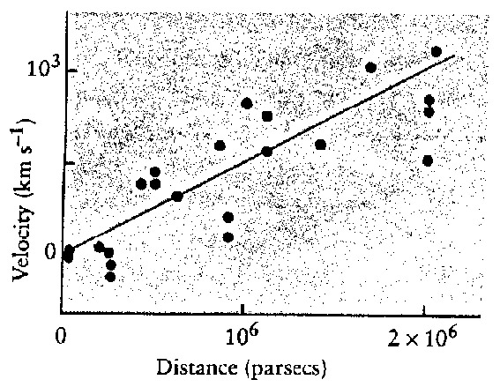
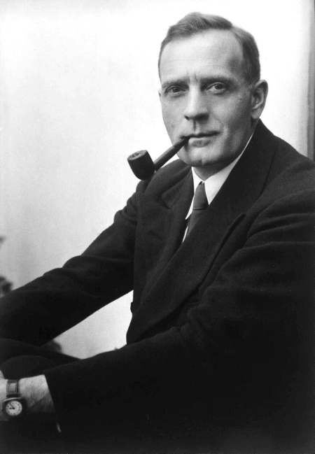

The discovery of Hubble constant
Edwin Hubble
$$v=H_{0}×D$$
V : recessional velocity
D : the proper distance to the observer
H₀ : Hubble's constant
[km/s/Mpc]
E. Hubble, Proc. Nat. Acad. Sci. 15 (1929), 168-173
Notes:
距离除以速度，年龄。 速度 propotional

Slide 7
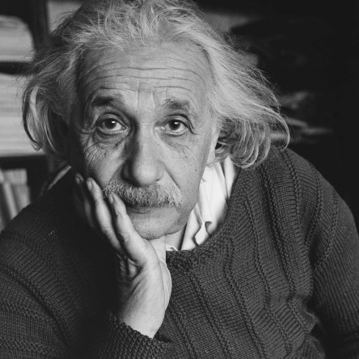
I also think the Universe should be stable
( in 1917)
Really the
biggest blunder in my life
(in 1931)
Albert Einstein

Slide 8
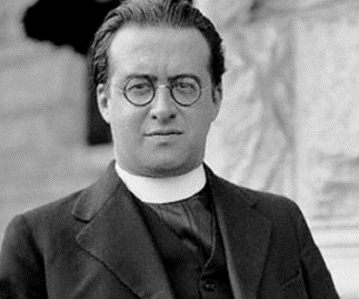
I also think the Universe should be stable
( in 1917)
Really the
biggest blunder in my life
(in 1931)
Albert Einstein
I discovered
earlier than Hubble
Georges Lemaître

Slide 9
I also think the Universe should be stable
( in 1917)
Really the
biggest blunder in my life
(in 1931)
Albert Einstein
I discovered
earlier than Hubble
Georges Lemaître
Shut up!
Edwin Hubble

Slide 10
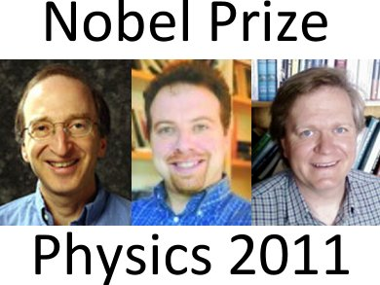
I also think the Universe should be stable
( in 1917)
Really the
biggest blunder in my life
(in 1931)
Albert Einstein
I discovered
earlier than Hubble
Shut up!
Georges Lemaître
accelerated expanding
accelerated expanding
accelerated expanding
Edwin Hubble

Slide 11
I also think the Universe should be stable
( in 1917)
Really the
biggest blunder in my life
(in 1931)
Albert Einstein
Now, questions:
What is the value of Hubble parameter?
How fast is the Universe expanding now?
I discovered
earlier than you
Georges Lemaître
Shut up!
Edwin Hubble

Slide 12
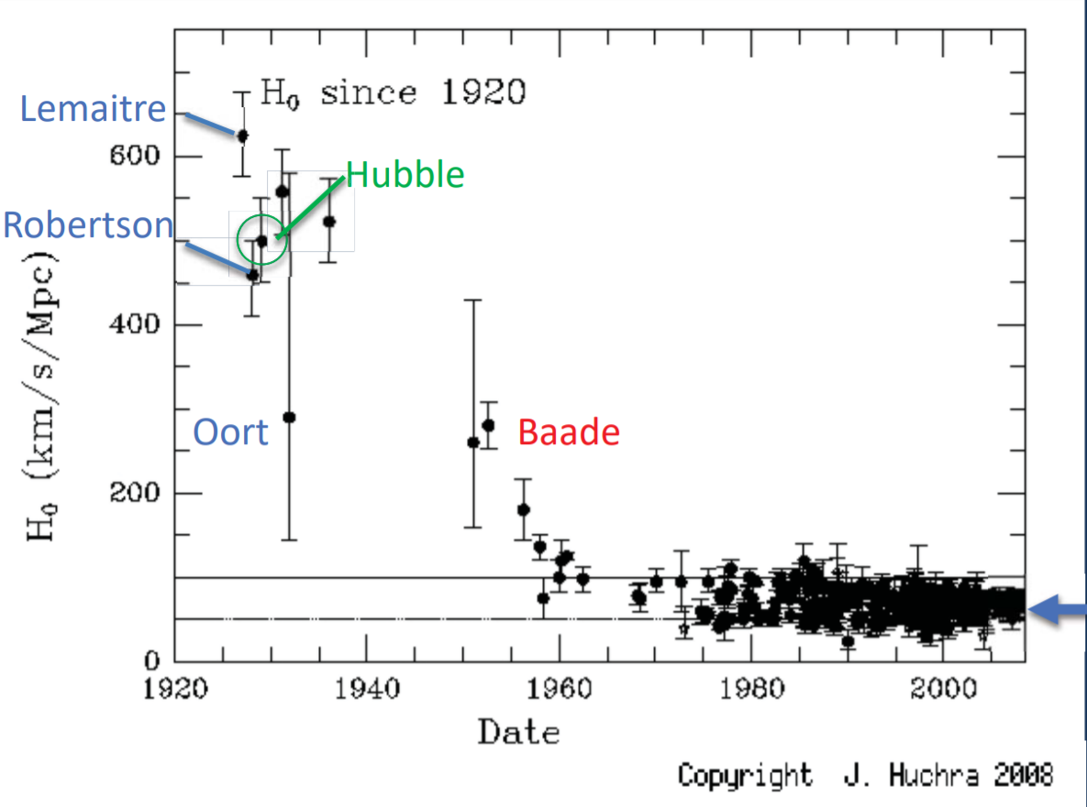
History of the Hubble constant
Notes:
detailed information of Robertson, baade Population II STARS accurate精确

Slide 13
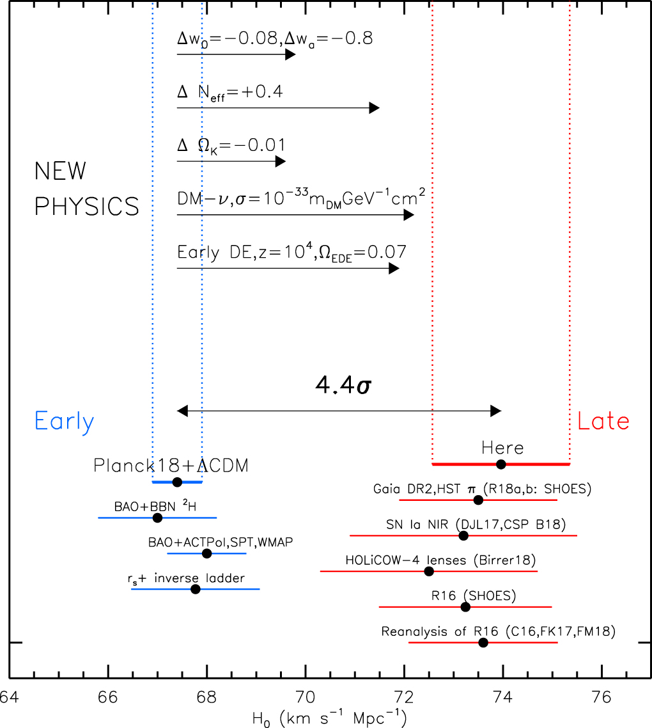
Potential new physics beyond ΛCDM
A different equation state of dark energy
Another relativistic species
(e.g.,additional neutrino or dark radiation)
Non-zero spatial curvature
A decaying relic massive dark matter
Early dark energy

Slide 14
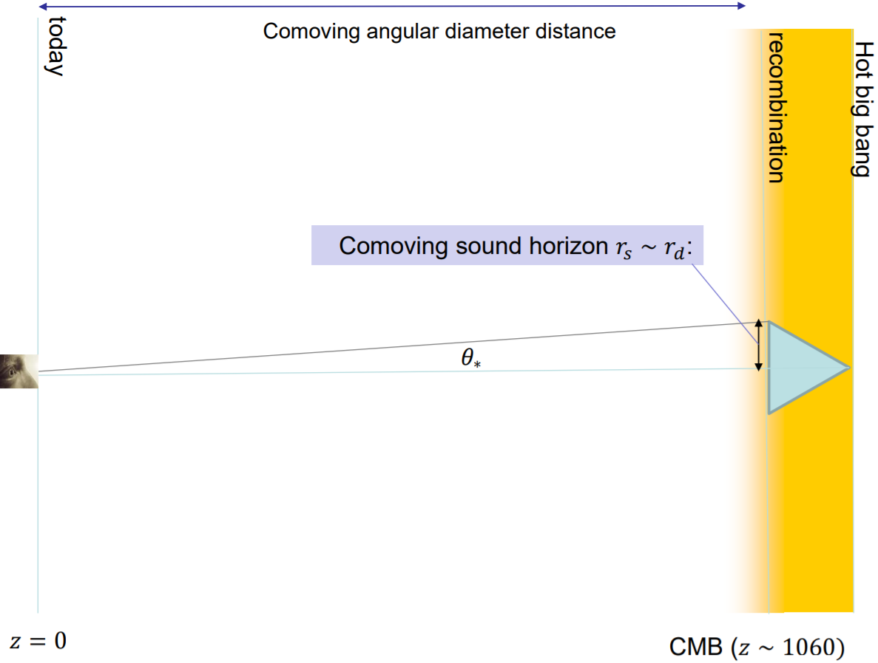
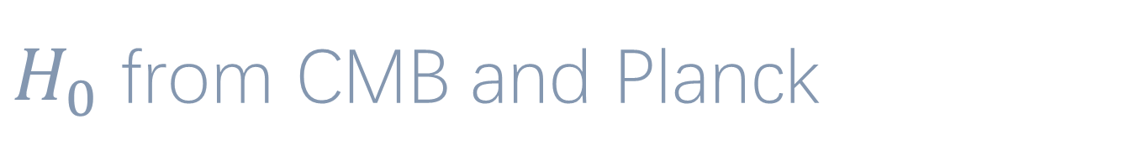
$H_{0}$ from CMB and Planck

Slide 15
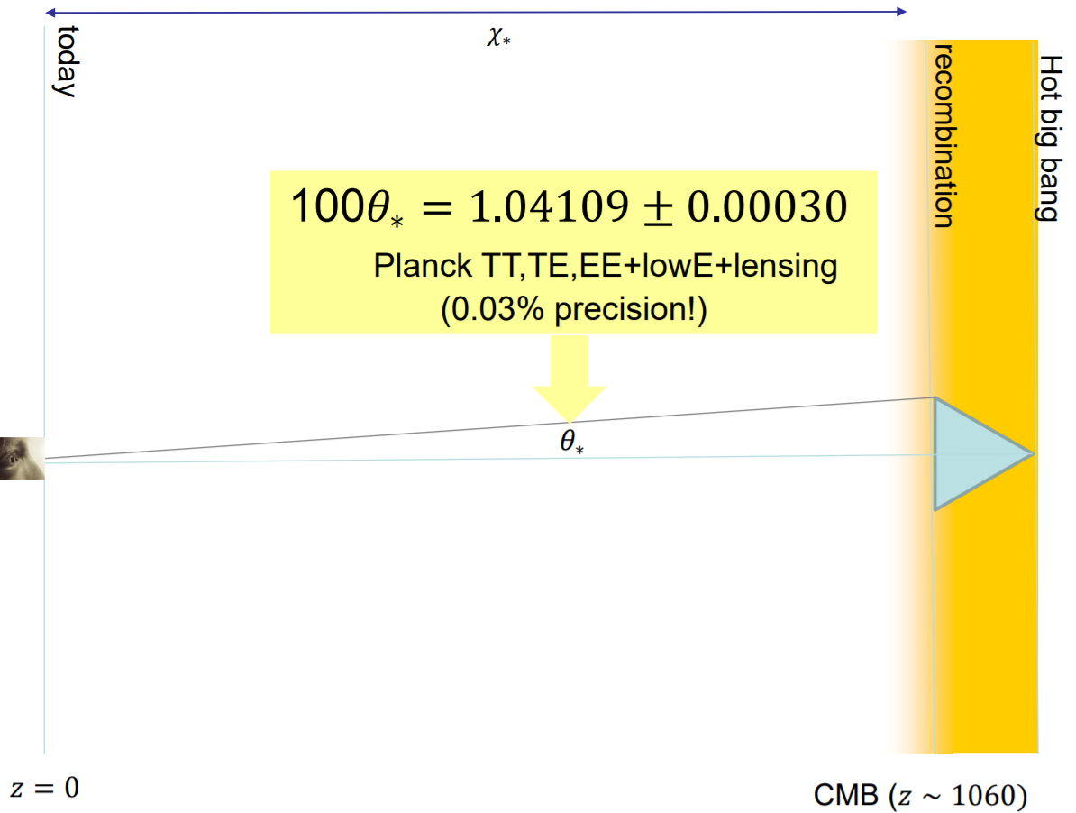

Slide 16
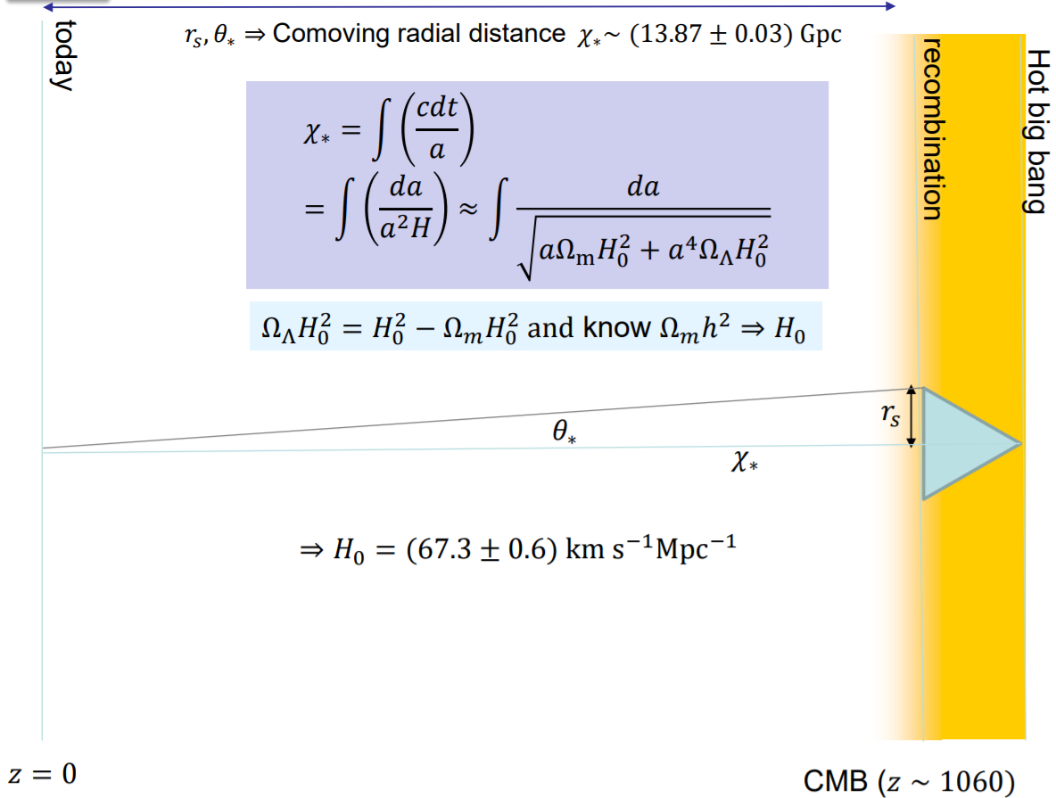
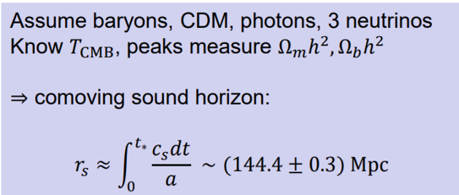

Slide 17
Potential new physics beyond ΛCDM
A different equation state of dark energy
Another relativistic species
(e.g.,additional neutrino or dark radiation)
Non-zero spatial curvature
A decaying relic massive dark matter
Early dark energy

Slide 18
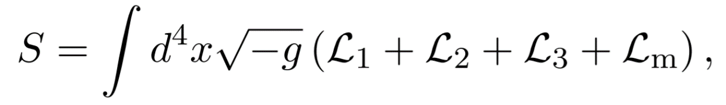
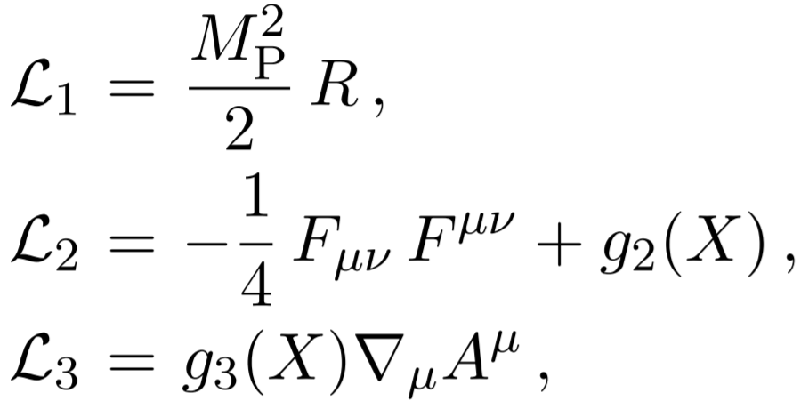
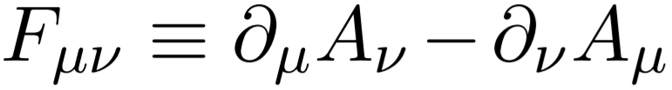
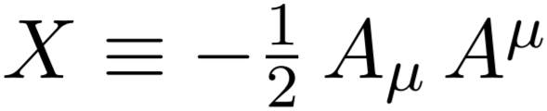


Release the H0 tension from the Generalized Proca model
[Based on: Antonio De Felice, Chao-Qiang Geng, Masroor C. P and Lu Yin, JCAP. 08 (2020) 038]
Q: Why is Generalized Proca theory?
A: It is a good way to make a U(1) breaking vector field
a Dark Energy candidate.
The GP action is given by,

Slide 19
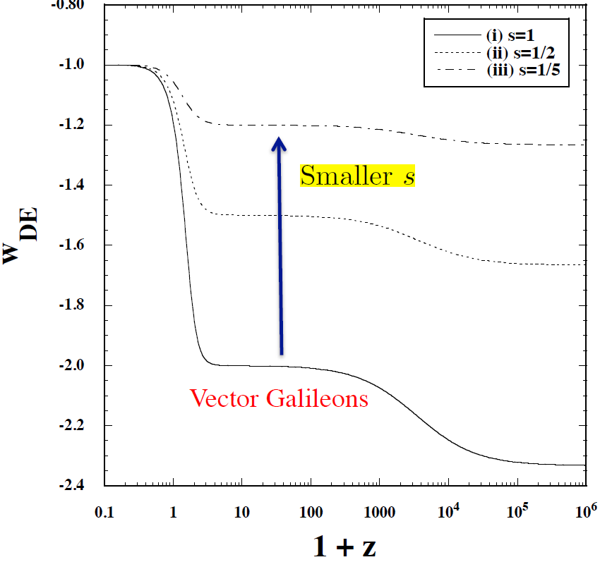


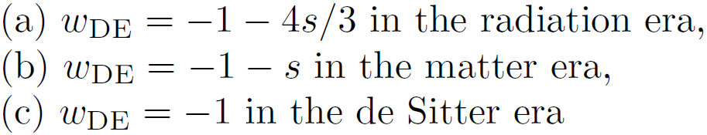
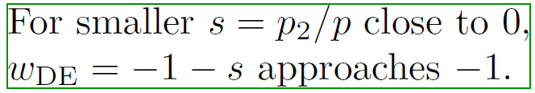
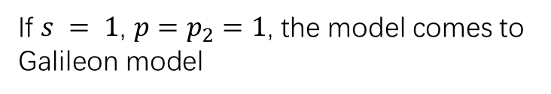
The dark energy equation of state
If $s = 1$, $p=p_{2}=1$, the model comes to Galileon model

Slide 20
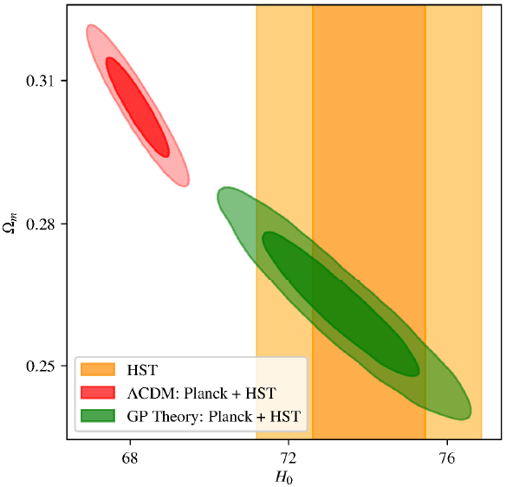
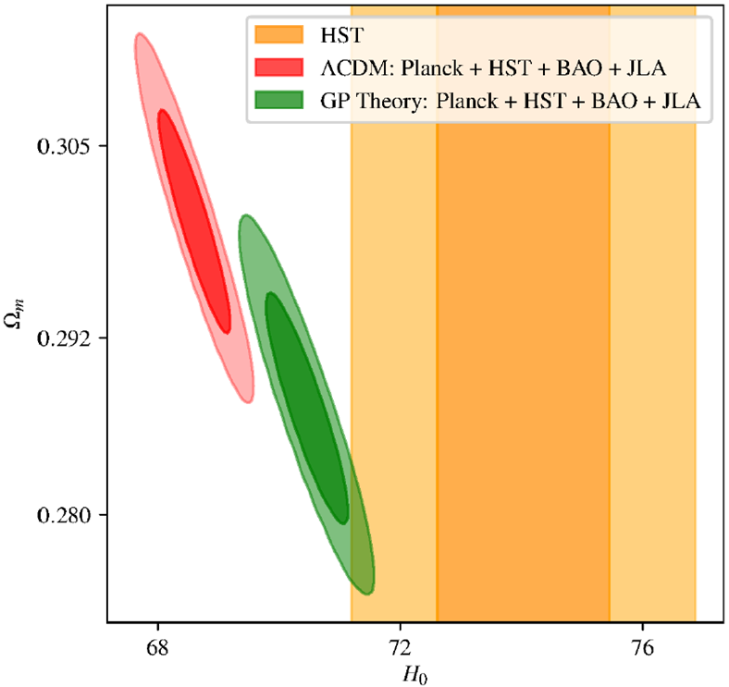

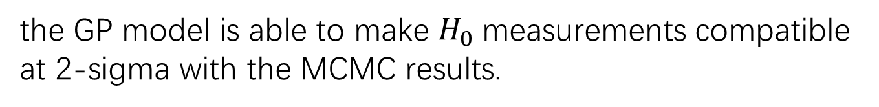
The result of $H_{0}$
the GP model is able to make $H_{0}$measurements compatible at 2-sigma with the MCMC results.

Slide 21
Potential new physics beyond ΛCDM
A different equation state of dark energy
Another relativistic species
(e.g.,additional neutrino or dark radiation)
Non-zero spatial curvature
A decaying relic massive dark matter
Early dark energy

Slide 22

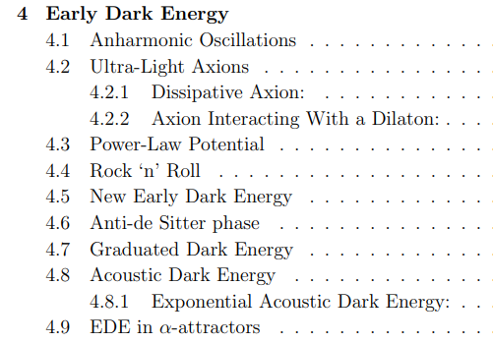

[ Class.Quant.Grav. 38 (2021) 15, 153001 ]

Slide 23

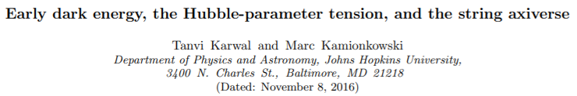
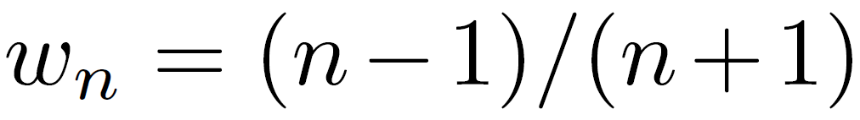
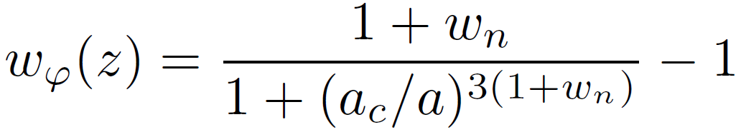
The difference between EDE, ADE, eADE model

Slide 24
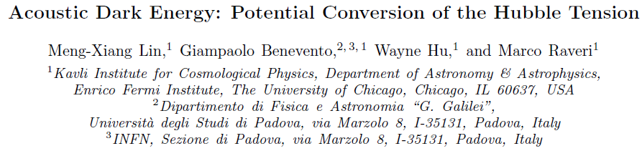
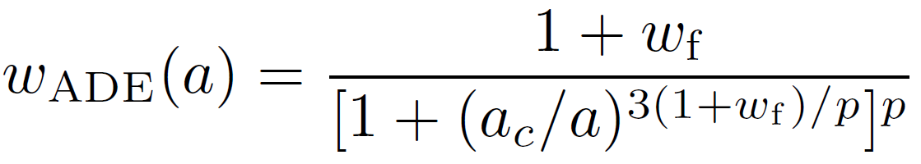

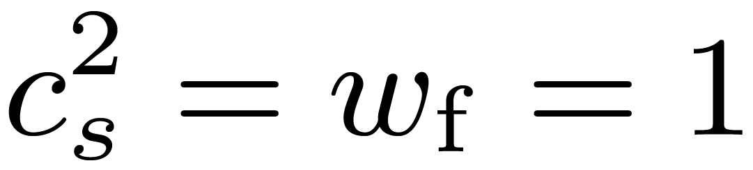
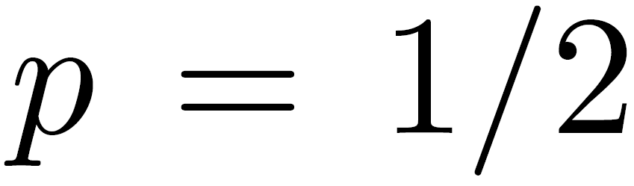

The difference between EDE, ADE, eADE model

Slide 25
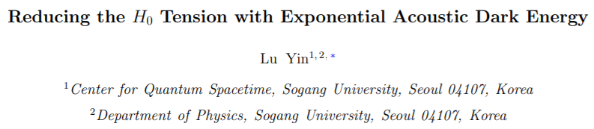
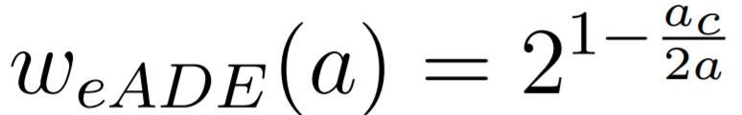
The difference between EDE, ADE, eADE model
The eADE have less additional parameters
Notes:
查一下三个模型哪里不同

Slide 26
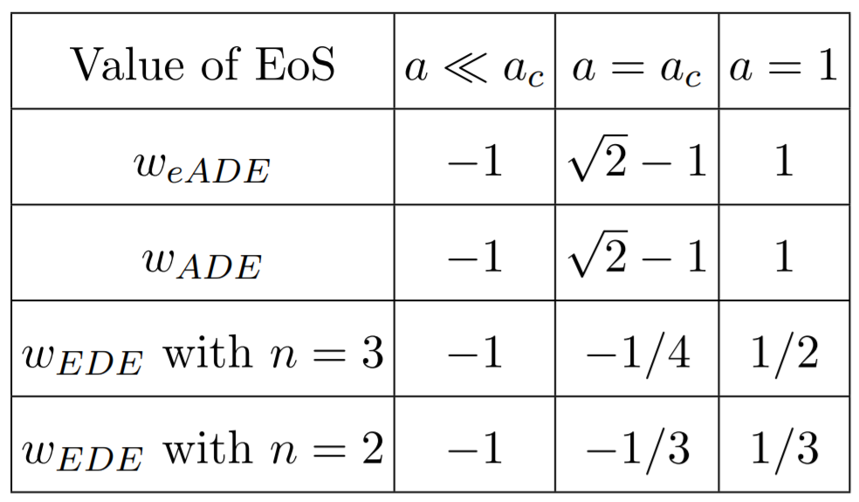
The difference between EDE, ADE, eADE model
The eADE have less additional parameters

Slide 27
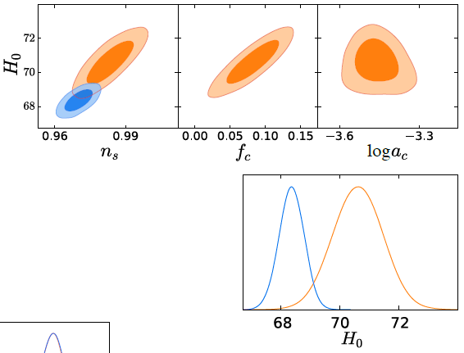
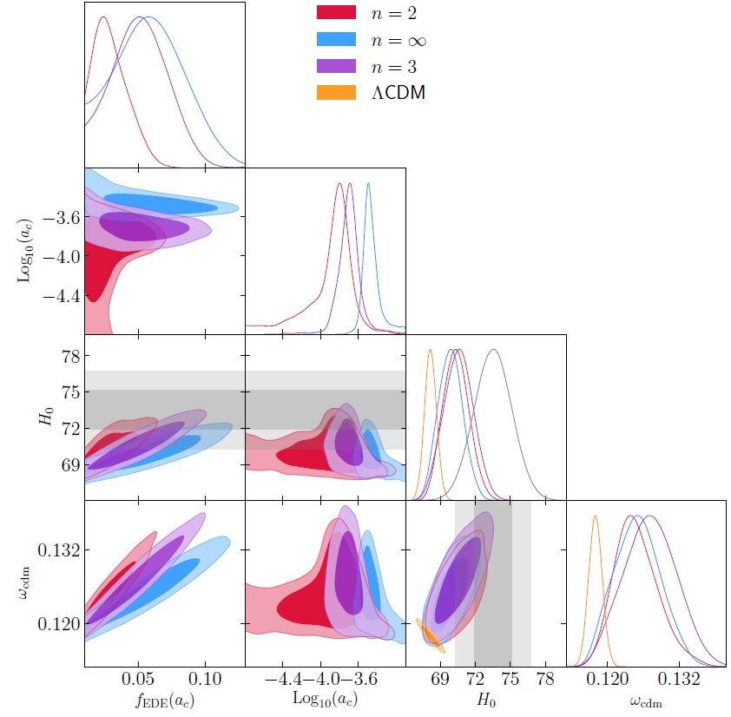


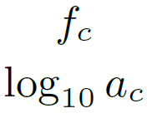










Fitting result for the EDE and ADE model
EDE fitting result ADE fitting result
Phys.Rev.Lett. 122 (2019) 22
Phys.Rev.D 100 (2019) 6
Table result
EDE (n=2) ADE

Slide 28
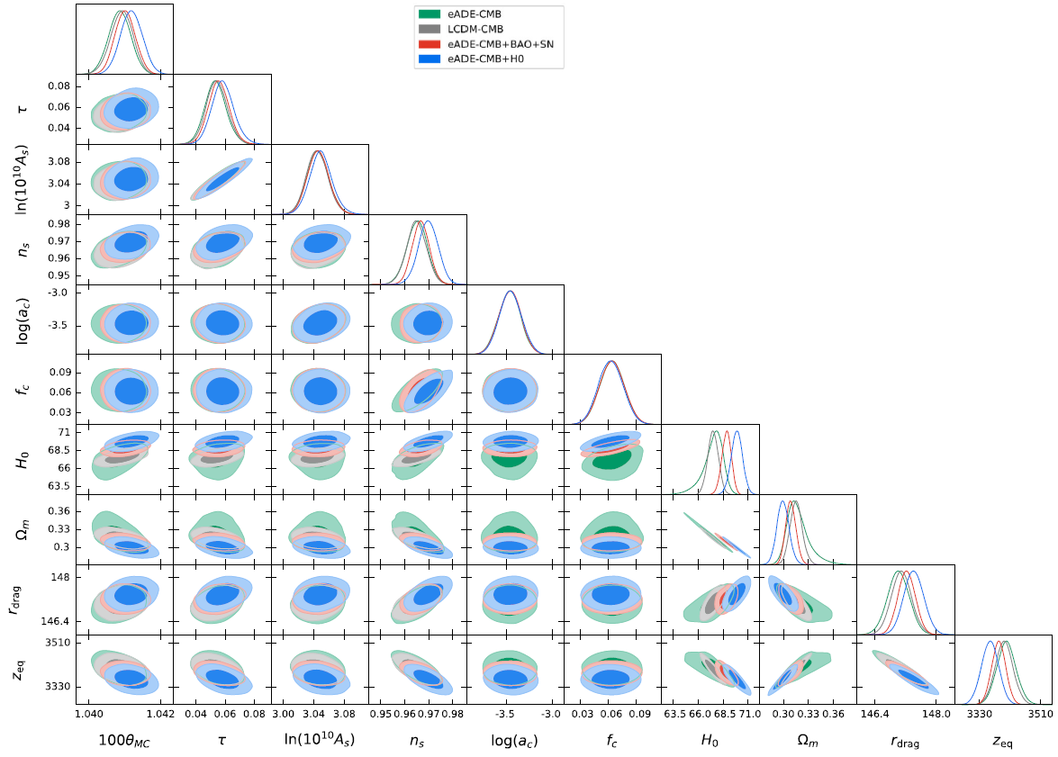



Fitting result for the eADE model
Table result
EDE (n=2) ADE eADE

Slide 29
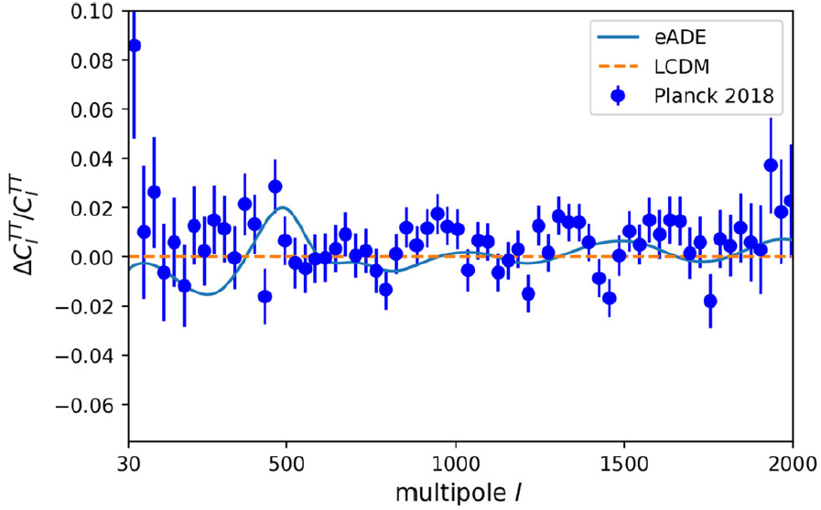
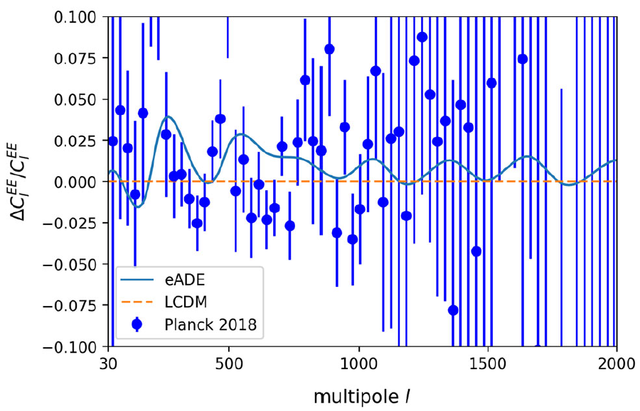
The difference in CMB power spectra
The eADE model closer to the CMB data than LCDM,
especially in the EE mode.

Slide 30
Potential new physics beyond ΛCDM
A different equation state of dark energy
Another relativistic species
(e.g.,additional neutrino or dark radiation)
A decaying relic massive dark matter
Early dark energy

Slide 31
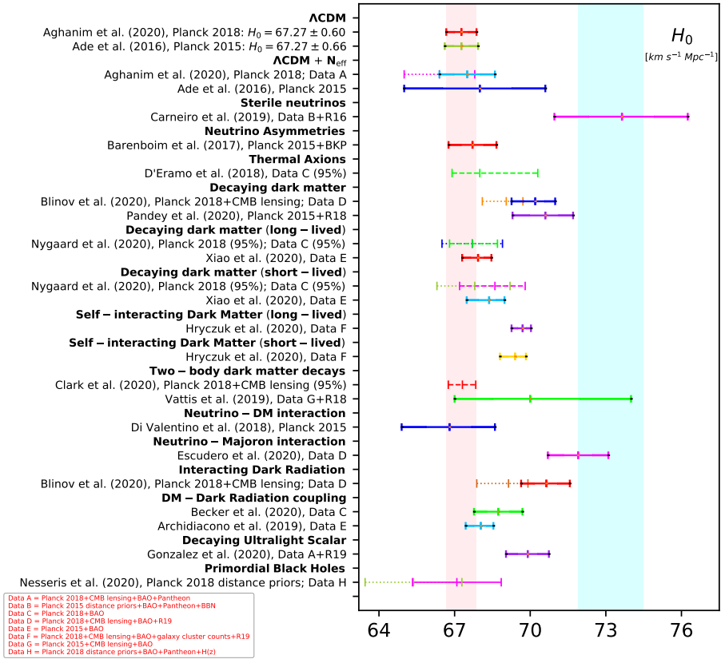
[ Class.Quant.Grav. 38 (2021) 15, 153001 ]

Slide 32
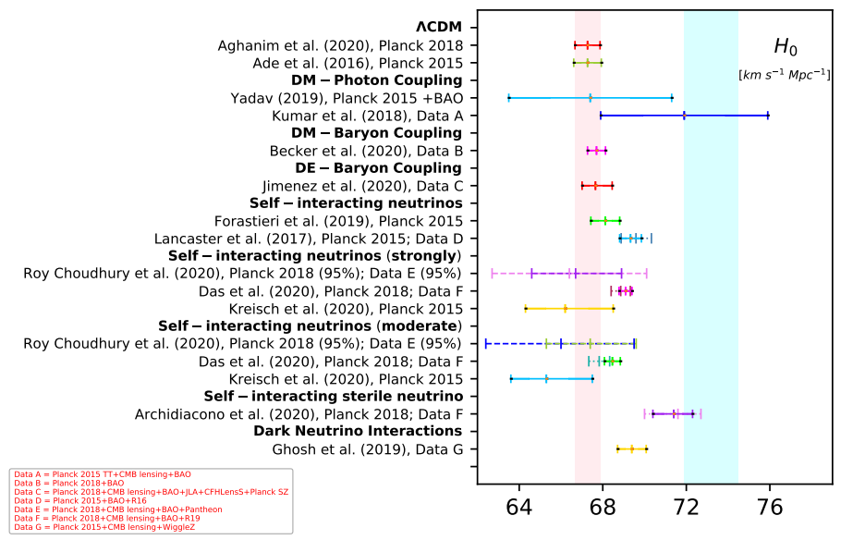

Slide 33


Slide 34
Conclusion
The H0 problem has always been one of the most important questions in cosmology.
Release the H0 tension in cosmology mainly focus on shortening the expansion history before recombination
The different value from High and low redshift suggest that Hubble tension may be a symptom of a deeper cosmological malaise.
Thanks for your attention!

Slide 36

Introduction of our work
In the standard model of particle physics and cosmology, the most studied fields (which are massive) are spin 0, ½, 1, and 2.
Q: What is Proca?
A: A massive spin-1 field.

Slide 37



What happens for a vector field with spin 1?
The mass m of the vector field $A^{μ}$ allows the propagation in the longitudinal direction due to the breaking of U(1) gauge invariance

Slide 38








Background evolution of Generalized Porca theory
The vector field $A^{μ}$with a time-dependent temporal component $φ\left(t\right)$ alone,
We can get the evolution of dark energy and the equation of state,

Slide 39

Observational constraints on GP
We use the CosmoMC, CLASS and Montyphthon program to perform the global fitting for the GP
Dataset:
CMB : Planck 2018
(Planck_ highl_TTTEEE, Planck_ low_EE, Planck_ low_TT and Planck_lensing polarization)
BAO : Baryon acoustic oscillation data
(6dF Galaxy Survey and Sloan Digital Sky Survey)
SN : Joint Light Curves (JLA)
H0 : Hubble constant H0=74.03$±$1.42
(Hubble Space Telescope observation)

Slide 40




The global fitting result
$x^{2}$ 2778.48 2796.18

Slide 41


The result
$x^{2}$ effective for individual experiments with the dataset of Planck + HST.

Slide 42



Slide 43


The result
$x^{2}$ effective for individual experiments with the dataset of Planck + HST + BAO +JLA.

Slide 44







Background evolution and linear perturbation for eADE
The eADE density evolves as
When the sound speed equal to 1:
The perturbation gives as:

Slide 45







Background evolution and linear perturbation for eADE
The eADE density evolves as
When the sound speed equal to 1:
?
The perturbation gives as:

