Slide 1
Fermionic dark matter model
with the dark Z boson
이강영 경상국립대학교
Workshop on Dark Universe@여수 2024.01.17

Slide 3
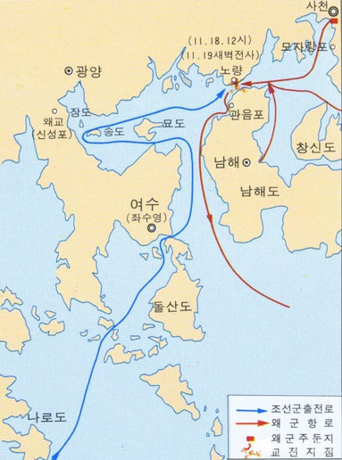

Slide 4
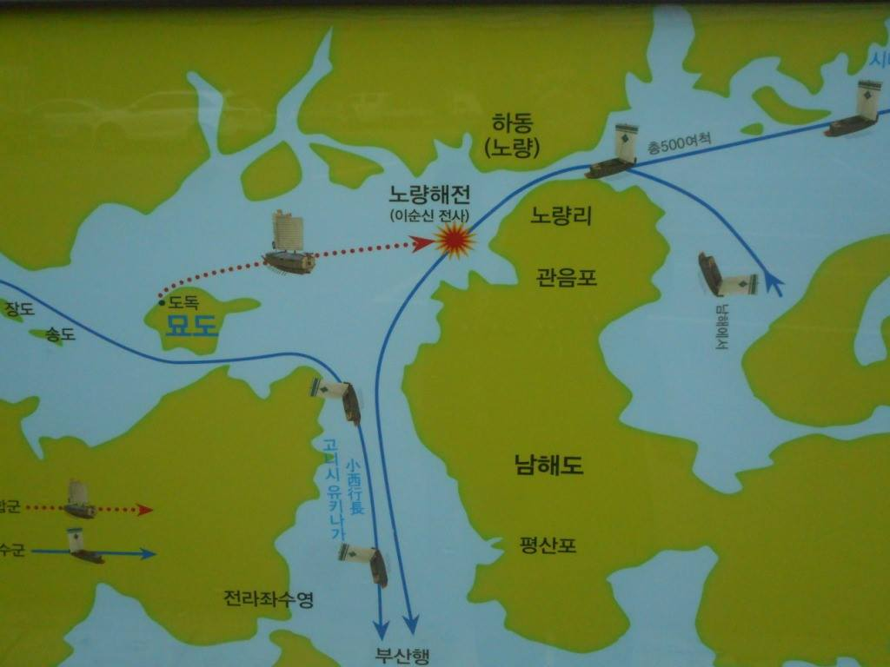

Slide 5
Outline
Fermion as a DM candidate
Fermionic DM model with the dark Z
Positronium decays
Dark Z lifetime
Summary

Slide 6
1. Fermion as a DM candidate
Minimal model
: How to connect to the SM?
Dimension-5 interaction
Higgs mediation after EWSB
satisfy the relic abundance & direct detection
Y.G. Kim, KYL, PRD 75, 115012 (2007)

Slide 7
Minimal RENORMALIZABLE model
Singlet scalar is the mediator.
After EWSB, Higgses mediation
satisfy the DM phenomenology & Higgs phenomenology
KYL, Y.G. Kim, S. Shin, JHEP 05, 100 (2008)

Slide 8
2. Fermionic DM and the Dark Z
D.-W. Jung, Y.G. Kim, KYL, S.-h. Nam, C. Yu,
Eur. Phys. J. C 80 (6) 513 (2020)
scalar doublet
QED-like
hidden sector
SM
SU(2)_{L}
U(1)_{X}
A new scalar doublet is the mediator.
Additional U(1)_{X} connect the hidden fermion to the mediator scalar doublet.
The hidden sector is QED-like.

Slide 9
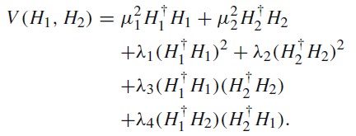
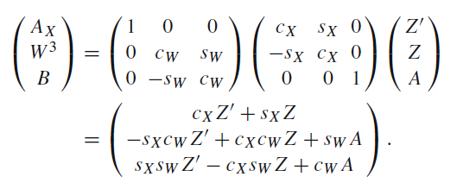
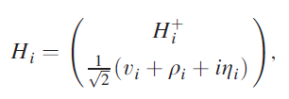
SM side : 2 HDM of type I + U(1)_{X}
P. Ko, Y. Omura, C. Yu, PLB 717, 202 (2012); JHEP 01, 016 (2014).
EWSB also breaks U(1)_{X} . → No new mass scale
After EWSB, Dark Z mediation
EW & Higgs & DM phenomenology

Slide 10
Features
Dark Z interaction = (Z interaction)*sin X
Dark Z is rather light.
Pseudoscalar is absent.
New Higgs bosons (neutral & charged) are rather light.
→ EW phenomenology & Higgs phenomenology affected

Slide 11
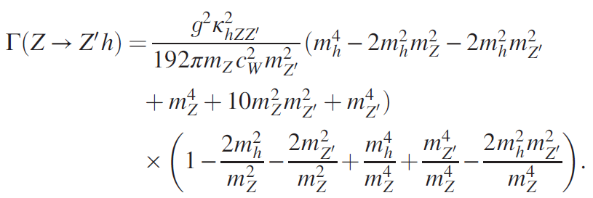
EW phenomenology
△ρ
APV
Z total width

Slide 12
Higgs phenomenology
Perturbative quartic couplings
Bounded from below
Perturbative unitarity of the WW scattering
HiggsBounds: 2006.06007, 1311.0055
HiggsSignals: 2012.09197, 1305.1933
D.-W. Jung, KYL, C. Yu, Phys. Rev. D 108, 095002 (2023)

Slide 13
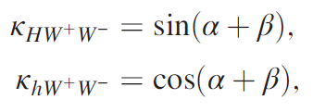
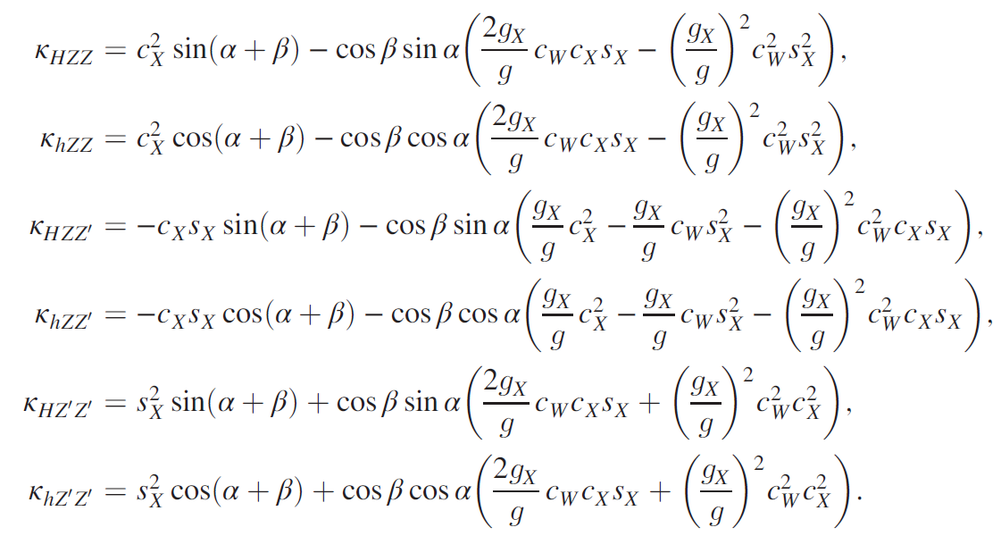

Slide 14
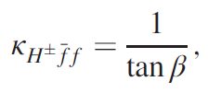
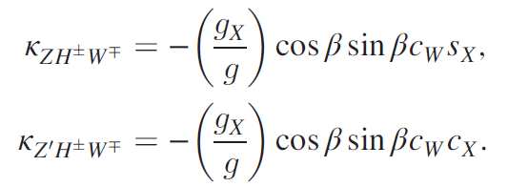

Slide 15
Parameter set
s_{X} is derived to be

Slide 16
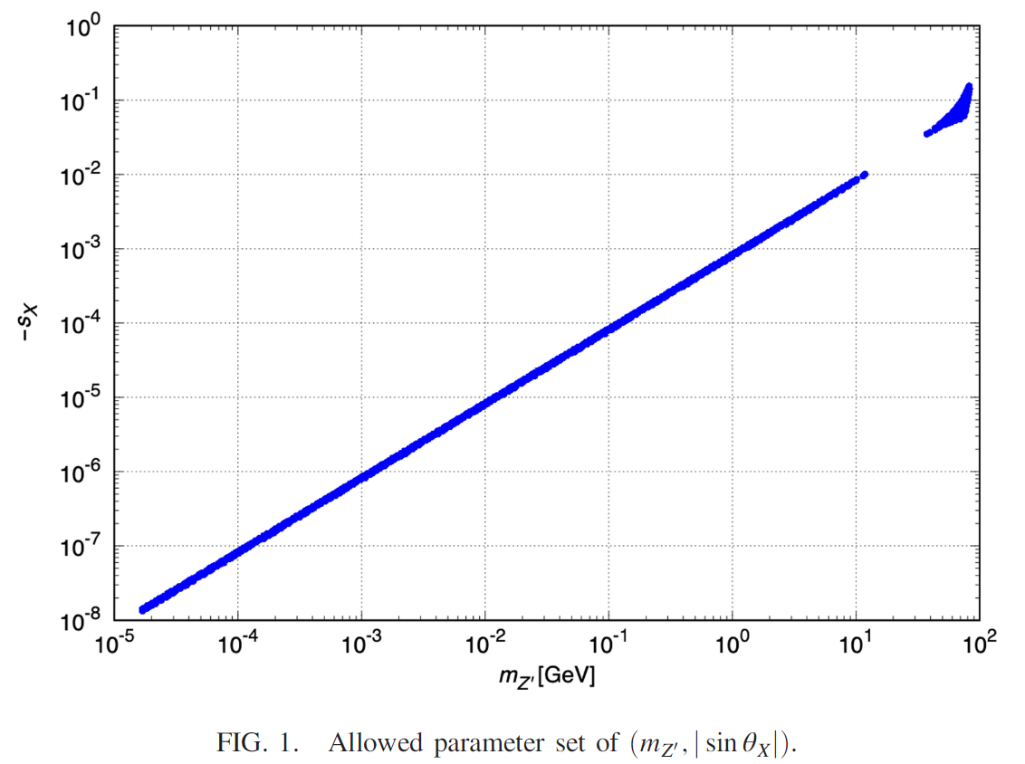

Slide 17
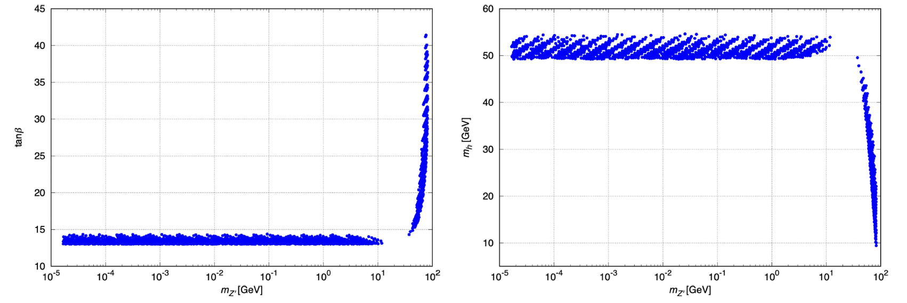
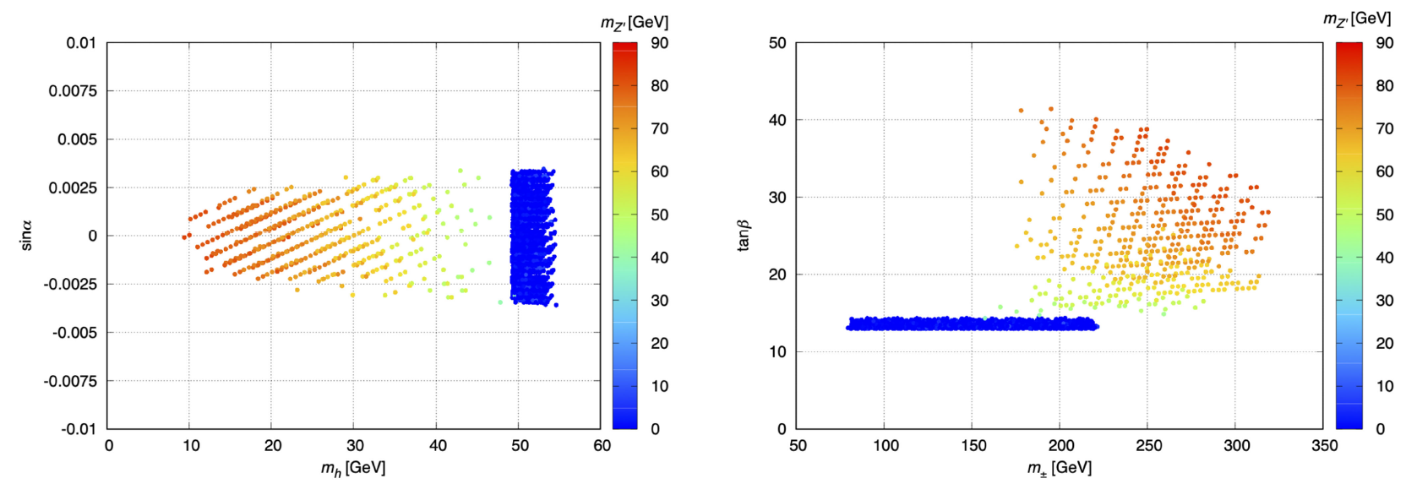

Slide 18
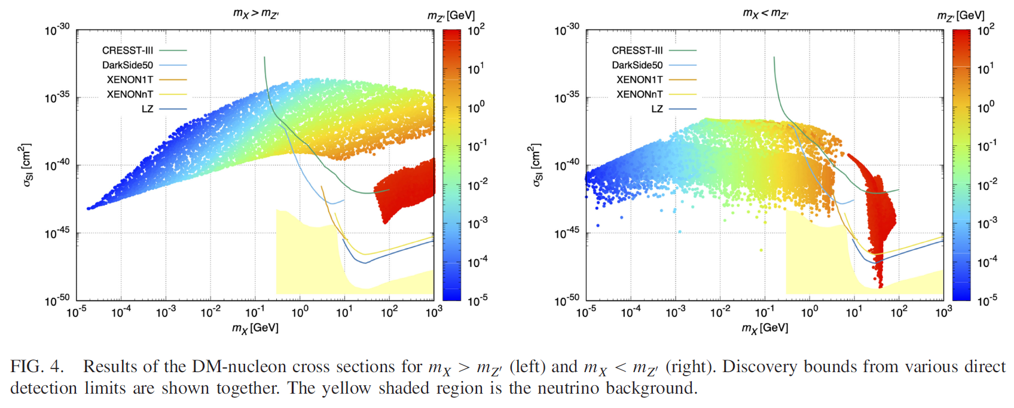

Slide 19
3. Positronium decays
Positronium = bound state of electron + positron
Hydrogen-like atom
Binding energy

Slide 20
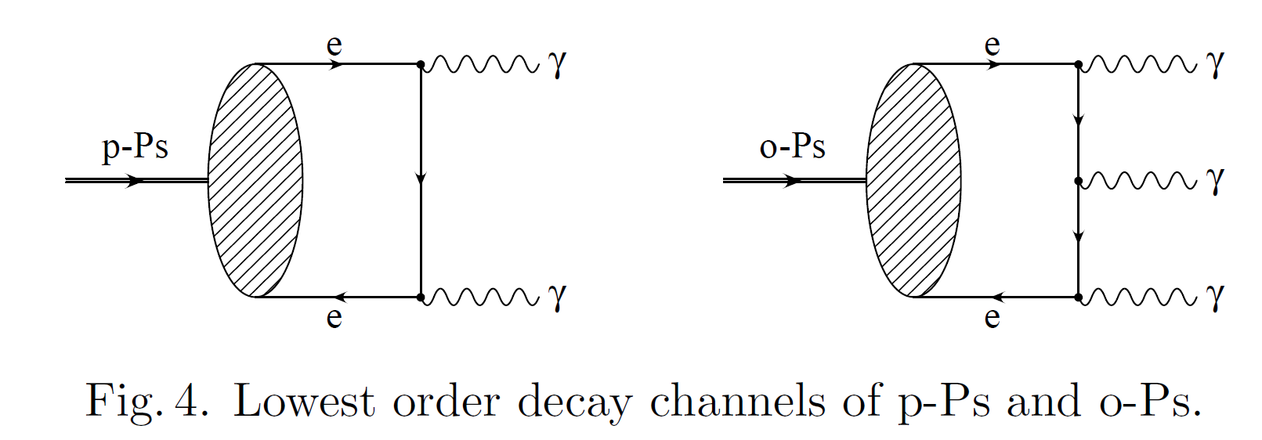
Para-positronium p-Ps : total spin=0, singlet 1¹S₀
decays into 2 γ
∼0.125ｘ10⁻³µs
Ortho-positronium o-Ps : total spin=1, triplet 1³S₁
decays into 3 γ
∼0.14µs

Slide 21
A. Czarnecki, Acta Phys. Pol. B 30, 3837 (1999).

Slide 22
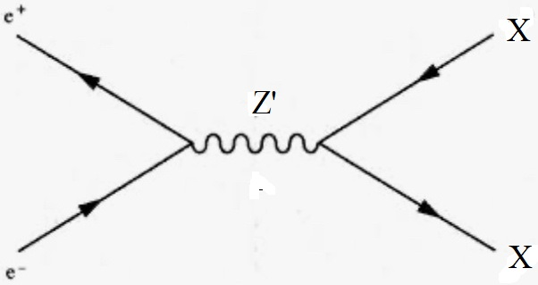
Possible New Physics Contributions
Invisible decays of o-Ps
DM mass < e mass
Single photon decays of p-Ps / o-Ps
Decay into DM is not necessarily.
Z’

Slide 23
Invisible decays / Single photon decays
D.-W. Jung, KYL, C. Yu, Phys. Rev. D 105, 095023 (2022)

Slide 24
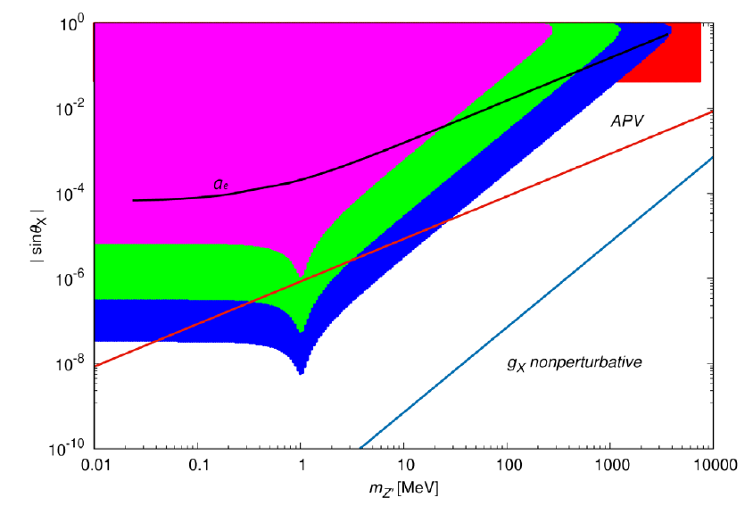
Green ~10⁻⁹, Blue ~10⁻¹¹

Slide 25
KAPAE-II Target branching ratio ~10⁻⁹

Slide 26
4. Dark Z Lifetime
Dominant decays of the dark Z

Slide 27
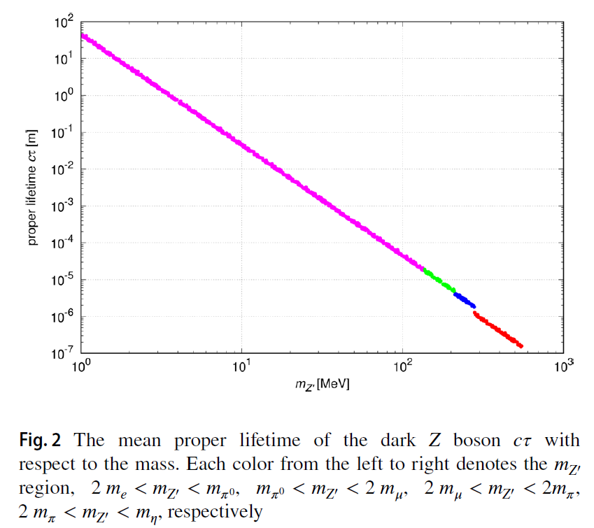

Slide 28
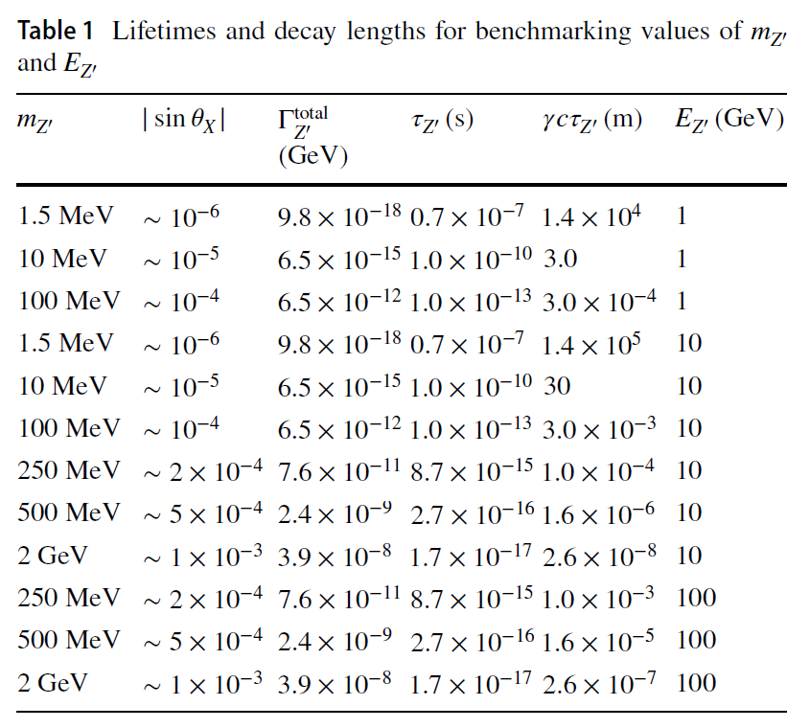
Final state is only e⁻e⁺ pair.

Slide 29
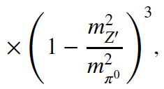
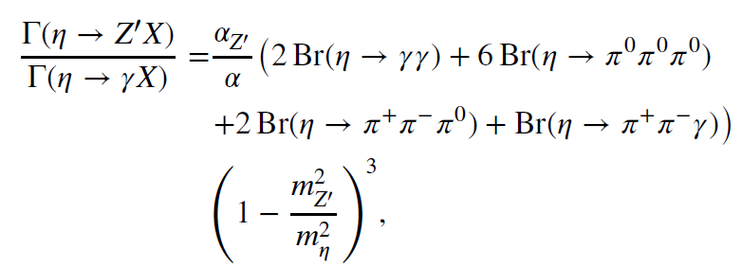
Dominant production of the dark Z : meson decays

Slide 30
LLP search at the LHC
A. Castaneda (CMS)

Slide 31
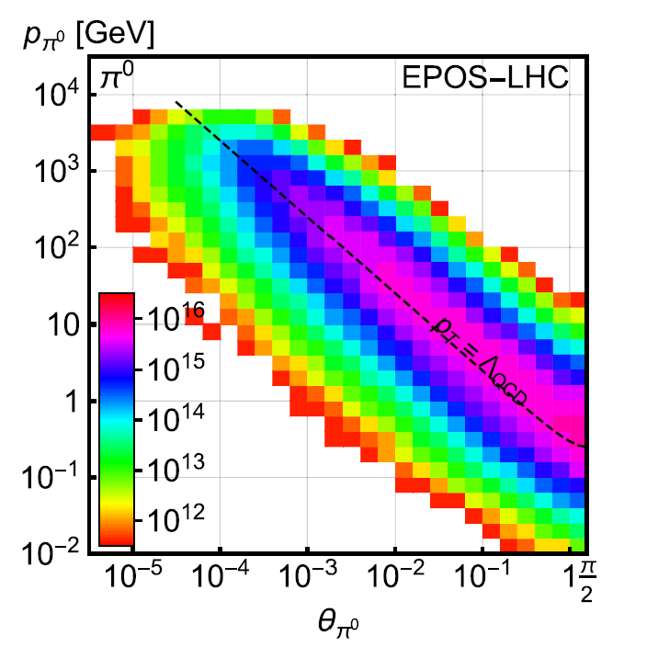
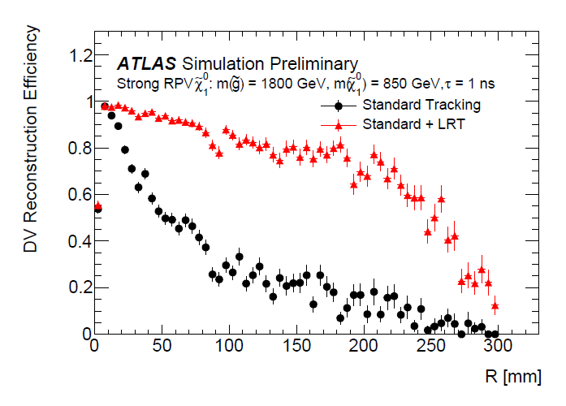
η<2.5
L_{Tot}=150 fb-1 for Run 3
1 mm < Decay length < 424 mm
Reconstruction efficiency of DV
J. Feng et al.,
PRD 97, 035001 (2018)
ATLAS-CONF-2022-054

Slide 32
SHiP – Search for (long-lived) Hidden Particles

Slide 33
SHiP collaboration, JHEP 04, 199 (2021)
N_{PoT}=6X10²⁰ for 15 yr run
37 m < Decay length < 87 m

Slide 34
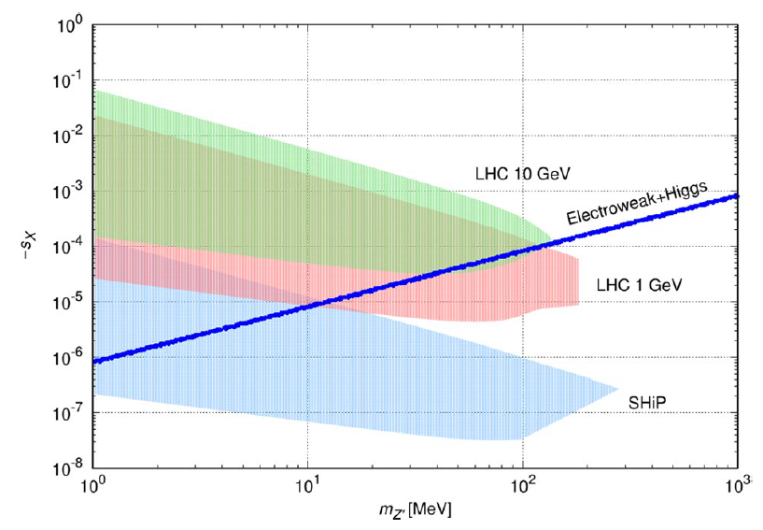
Demand N_{ev} > 25

Slide 35
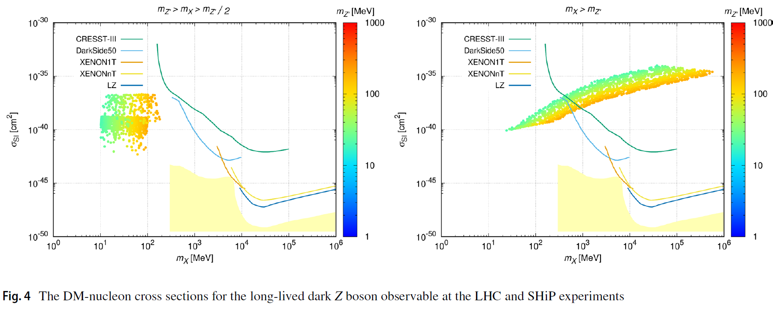
assumed

Slide 36
Summary
New scalar doublet mediator fields.
Fermionic DM, Dark Z mediation
Light dark Z favored.
Type I 2HDM-like Higgs sector
Application : positronium decays
Application : LLP searches
More phenomenologies… (cosmology, new experiments,…)

Slide 37
한국 입자물리학 발전을 위한 제언

Slide 38
P모 교수님 페이스북

Slide 39
그런데 연구할 사람도 부족하지 않나?

Slide 40
더 많은 학생을 교육하고 더 많은 입자물리학자를 배출해야 한다!
_{연세대와 중앙대에 박수를.}

Slide 41
감사합니다.

Slide 42
Backup slides

Slide 44
Experimental bounds
Br(o-Ps→invisible) < 1.7 X 10⁻⁵
C. Vigo et al., Phys. Rev. Lett. 124, 101803 (2020).
No bounds for Br(p-Ps→single photon)
Or I have not found it yet.

